Slide 1
Zonta Club of St. Louis
BEST PRACTICES
Using ‘hands on’ projects and outreach to engage membership
District 7 Conference
September, 2015

Slide 2
Following up with Prospective Members
A new prospective member is followed up within 2 days of receiving word that they are interested in joining. If we wait a week or two weeks they may lose interest.
A prospective member application is EMAILed to them. It is also available for download on our club website.

Slide 3
Following up with Prospective Members
Invite prospective members to come to a meeting!
Make them feel welcome and introduce them to others.
If they are made to feel welcome they will want to be involved.

Slide 4
Electronic Files
All of our membership files are now electronic.
Prospective Member Form
Registration
Club Manual – we produce a printed document every year but we will also provide members with an electronic version to make it easier for them to contact other members

Slide 5
Membership Best Practices
Members who feel that they are important and needed are members that will continue to be active and stay in the club.

Slide 6
Serve Enthusiastically!
Every new member is REQUIRED to serve on our membership committee for the first year.
This will keep them active in the club by communicating via email and planning our annual membership meeting in March

Slide 7
Awards Committee
Newer members plus experienced member work together to identify candidates and select winners
YWPA – Julie Hardy
Jane Klausman - Peggy Gilbertson
Irene Geer – Judy Jenson
Sonya Y. Jennings
STL and District 7
Jane Klausman winner

Slide 8
Advocacy Committee
New Committee filled with newer members plus established member
Identified older adult women as focus
First Advocacy Grant
$5000 to The Shepherd Center, a community non-profit volunteer organization helping older adults enjoy life and maintain independence.
Guest speakers from the Shepherd’s Center

Slide 9
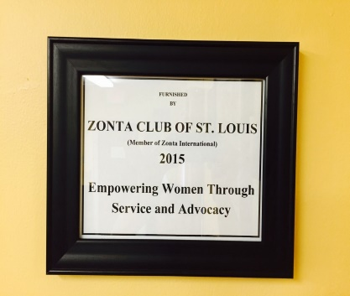
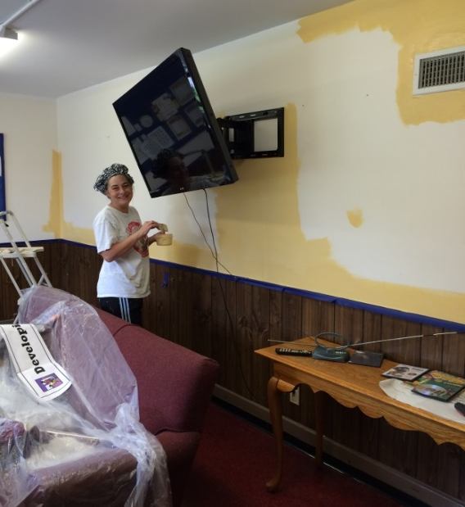
Jane M Weinmann Center Project
Hands on projects promote our club to new members
Renovation of Weinmann Center lounge
Organized by experienced members and new members with help from WashU students

Slide 10
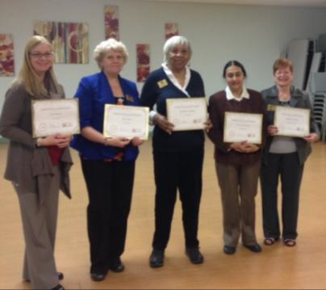
Getting to know you
Service awards
Member profile in Zest newsletter

Slide 11
Questions? Ask Zonta Club of STL members

