Slide 1
Zonta Club of Austin, MN
Peace Statue & 16 Days of Activism

Slide 2
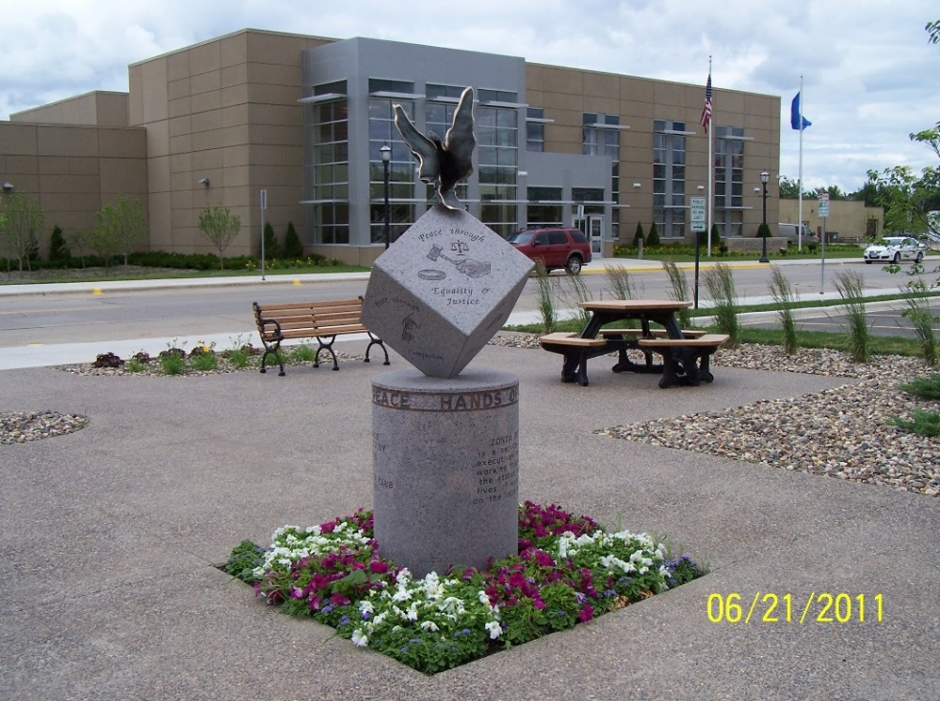
“Hands of Peace, Hands of Humanity” Statue
Created by Renee & Jeff Anderson
Placement of Peace Statue at new Justice Center
Club Vision: Expand community awareness -yellow flag project launched

Slide 3
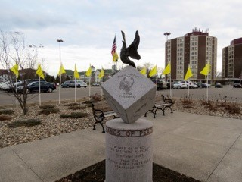
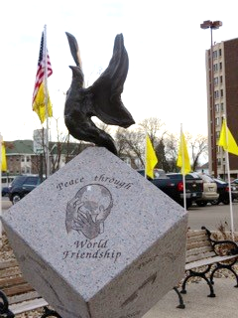
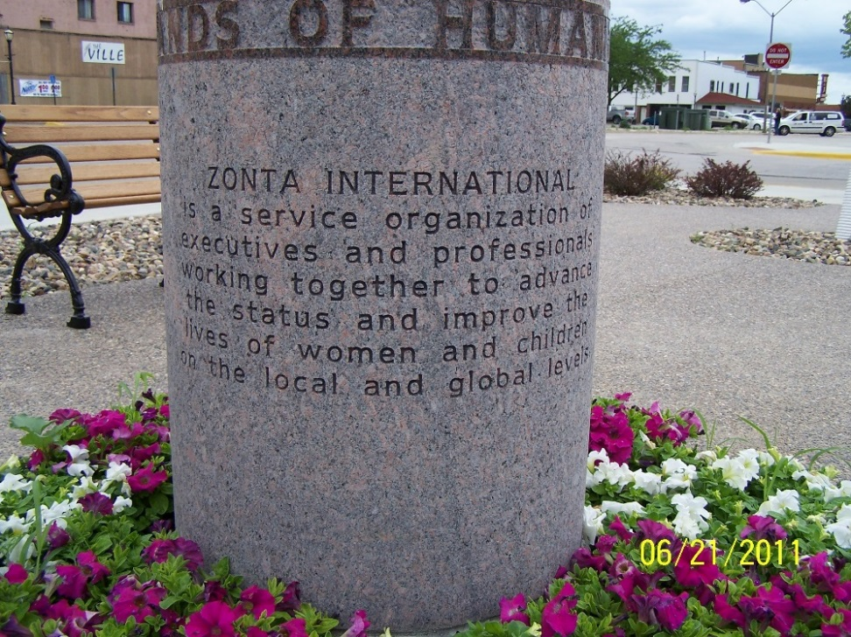
Peace Statue & Yellow Flag Project

Slide 4
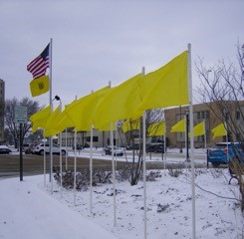
16 Days of Activism, 16 Yellow Flags
Requested permission from City & County
Purchased:
1 permanent flag & pole
16 additional flag poles
19 yellow flags from flags.com
2 embroidered with Zonta International logo
American flag, pole & roping (from American Legion) $98.59
Total cost $460.89

Slide 5
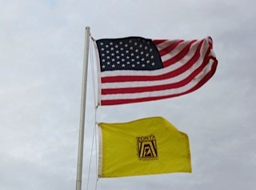
Additional Materials
Plastic piping
16 1.5” 10’ pipes
3 2” 10’ pipes
Cut into 18” segments
16 covers for the 2” flag pole holes
60 lb. bag of premixed cement for the permanent flag
Total cost $108.12

Slide 6
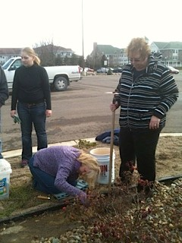
Labor, Construction & Placement
Directional boring for the 2” pipes (pole holders) into the ground
Pipes cemented for permanent flag
Assembly with zip strips to attach flags to poles

Slide 7
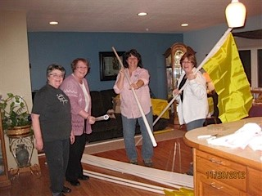
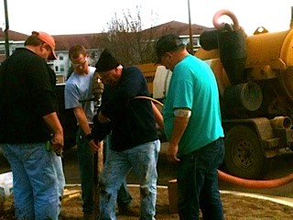
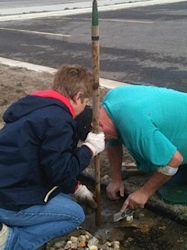
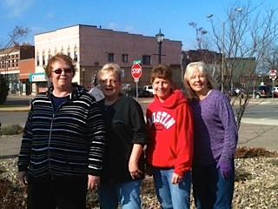
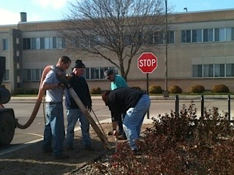
More Labor & Construction

Slide 8
Advertising & Promotion
Free ads from
Radio
Newspaper
Convention & Visitors Bureau
Chamber of Commerce

Slide 9
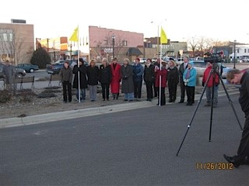
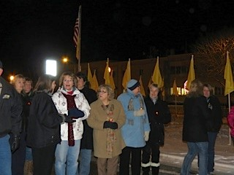
Event
Opening Ceremony - November 25th
Invited City and County staff
Held small ceremony & flag raising by the American Legion
Speeches
Closing Ceremony - December 10th
Attendees:
State Representative Jeanne Poppe
County Attorney Kristen Nelson
Victims Crisis Center Tori Miller
Friends, family, & members of the community
Zonta Club members
Prayer & Candlelight Ceremony

