Slide 1
Sheffield Place
Zonta Club KCMO II
Local Service Project for the past 13 years

Slide 2
Sheffield Place (SP)
Mission Statement
To empower homeless mothers and their children to heal from their trauma and help them become self-sufficient

Slide 3
Sheffield Place- brief history
“safe today, strong tomorrow”
opened its doors in Feb 1991 as a transitional residence for homeless mothers and their children as a community response to their growing population
since then SP has assisted more than 800 families from homelessness to self sufficiency
maximum length of stay - 2 years; on site tx and ongoing case mx as necessary

Slide 4
Mother’s Programs
parenting
mental health strategies
financial literacy
employment,computer, time mx skills
12 step, addiction recovery
adult and child health
empowerment

Slide 5
Children’s Programs
social skills
healthy living
safe living
“mommy and me” programs
aftercare program

Slide 6
SP-re: “trauma informed care”
2007-1st homeless shelter in the nation to provide the best evidence-based tx modalities for children
2009 - recognized as a national best practice for work with traumatized ,homeless children
2011- named a “best practice in homeless services” by the US Dept of Housing and Urban Development in Region VII
2012 -certified by the MO Dept of Mental Health

Slide 7
Zonta KCMO II role : service project
(since 2002 to the present)
started 2002 - initially to support fundraisers, volunteered to paint their fence , lunch
Mothers’ Day Out + shows, shopping,library
Children’s Dental Day Screening + lunch
Thanksgiving Dinner with the families &staff
Holiday Gifts for moms’ basic necessities
Support of annual major fundraiser
Yellow Roses on Woman’s Day (March 8)

Slide 8
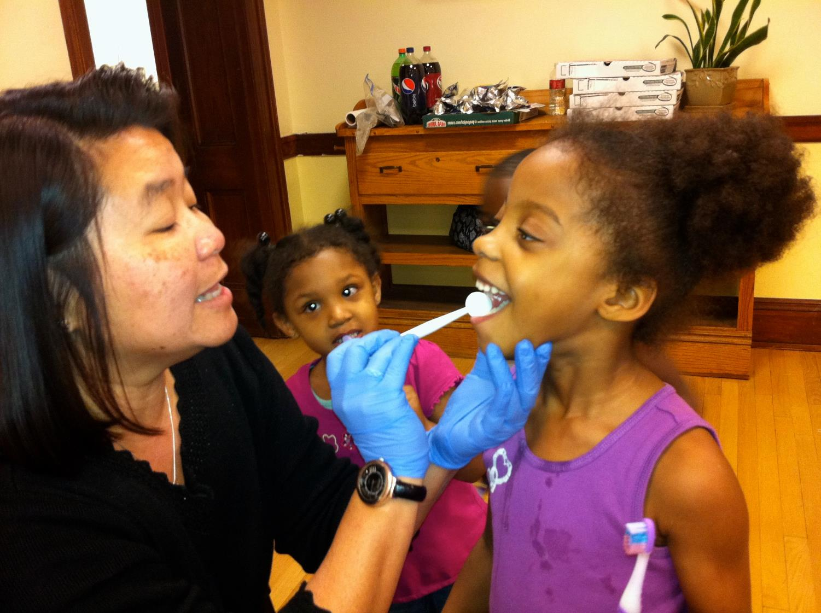

Slide 9
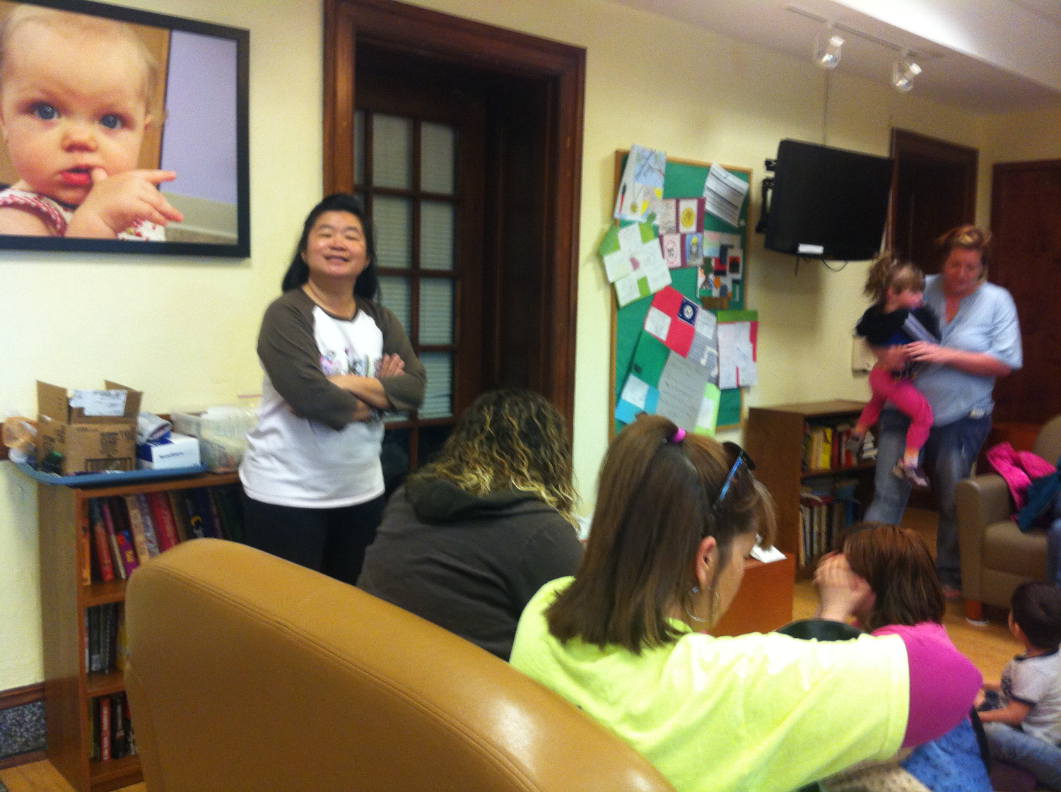

Slide 10
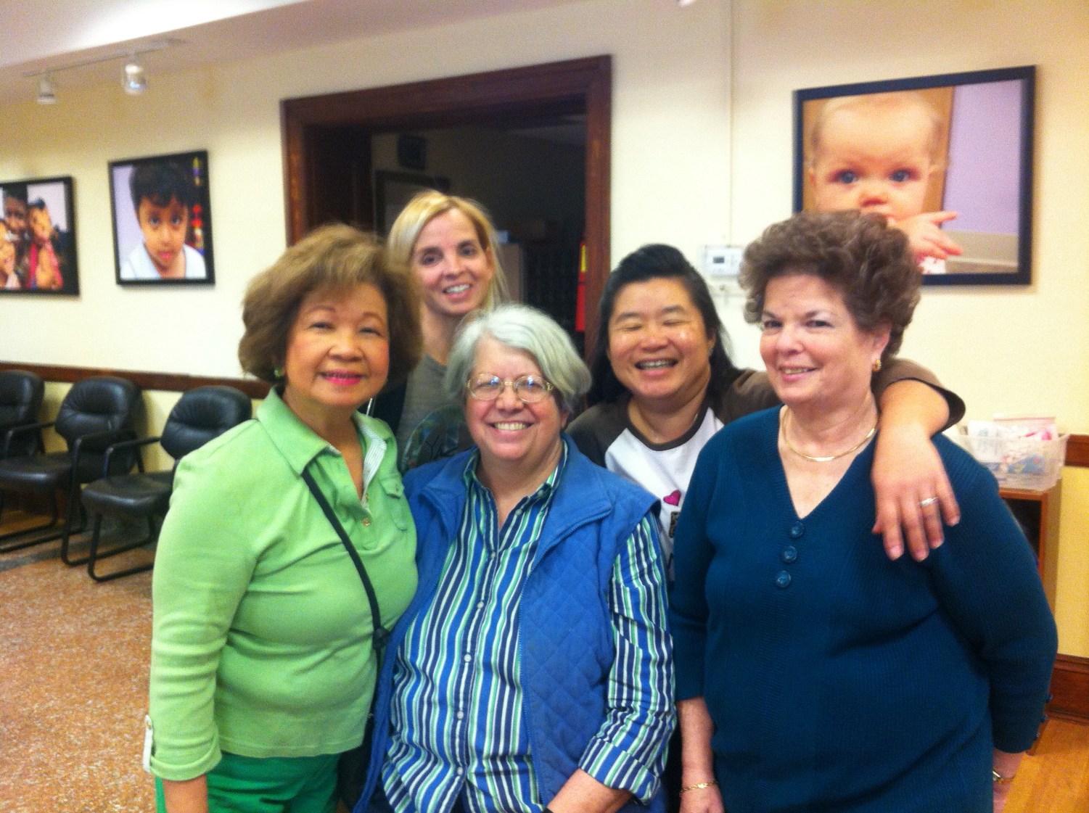

Slide 11
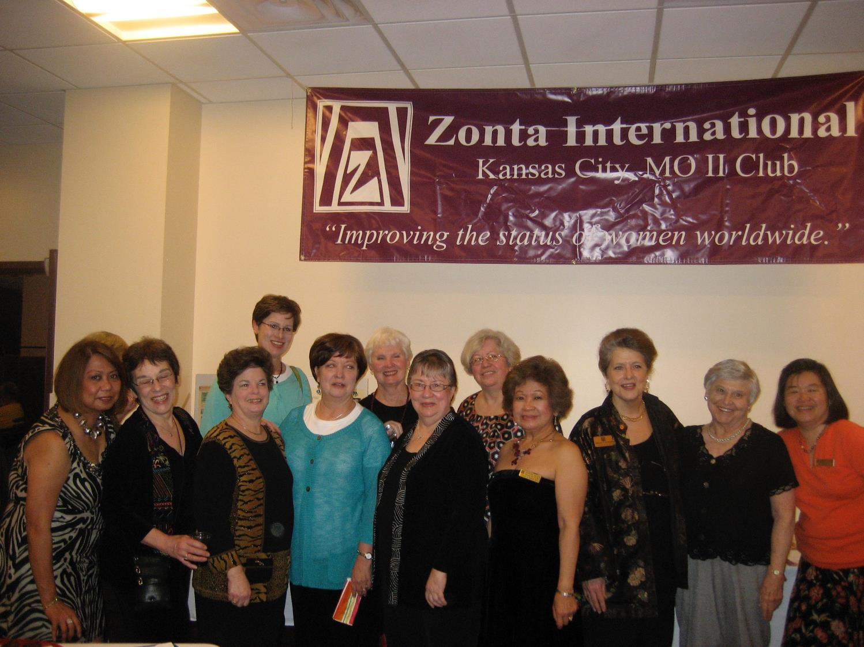

Slide 12
SP Needs List : in kind gifts
Home Items
twin sheets,blankets, pillows
comforters, towels, washcloths
crib sheets

Slide 13
SP Needs List : in kind gifts
Hygiene, Food , paper Goods
paper towels, toilet paper, facial tissues
diapers ( sizes 4 - 6), pull ups, wipes
detergents, dish soap, cleaning supplies
feminine hygiene products
gift cards for gasoline or Walmart

Slide 14
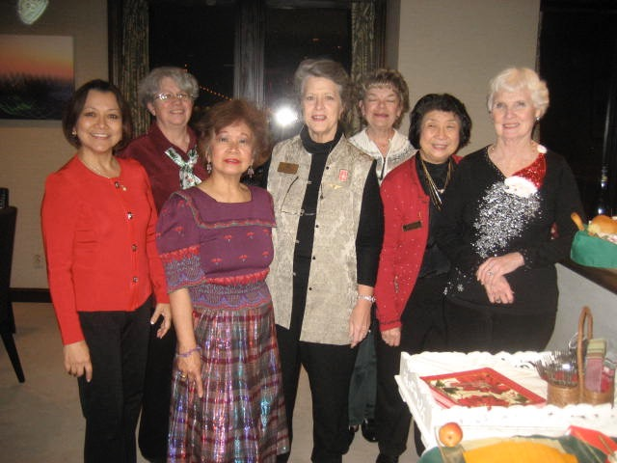

Slide 15
