Slide 1
Zonta International District 7
2020 Virtual Area Meeting
Advocacy Update
Jane Austin
D7 Rep to USA Caucus
April 4 and 25, 2020

Slide 2
Zonta International District 7
USA Caucus
https://zontausa.org/
Top Issues 2018 – 2020 and into the next biennium:
Ending Child Marriage Laws (State)
Equal Rights Amendment (National)
End Violence Against Women
VAWA (Violence Against Women Act) renewal
Title IX protections
Combat Human Trafficking (State)
Cities for CEDAW

Slide 3
Zonta International District 7
2020 Virtual Area Meeting
Campaign to End Child Marriage
Broader Context
Zonta Centennial Celebration Nov. 2019
Gives Zonta a stronger voice in National, State, and NGO politics to End Child Marriage
Aligns Unicef USA, Unchained at Last, and Zonta USA on ending child marriage at the state level
Greater Zonta USA Member Engagement: New Tools
Makes Zonta more Visible in USA as a leader in Women’s Rights

Slide 4
Zonta International District 7
Status of D7 Child Marriage Laws -- 2019
KS: Minimum age is 15; minors 16–17 years of age can marry with consent of both parents or legal guardians; judicial approval required for those 15 years old.
MN: Minimum age is 16; all minors are required to obtain judicial approval to marry.
Bill to eliminate all exemptions to child marriage up for Senate vote in March/April
MO: Minimum age is 16; all minors are required to obtain written consent of a parent or guardian. No minor may marry an individual 21 years or older.
ND: Minimum age is 16. If a person is between age 16 and 18 years, the state requires consent of a parent or legal guardian and official proof of age. No provision for judicial approval of any marriage involving minors.
SD: Minimum age is 16. If a person is between age 16 and 18 years, a notarized statement of consent to marry from one parent or one legal guardian is required. Judicial approval is mandated based when a minor lacks parental consent for the marriage.

Slide 5
Zonta International District 7
End Child Marriage PSA
Campaign Goals
Unite Zonta clubs and districts in the US to support Zonta International’s mission to end child marriage in the United States, at both the National and State level
Educate: Increase awareness of the prevalence of child marriage in the US and lack of laws protecting children, particularly girls.
Act: Encourage residents in Zonta districts, club areas, and state capitols to
Learn more about child marriage in their state
Take action via an easy-to-use platform
Partner: work with key allies to amplify the message and lend credibility and impetus to act

Slide 6
Zonta International District 7
PSA Billboard Campaign
Billboards as Public Service Announcement (PSA) 12-month rolling campaign
USA WIDE – consistent message across all states
Primary targets: key locations in State capitals and Zonta home towns
Priority states of national campaign in D7: Missouri and Minnesota
Alternate placements of digital signage (airport and convention centers, shopping malls)
Materials and toolkit designed to work with Lamar, Newman, or any billboard company
Custom artwork prepared with ZI and UNICEF (available online)
Single, simple URL landing page on billboard to direct people to more info
Placements and production coordinated and funded locally by Clubs with training and support from USA Caucus as part of Zonta SaysNO.

Slide 7
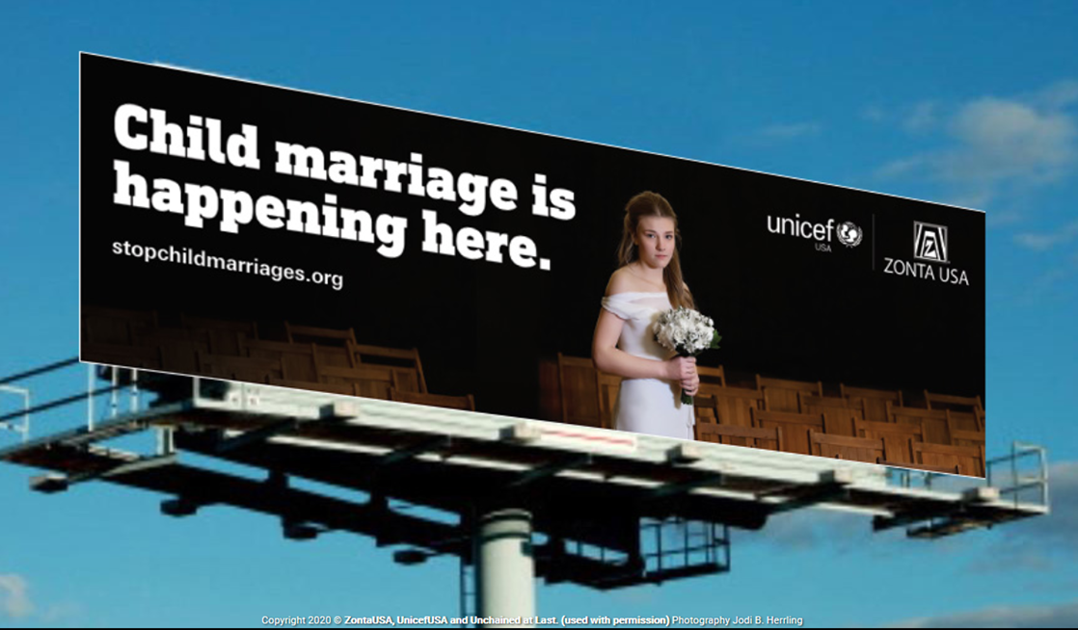
Zonta International District 7
Stopchildmarriages.org

Slide 8
Zonta International District 7
2020 Virtual Area Meeting
https://zontausa.org/stopchildmarriages-psa-toolkit/
Billboard and Digital Sign Artwork: Print-ready for large scale printing.
Very large vector files of the Billboard images in multiple sizes for both print (vinyl or other materials for print billboard) and digital signs to download
How to work with a Billboard company script and guide.
Become conversant in Outdoor advertising. Billboard terminology, digital sign information. How-to’s and answers to all your questions.
Resources for public relations and social media campaign with small-scale artwork and signs, for documents, power points, emails, letters. Images for Facebook, Twitter and Instagram
#StopChildMarriages #EndChildMarriage #USAChildMarriage #ChildMarriageHappensHere
@UnicefUSA @ZontaUSA @UnchainedatLast @GirlsNotBrides

Slide 9
Zonta International District 7
Support from Zonta USA Billboard Team:
Online --- PDF files for PSA checklist, fundraising letters, social media tools, imagery, etc.
Keeping the website updated for resources and news
Helping to raise funds to target billboards in state capitols in priority states (where district or local club is not able to do so)
Donations via Zonta Club of Porterville Foundation (PSA is tax deductible): Designate USA billboard campaign.
$2000 donor match for designated priority states
Available for support and answers to your questions:
Zonta@clelandmarketing.com 541 231 4445

Slide 10
Zonta International District 7
The steps to make this happen:
Identify a billboard project leader in your club or state. Read the Billboard FAQ’s. Review Scripts.
Call local billboard companies and ask for PSA space as available -- target your State Capitol and Zonta community.
(Newman-Jamestown ND or Lamar; USA Caucus will provide a list of area-specific Lamar contacts)
Raise money to print non-digital billboards ($800-$3000 each depending on size and material, as specified by billboard company -- Digital / Vinyl / Print Paper). Ask for non-profit discount (if your club is 501c3) and lower-cost materials, based on duration for scheduled placement.
Work with local billboard printers to have art print ready. ZI will have standard sizes ready and can customize sizing as needed.
Follow up with billboard companies to get space in target locations. Be ready to print and place when space is available (more than 30 days in desired location)
Repeat over time and places as possible.

Slide 11
Zonta International District 7
Match billboards with
social media campaign
Be informed – keep your club members aware of the issues around child marriage and identify ways to contribute to the campaign
Post on Facebook, Twitter, etc. using resources from the toolkit
Engage and collaborate with organizations in your community to expand discussion of the issues.
Write letters to the local newspaper.
Talk with and write your state representatives.
Talk with your friends and neighbors!

Slide 12
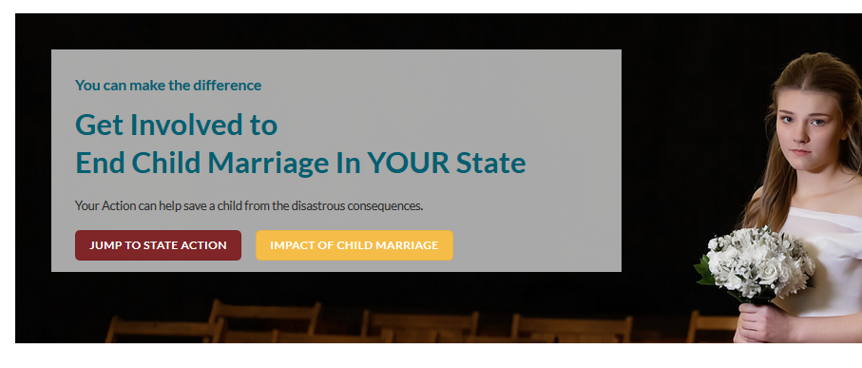
Zonta International District 7
https://zontausa.org/end-child-marriage-in-the-usa/end-child-marriage-action/

Slide 13
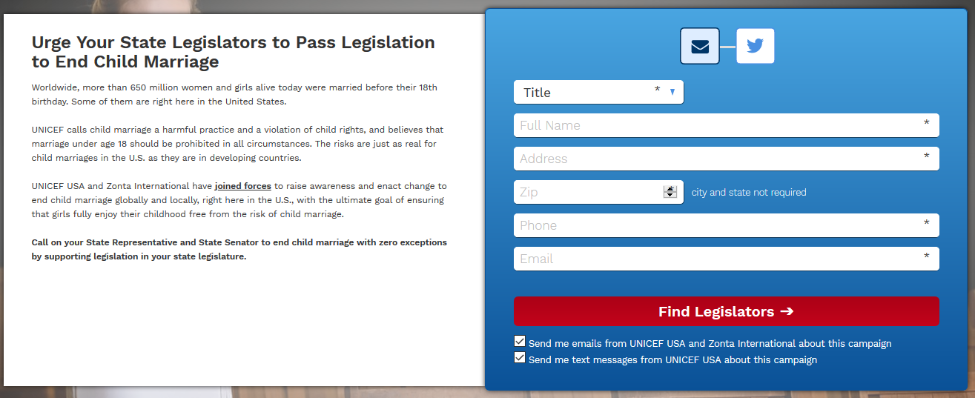
Zonta International District 7
https://act.unicefusa.org/childmarriage
Questions? Comments?

Slide 14
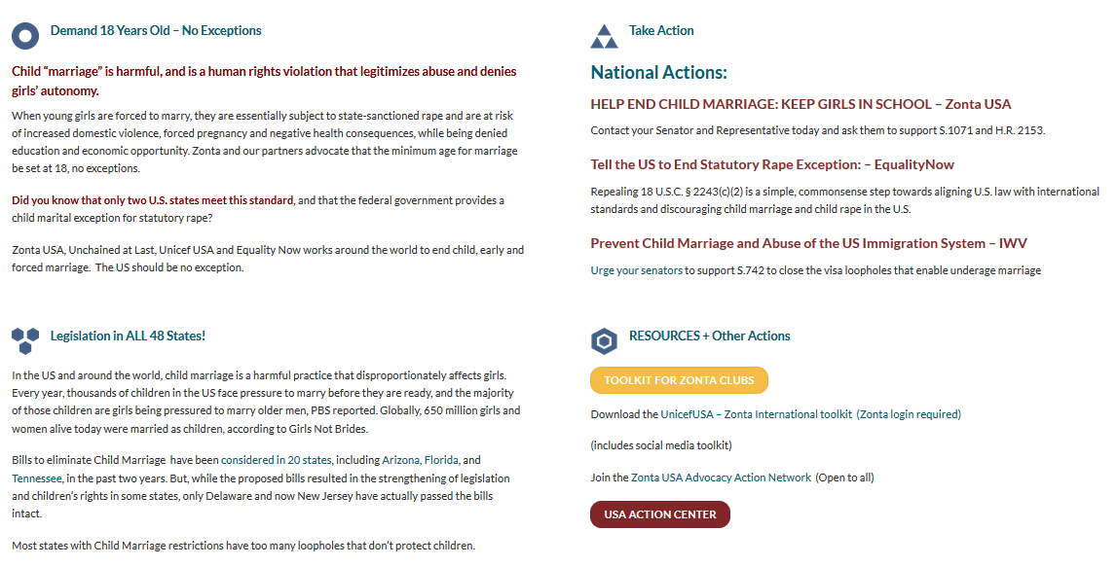
Zonta International District 7
https://zontausa.org/end-child-marriage-in-the-usa/end-child-marriage-action/

Slide 15
Zonta International District 7

Slide 16
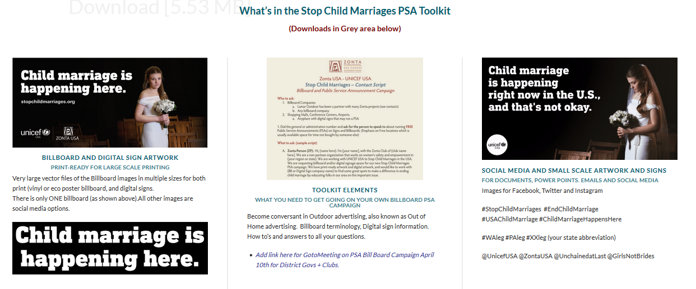
Zonta International District 7

Slide 17
Zonta International District 7
2020 Virtual Area Meeting
https://zontausa.org/stopchildmarriages-psa-toolkit/
Questions? Comments?

