Slide 1
Climate Action through Zonta Finding your Passion and Avenue for Action Service, Advocacy, Education
Framework for Action
Table discussions
Sharing/Recap

Slide 2
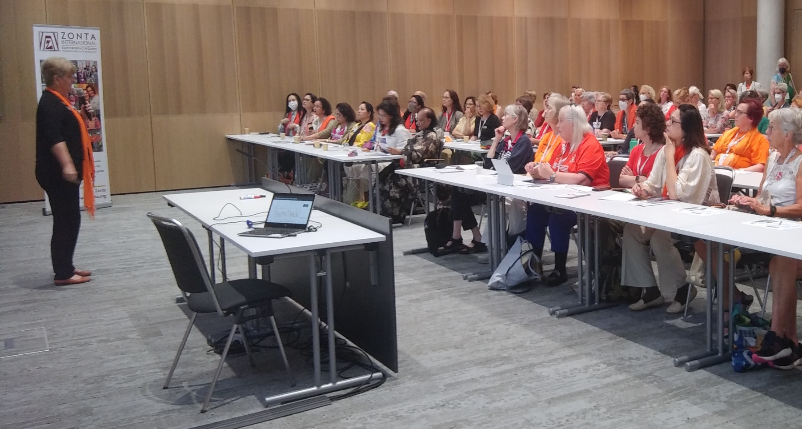
Find Your Passion and Avenue for Action
SERVICE
EDUCATION & SCHOLARSHIPS
ADVOCACY

Slide 3
Framework for Action: Five Pillars for Gender-Equal Climate Action
Use the framework to accelerate our mission in all areas of Zonta
 | Gather the facts | Lead by example | Add your voice | Advocate | Collaborate with like-minded organizations
Educating girls
Advocating for women’s rights Gender equality End violence against women Climate action
Inspiring more female leaders
Notes:
We can use the Zonta Says NOW framework for action to help us.
We will put you into breakout groups and use this table to think about what actions you can take.
When completing the advocacy line, indicate how you could work with club, area, district and international advocacy committees. We need to make sure we are not working in silos!

Slide 4
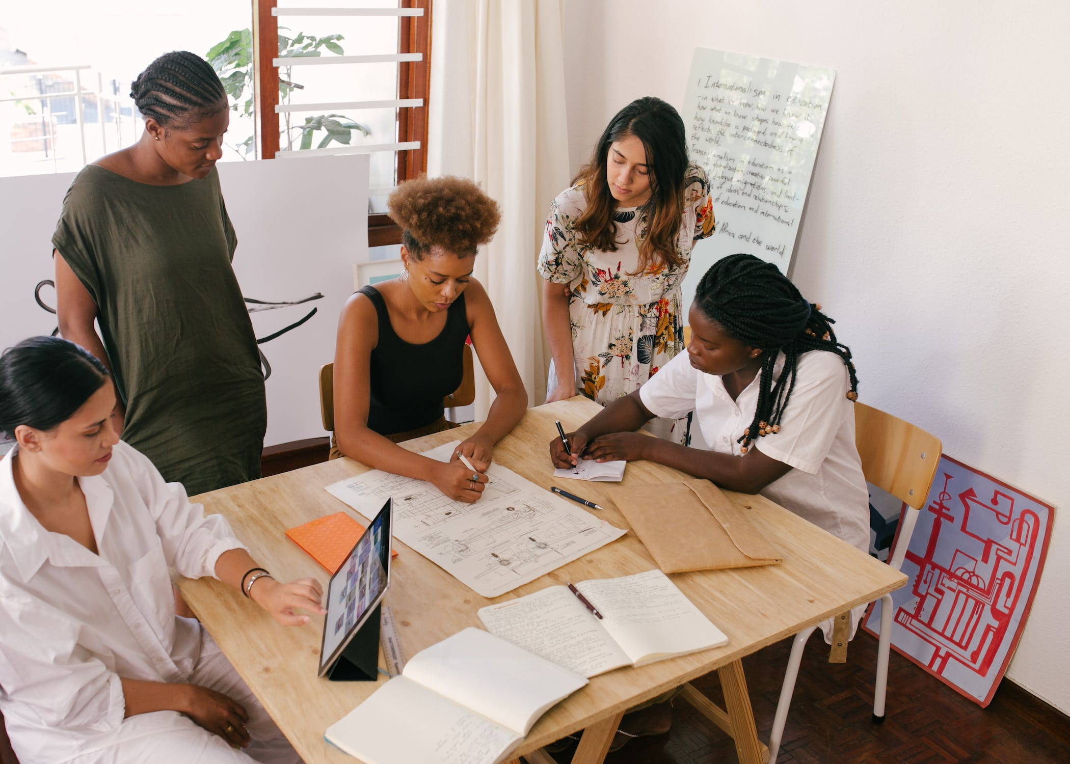
Round Table Discussions: What is your passion? Your skills? What generates the most enthusiasm in your club? What’s happening in your community or state? What actions can you and your club take? 30 min for discussion 15 min for sharing

Slide 5
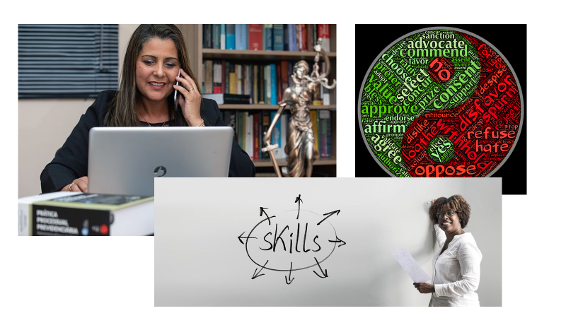
What is your passion? Your skills and talents? Your club’s passion? What’s happening in your community or state that you can get involved with? What actions will you and your club take?
Finding Your Passion and Avenue for Action
Round Table Discussions: What did you discover?

Slide 6
Framework for Action: Five Pillars for Gender-Equal Climate Action
 | Gather the facts | Lead by example | Add your voice | Advocate | Collaborate with like-minded organizations
Educating girls | What is happening in your schools re: climate education? Do they address the link between climate change (CC) and gender quality GE)? | Mentor girls and young women to recycle and reduce their carbon footprint Mentor young women to get involved with STEM subjects | Talk about the issue with your family, friends, and co-workers Write personal letters to your elected officials Write letters to the editor Suggest FAFs to your Caucus delegate Share and post accurate information on social media Calls to action: The R U’s (Reduce, reuse, recycle, repair, repurpose, regift….) | Have a guest speaker to talk about the issue and what can be done locally | Find local initiatives that engage and educate girls about climate and STEM
Advocating for women’s rights Gender equality End violence against women Climate action | Find out how climate and pollution affect women and girls in your area | Reduce your carbon footprint EARTH DAY Rally |  | Visit state and national legislators Attend and speak at local hearings | Work with AAUW, League of Women Voters, and others that share interests
Inspiring more female leaders | Identify female leaders and learn what they are doing | Take on a leadership role in your club, work, or community on CC & GE |  | Highlight roles and support other members to take leadership positions | Highlight roles and support other members to take leadership positions Hold leadership training sessions

Slide 7
Key take-home points:
Learn | Learn the issues in your community and state
Use | Use valid resources
Create | Create service, education, or advocacy action plan
Look | Look for service opportunities in your community
Attend | Climate Think Tanks and other presentations to learn and share
Reach out | Talk with others in your community

