Slide 1
Governor’s Report
Tania Hughes-Kremers
2023 Area Meetings: April 22 & 28

Slide 2
District 7 Dashboard
371 Total Membership
10 Young Professionals
361 Standard Members
34 Member Increase
17 Clubs in 5 States
1 club decrease
3 clubs in formation – Missouri, Iowa & Nebraska
On budget for biennium
$86,838 total in bank
As of March 31

Slide 3
Biennial Goals: 5 Pillars
Zonta International President, Ute Schultz

Slide 4
Let’s look at the 5 Pillars: #1
Stand Out for Gender Equity
Advocacy & Action: 2 periods each year
16 Days of Activism and Orange the World (Nov/Dec)
Rose Day/International Women’s Day (March)
Violence against women and girls, especially:
Ending Child Marriage
Domestic Violence
Digital Violence
Climate Change and its impact on the lives of women

Slide 5
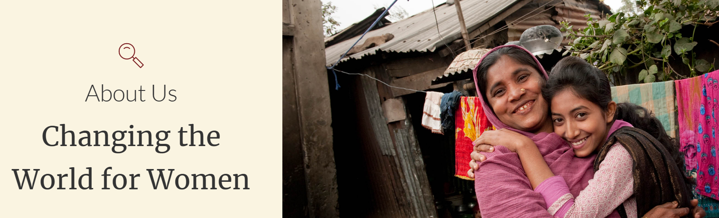
Pillar #2
Represent Global Citizenship
Support of Fundraising Goals – 1/3 of Donations for Foundation
Align local programs to ZI objects and biennial goals
Connect to Climate Change project in Madagascar with the lifestyle in industrialized countries

Slide 6
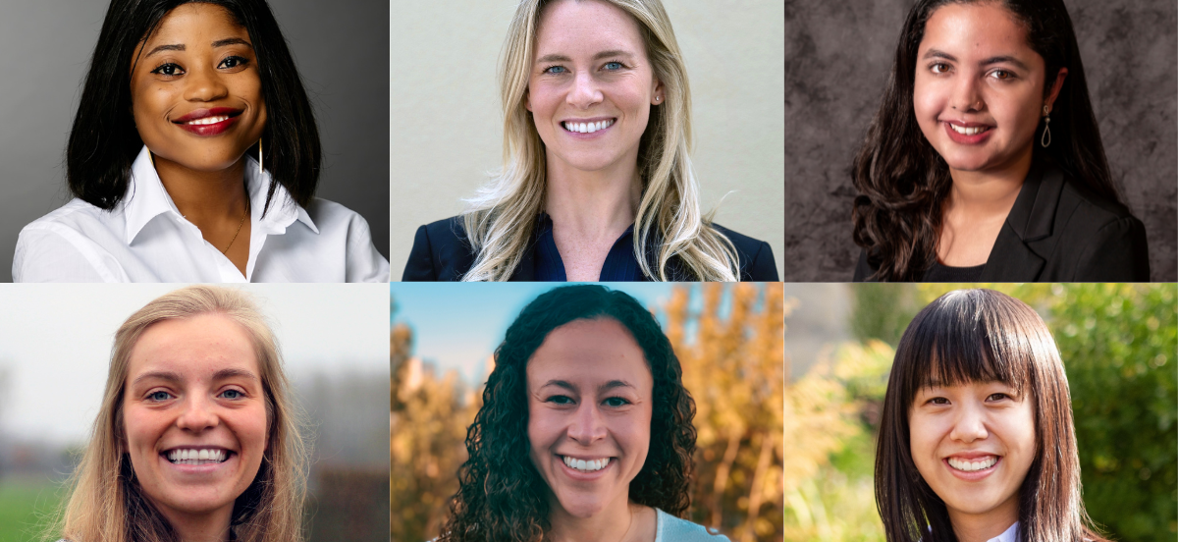
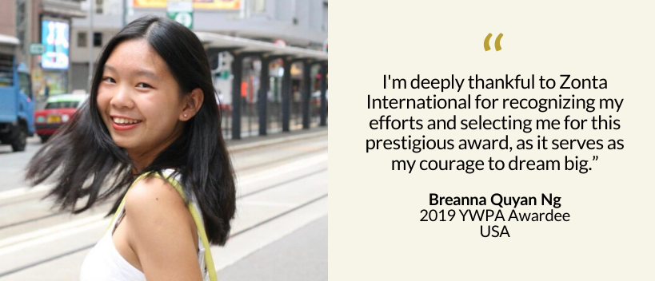
Pillar #3
Develop Future Leaders
Bridge Young and Experienced = Close the Age Gap!
Awardees (YWPA; JMK; AE)
Golden Z Club Members
Young Professionals
Great Girls & Great Women Cross-Mentoring Program
Invite NOW!

Slide 7
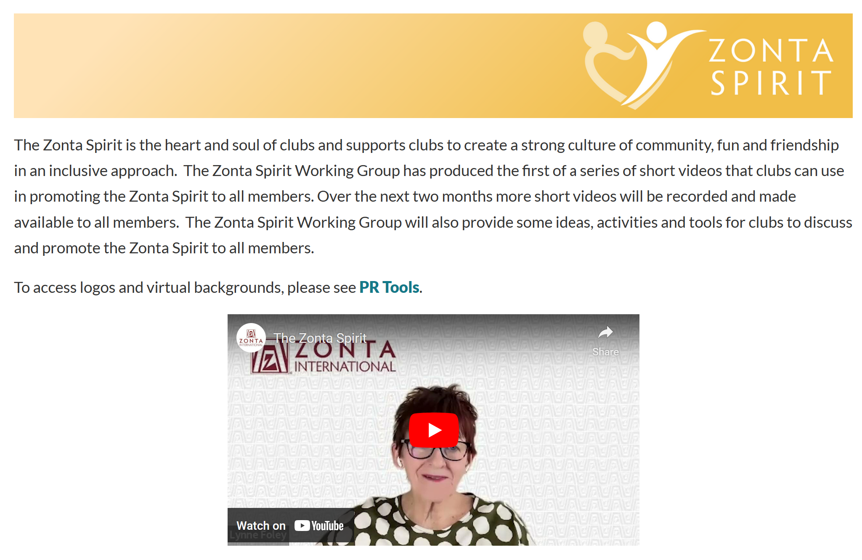
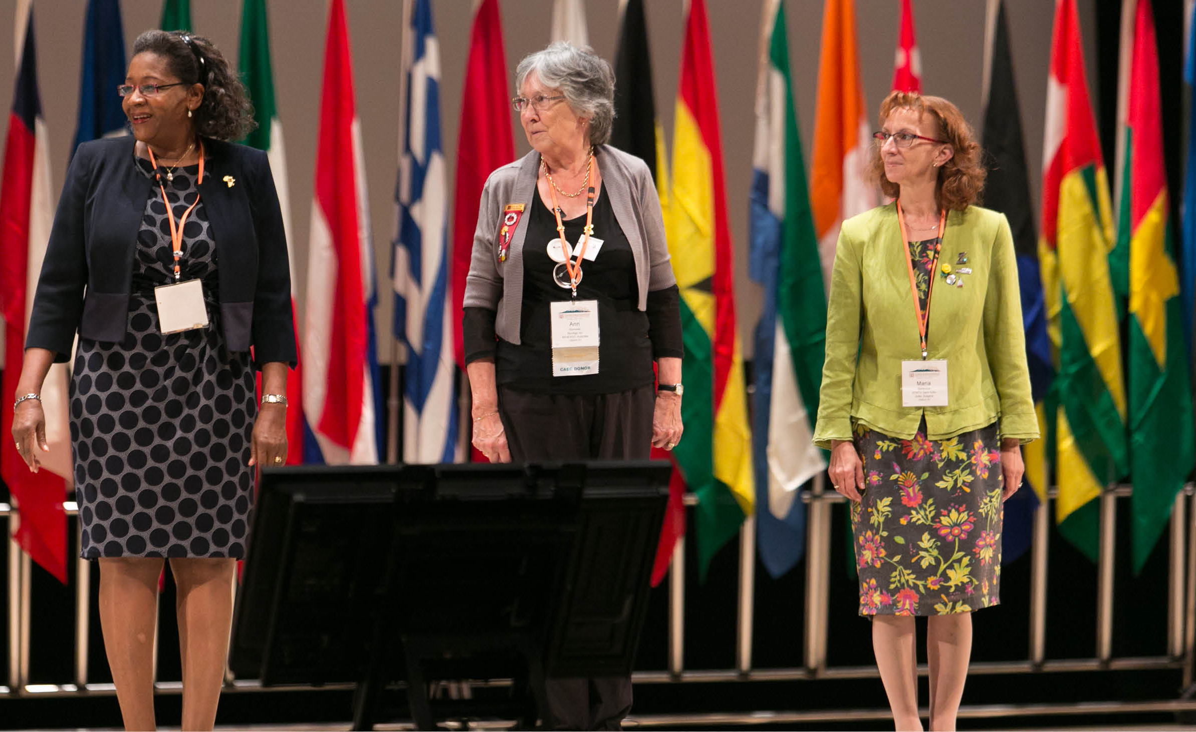
Pillar #4
Celebrate Ourselves
Zonta Spirit – Our Heart and Soul
Honor our 25+ Zontians
Value Diversity ☺ Age, ethnicity, race, color, religion, social status, culture, etc.

Slide 8
Pillar #5
Position Zonta for the Future
Continue process of overall review (Resolution #2)
Develop Strategic Plan
Club Creation is Priority!

Slide 9
Looking ahead . . .
Join District 7 for our 67th Conference
8 -10 September 2023 St. Cloud, Minnesota
Join Zonta International for our 66th Convention
27 - 30 June 2024 Brisbane, Australia

Slide 10
AND FINALLY . . .
Most important
Have Friendship
Have Teamwork
Have Fun in ZONTA

Slide 11
QUESTIONS?
Contact Governor Tania
Tania Hughes-Kremers
Find me on the Zonta App!
Call or text: 612-845-8737
Email: taniahughes@yahoo.com

