Slide 1
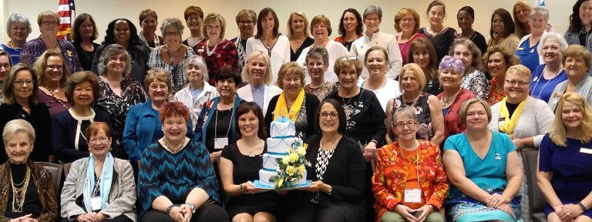
Membership
Jane Austin
D7 Lt Governor

Slide 2
Current Membership in District 7
As of April 1
If each of our 16 clubs increases membership by just 2 more members by May 2024:
394
If we are successful in creating three new clubs this biennium:
+45 new members!
Let’s go for 450!
22 clubs
17 clubs

Slide 3
Who & Where We Are in District 7
Interested individuals who like what we but don’t quite have the time but, or are stepping away?
Encourage them to be a
Supporting Member!

Slide 4
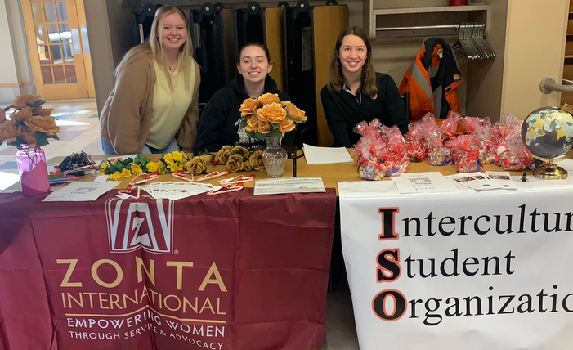
Z and Golden Z clubs: Our future Zontians
A To Z Club (MN …?) Granite City (St Cloud)
Jefferson City High School (Jefferson City)
Jamestown Blue (Jamestown)
Jefferson City (Jefferson City) Maryville University (St Louis)
Southeast Missouri State University (Cape Girardeau) University of Jamestown (Jamestown)

Slide 5
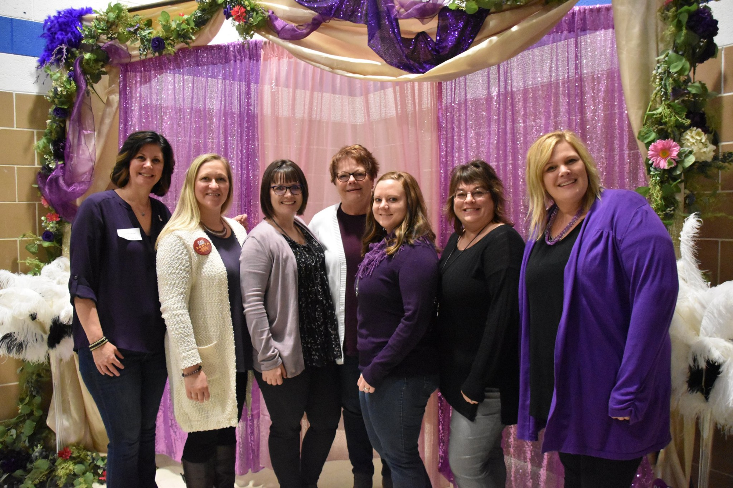
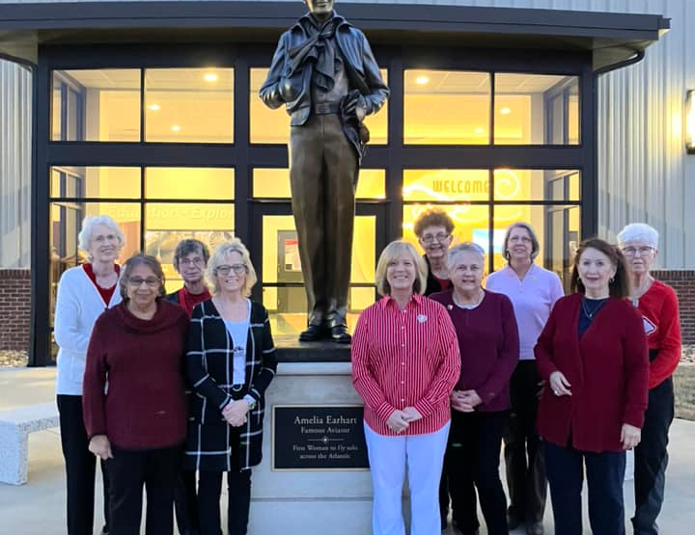
CELEBRATING OUR CLUB ANNIVERSARIES 2022-2023
85 Years -- Kansas City MO I
75 Years -- Jefferson City, MO
70 Years -- Aberdeen SD, Breckenridge-Wahpeton,
Fargo-Moorhead, Jamestown, ND
65 Years -- Atchison Area
50 Years -- Johnson County, Kansas
10 Years – E-club USA1

Slide 6
Members are key to doing –
Supporting International service projects with funds
Supporting local service projects – hands-on and funds
Raising our voice for advocacy
Not just about bringing in new members but
keeping our members!
New Member Video and online training (available monthly)
Orientation – not only for new members
Our mission
What we do
How ZI – District – Area – Clubs are organized and function
The Zonta Why
Recognize and celebrate your members!

Slide 7
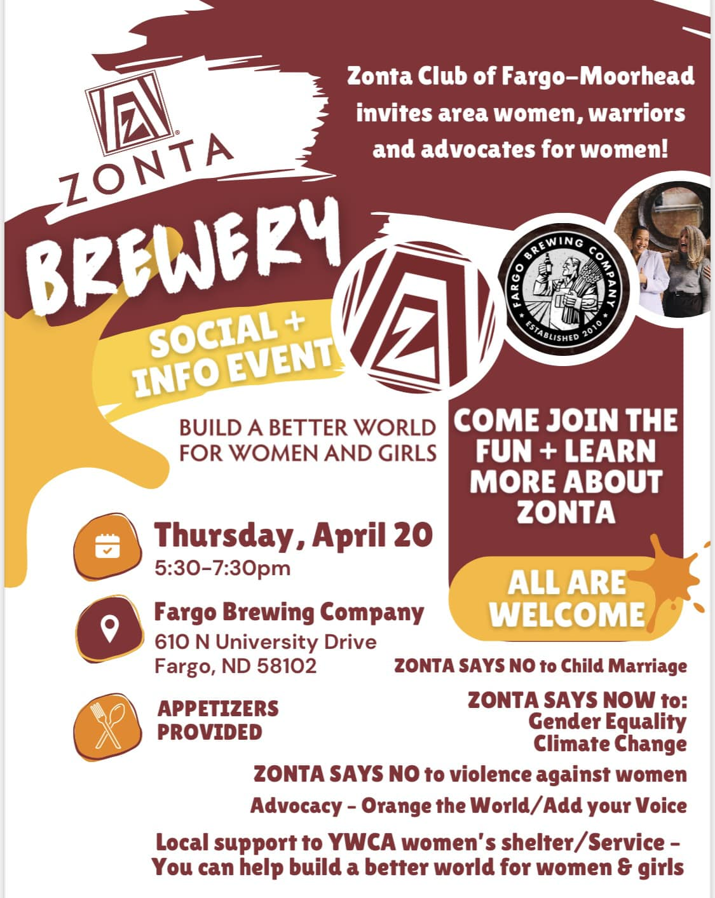
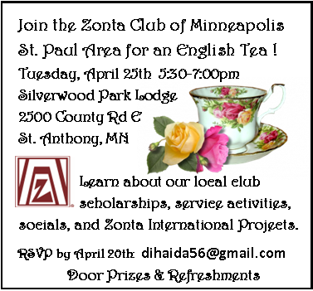
District 7 Membership Plan
Grants for activities to build membership: Funds still available!
Information and forms online at
www.zontadistrict7.org >> Resources
What clubs are doing with grants:
KCII: Membership Lunch at Strawberry Hill Museum
Mankato: Service/Membership, Kits for Women in
Safe Haven, April 17
Fargo: Membership event at the Fargo Brewery, April 20
Minneapolis: Membership “English tea”, April 25

Slide 8
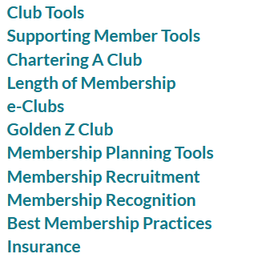
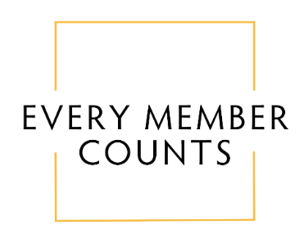
Resources Online:
https://www.zonta.org/Web/My_Zonta/Tools/Membership_Tools_Home

Slide 9
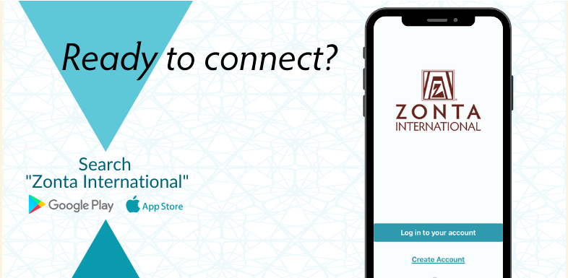
Connect with the Zonta Mobile App
News feed with the latest updates from ZI
Calendar of Zonta events
Discussion forums tailored to your Zonta role and special interests
Easy access to essential member resources
A member directory with instant private and group chats

Slide 10
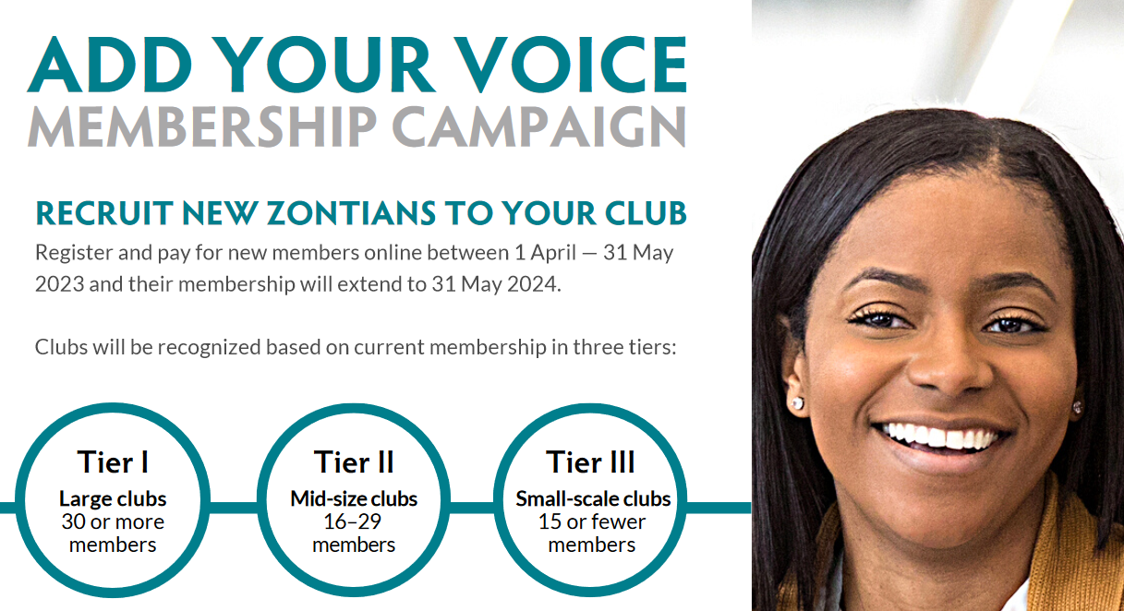
Prizes to top 30 clubs in each tier that achieve a minimum membership increase of 20% from March 31st
All new members to clubs in April & May are entered with payment in ZI database
July – ZI announces winners in each tier

Slide 11
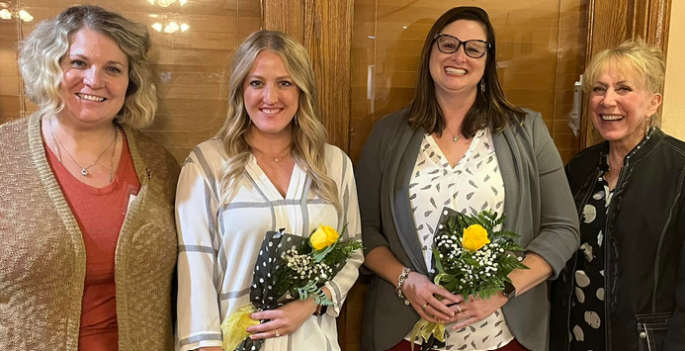
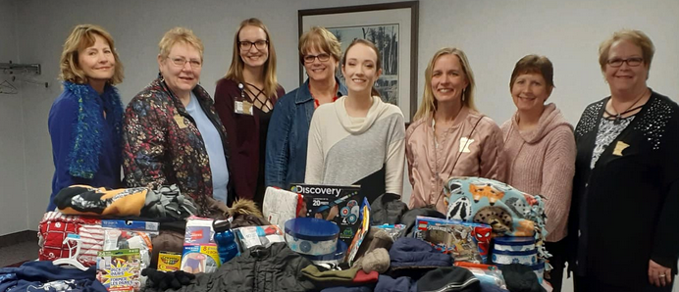
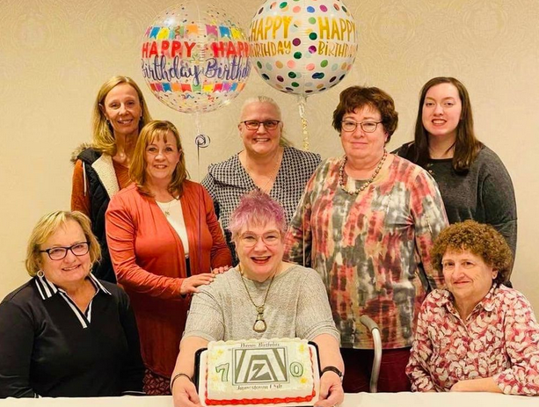
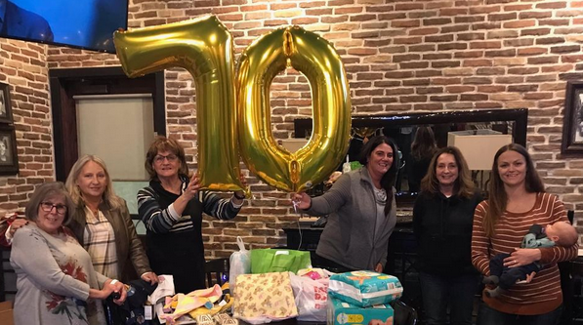
Questions?

Slide 12
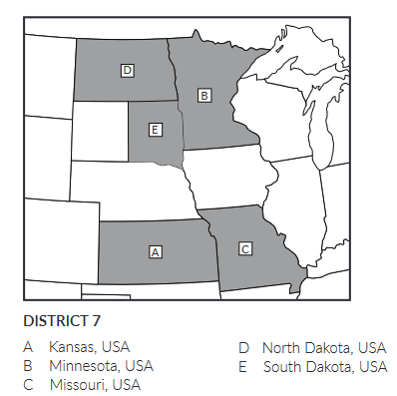
Club Creation
Gayle Borchert - District Club Creator
Team: Jane Austin, Sue Dege, Sue Keirstad, Deb Kellerman, Shelley Schultz
Starting new clubs:
Des Moines, Iowa
Lincoln, Nebraska
Springfield, Missouri
D12
D6

Slide 13
Basic steps to creating and chartering a new club:
Request ZI approval for new club and name, new club logo
Develop contact list for potential members, community leaders
Plan and invite to informational events
Zoom meeting(s)
In-person events
Follow up with interested individuals
Create club social media accounts and basic website
Hold organizational event
Celebrate new club charter!
Mentoring by nearby clubs will help put the new club on their feet
We would love your help!!

Slide 14
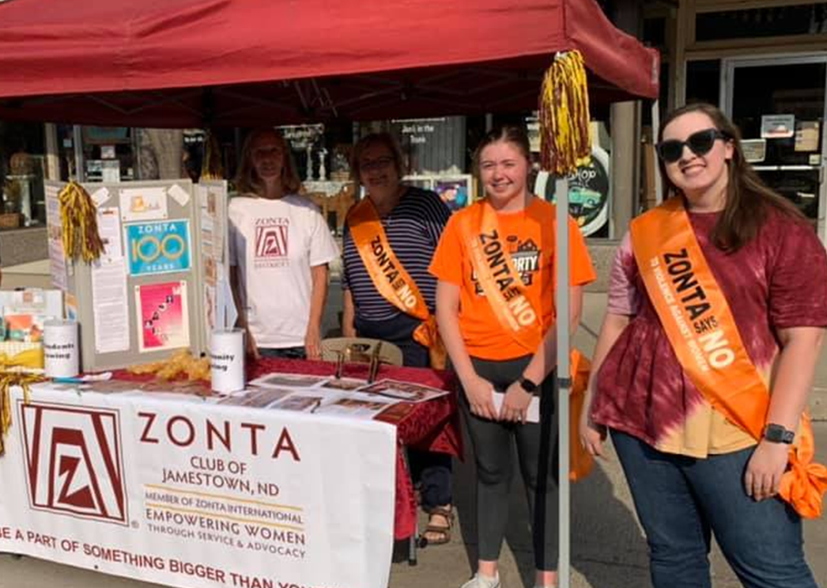
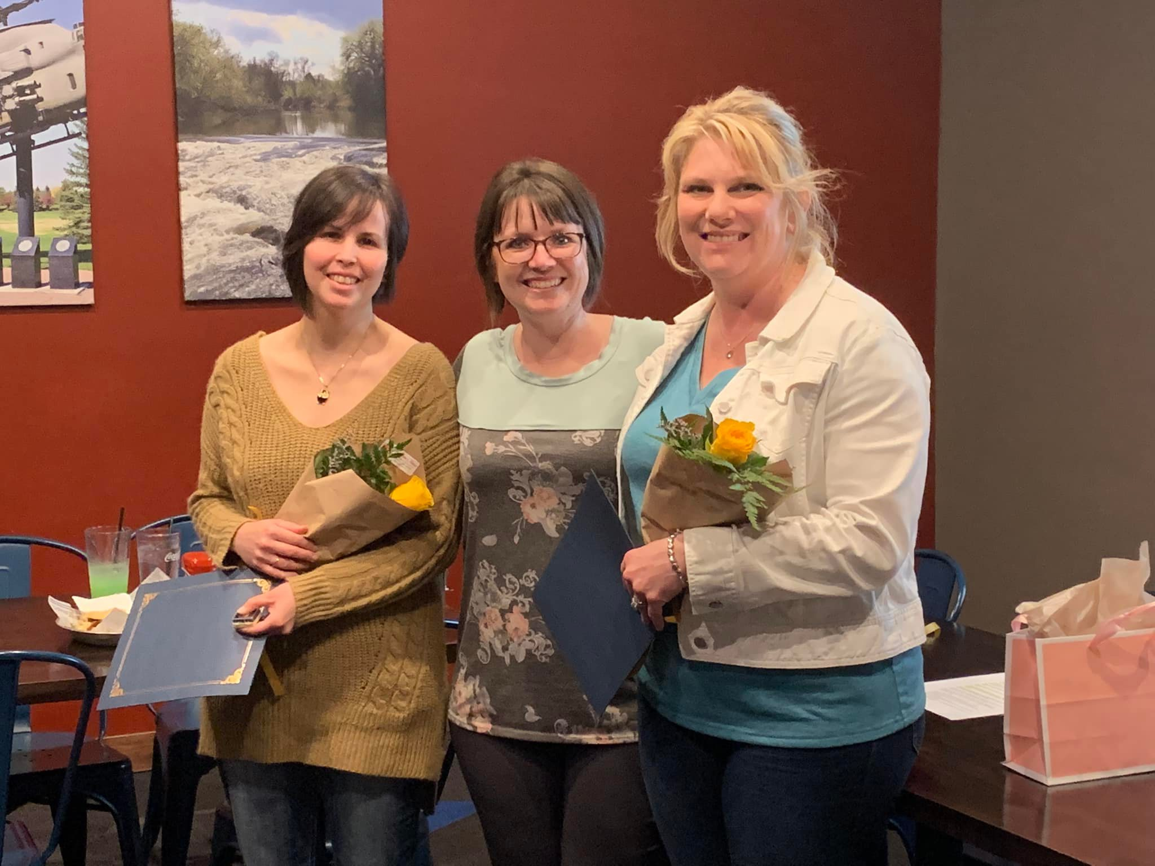
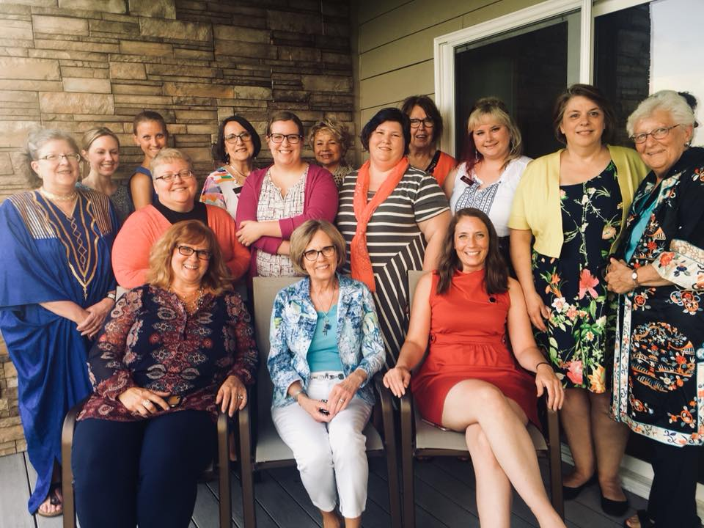
Sharing Membership ideas:
Attract & Active
Engage & Retain
Table discussions
Sharing and Recap

