Slide 1
Zonta Says NOW:
What’s climate got to do with us?
The What, Why & How of Zonta International’s Climate Change Initiative
Jane Austin, Zonta Club of Minneapolis
D7 Lt Governor and Zonta Says NOW Working Group
Notes:
In recognition of Earth Day this month, we wanted to introduce the Zonta Says Now initiative and explain --- what’s climate got to do with us – and our Zonta mission.

Slide 2
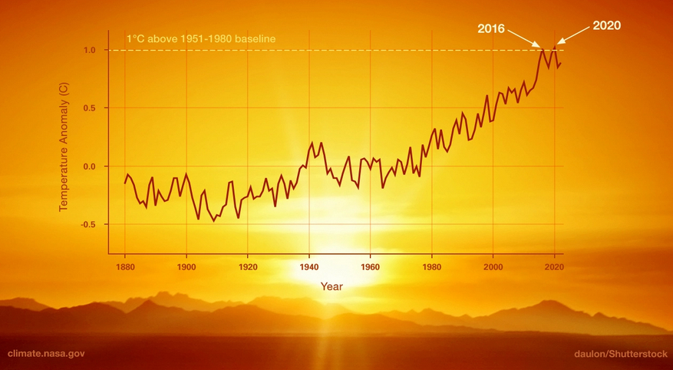
Average global surface temperatures have already risen more than 1.1°C (1.8°F) above pre-industrial times
1.5° Celsius = 2.7° Fahrenheit
Notes:
Global temperatures have dramatically risen over the last century, reaching 1.1 degree C warmer than pre-industrial times – ie what our parents and grandparents – were used to. The world will likely breach the 1.5C limit -- 2.7 F -- by the early 2030s
The warming of air and oceans is already triggering extreme weather events – increasing the amount of moisture held in the atmosphere, changing ocean and air currents like monsoonal patterns, the polar vortex. Around the globe we are seeing more extreme droughts, floods, intense rain storms, and changing patterns of where those extreme events occur.
Given this trend, what will your children and grandchildren experience if this trend continues?

Slide 3
Other greenhouse gases: methane, ozone, water vapor, nitrous oxide, and chlorofluorocarbons
Notes:
Global warming is driven by having too much heat-trapping greenhouse gas in the atmosphere. The main greenhouse gases are carbon dioxide, but also include methane, ozone, water vapor, nitrous oxide and chlorofluorocarbons, all of which have dramatically increased in the last century to far beyond any historic records.

Slide 4
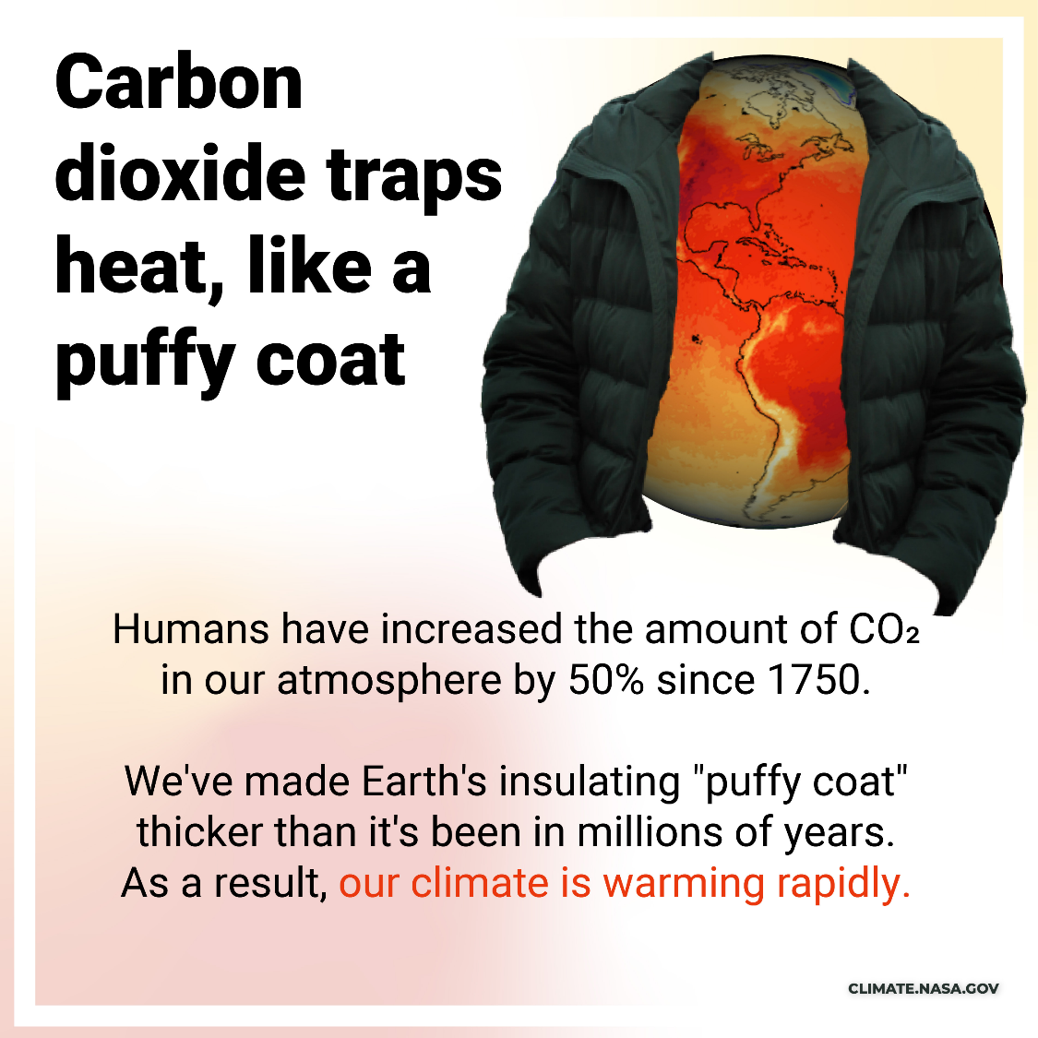
Not just CO₂:
One pound of methane traps 25 times more heat in the atmosphere than one pound of carbon dioxide. But methane lasts there for only about a decade – CO₂ lasts for centuries
Notes:
We’ve known how CO2 hold heat in the atmosphere since the 1800s. These gases help to warm the planet by preventing heat to escape into space.
We primarily talk about CO2, but one pound of methane traps 25 times more heat in the atmosphere than one pound of carbon dioxide but methane lasts there for only about a decade on average—while CO₂ can last for centuries. So reducing methane (a byproduct of burning nat gas) can be a key immediate action to reduce the effects of greenhouse gases.

Slide 5
The difference half a degree C (0.9° F) makes:
Paris Agreement 2015: keep global warming below 2°C, preferably below 1.5°C
Extreme Heat
(% of global population exposed to severe heatwaves
Species Loss (Plants)
2.6x
worse
1.5°C 14%
1.5°C
8%
2x worse
2°C
37%
2°C
16%
Decline in coral reefs
Species Loss (Vertebrates)
1.5°C
2°C
1.5°C
4%
up to 29%
worse
2x
worse
2°C
8%
70-90%
99%
Notes:
The goal of 1.5 C or 2.7 F is critical to many features of life on earth --

Slide 6
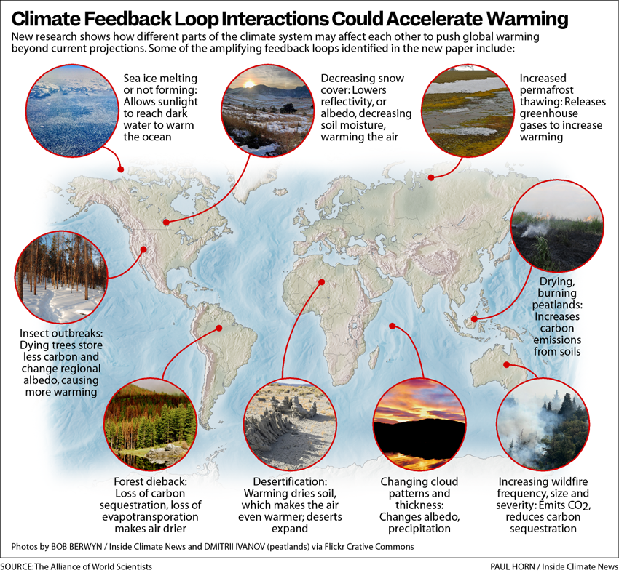
Notes:
Our earth’s many physical and biological systems are intimately interdependent – changes in one affect another, sometimes in ways we are just beginning to understand. We are now seeing in dramatic and rapid changes such as changing ice on the seas and Great Lakes, less snow cover, melting permafrost, outbreaks and changing distribution of insects and disease, more intense wildfires, changing monsoon patterns. Each of these is nearing key tipping points where reversing the trend becomes extremely difficult.

Slide 7
Extreme Climate Events in 2022 included…
PLUS
Wildfires, lightning, snowstorms, sea level rise…
Heatwaves
Drought
Floods
Tropical Cyclones & Tornados
India, Pakistan, Europe, Nigeria, DR Congo, South Africa, China, Korea, USA, Argentina, Australia
India, Pakistan, Japan, Europe, USA, China, Australia
East Africa, Chile, Europe, China, Kiribati, southwest USA
Madagascar, USA, Bangladesh, Fiji
The new ‘normal’
From: https://www.climatecouncil.org.au/resources/cop27-australias-global-climate-reset/
Notes:
Although the global temps have “only” increased 1.1C degree so far, we are already seeing real impacts of climate change around the world that have led to major social disruptions. Just in 2022, we saw--
India and Pakistan ravaged by heat and recent floods that affected over 30 million people.
In East Africa the prolonged drought has put over 22 million people at risk of starvation and displacement
Europe and parts of the US have experienced intense heat, drought and floods
Madagascar was hit by 2 tropical storms and three cyclones with 1 million people affected
Western Australia had its hottest summer on record and in eastern of Australia the floods have been relentless.
Extreme wildfires increased in Europe, western US, and South America
This is the “new normal” – and will continue to amplify in severity and frequency.

Slide 8
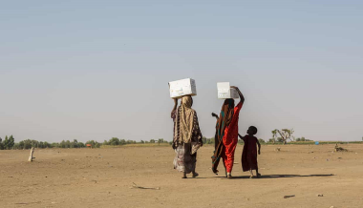
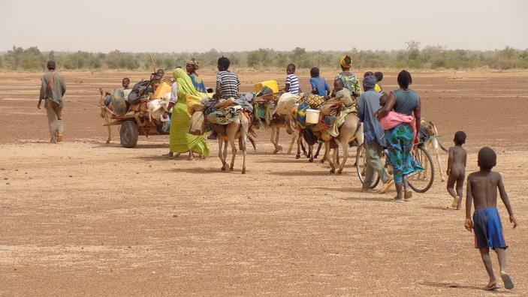
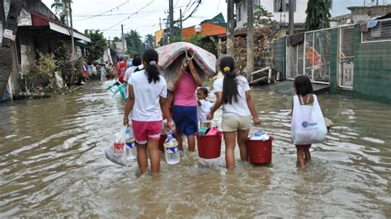
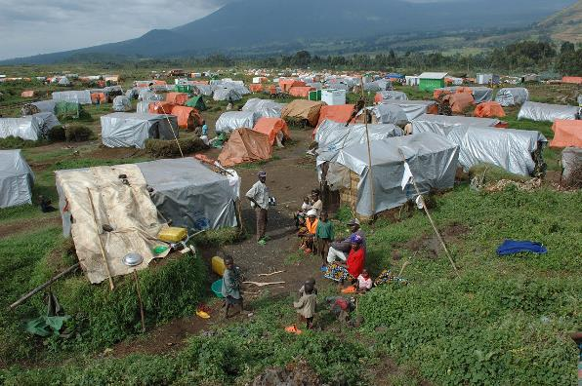
People are three times more likely to be displaced by climate-fueled related disasters than by conflicts
Global climate change impacts displaced 30 million people -- just in 2020
Without increased and immediate action on climate change,
216 million people will be internal climate migrants by 2050
80% of those displaced by climate change are women
Notes:
With extreme events driven by climate change, we are seeing more and more people displaced from their homes and communities.
Just in 2020, 30 million were displaced by droughts, floods, severe storms. Displaced from town to town, rural to city, sometimes to different countries, seeking water, food, livelihoods, survival.
If we do not act to prevent the global temperatures rising above 1.5 degrees C, the World Bank estimates 216 million people will be internally displaced by 2050 – your grandchildren’s time? -- Eighty percent of those displaced will be women.

Slide 9
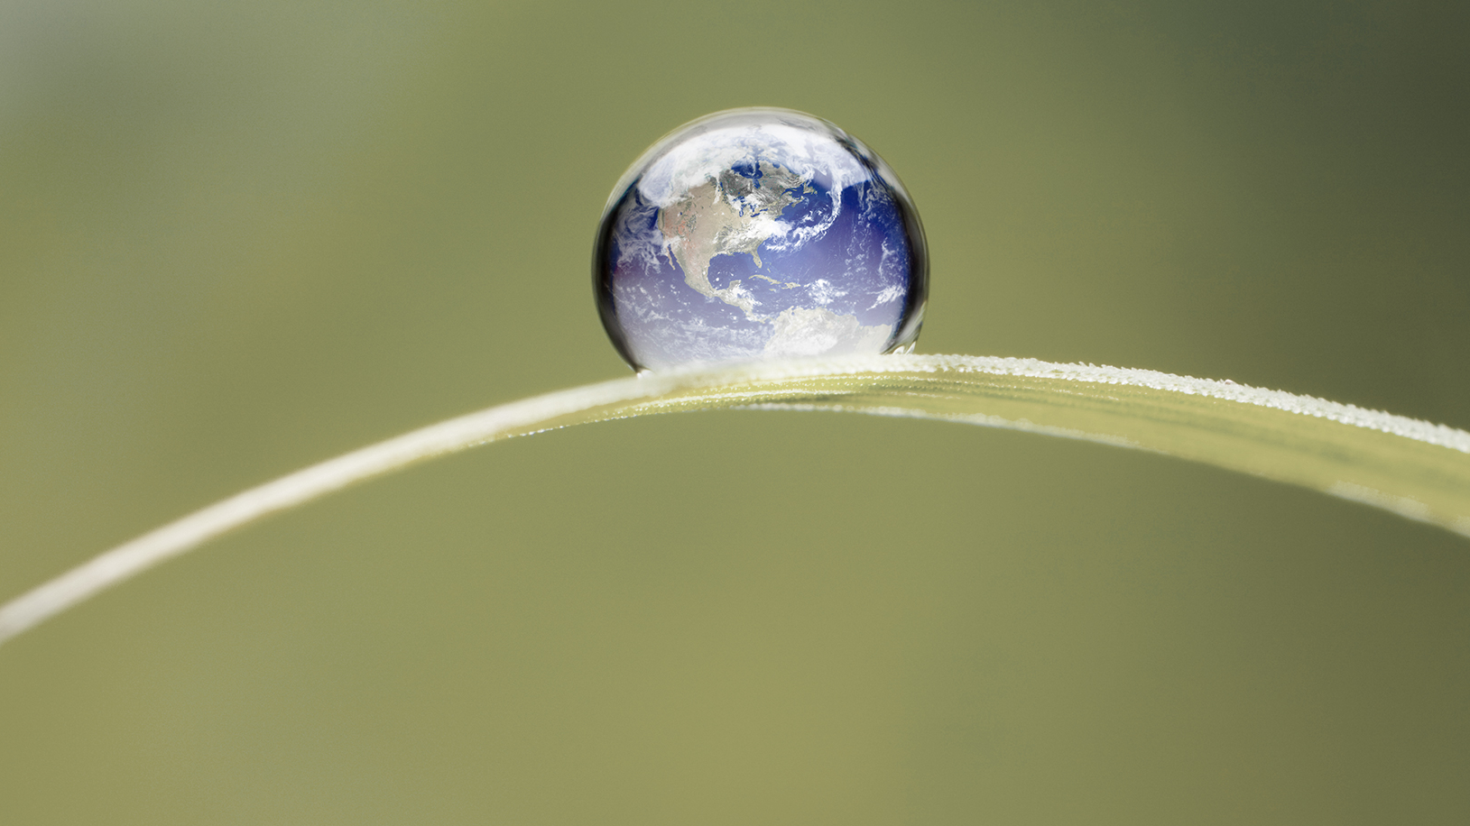
Reaching critical tipping points – ecologically and socially
Intro imagePhoto © iStockphoto.com | ThomasVogel
Notes:
If we do not change the trajectory we are on, we are approaching tipping points into unknown social and ecological disruption

Slide 10
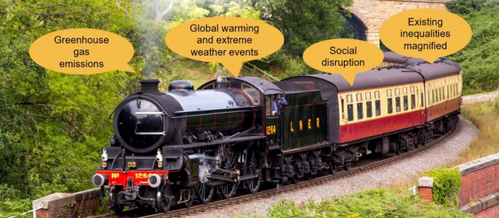
Notes:
Carole Theobold from District 23 has provided a simple way for us to think about how climate change is related to gender equality, as being on a runaway train --
Increasing greenhouse gas emissions from fossil fuels are causing global warming.
Global warming is triggering extreme weather events, increasing in frequency and severity.
Extreme weather events are causing major social disruption as millions of people lose homes, communities, are displaced.
Social disruption magnifies existing inequalities – including gender inequality.

Slide 11
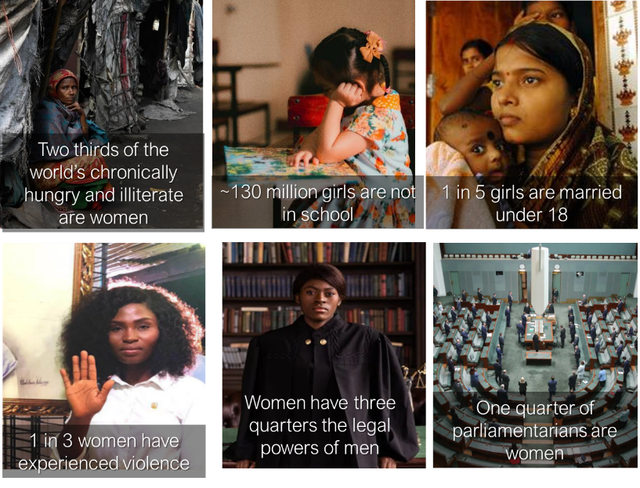
So why should we as Zontians be involved in climate issues?
Gender equality!
Notes:
As Zontians, we already know about inequalities women face globally --- access to food and education, pressures leading to child marriage, gender-based violence, lack of legal and economic opportunities and power, limited women in leadership.
Women may make up half of humanity but their voices are not heard equally in in decision-making, yet they bear much of the burden when societies falter and fall apart. So taking action on climate change is about gender equality – the core of Zonta’s mission

Slide 12
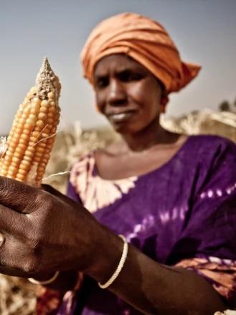
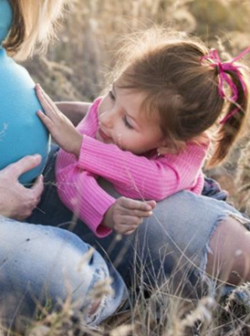
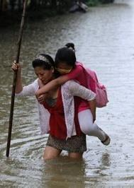
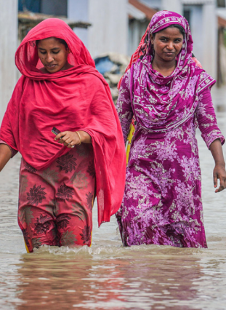
Climate change amplifies gender inequalities
Whether sudden or slow-onset climate events, women are more vulnerable and burdened:
Responsible for child and elder care
Responsible for providing food and water for family
Suffer more from shortages of food and economic resources
May have social constraints in their clothing, activity, skills (e.g., travel, swimming), resources
Gender differences are directly linked to women’s economic and social rights
Globally, women are more likely than men to
Live in extreme poverty
Experience severe hunger and food insecurity
Experience partner violence
Be injured and much more likely to die in severe events
Notes:
Climate change amplifies existing gender inequalities.
Women are the caregivers for children and the elderly, the ones primarily responsible for providing food and water, and – when food is limited – they are often the last to eat or get needed personal resources.
Where societies constrain their roles and activities, women may be less able to travel, know how to swim, have clothes that inhibit their ability to escape during an event, or they may not have the skills and resources to recover what has been lost.
Gender differences are directly linked to women’s economic and social rights. In societies where women have fewer rights and economic resources, women and girls are more likely than men to –
Live in extreme poverty
Experience food insecurity
Experience partner violence
Be injured and MUCH more likely to die in severe events

Slide 13
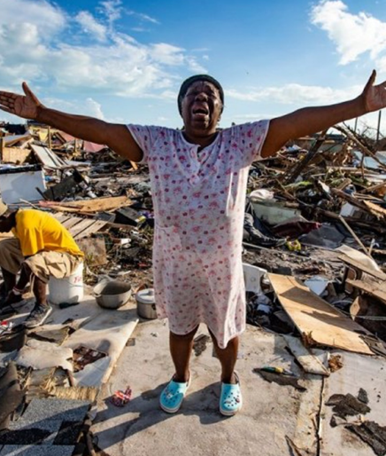
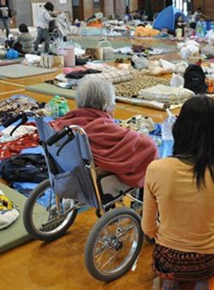
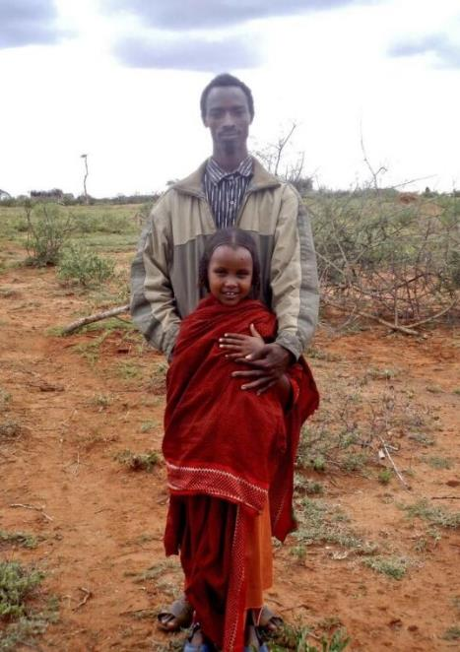
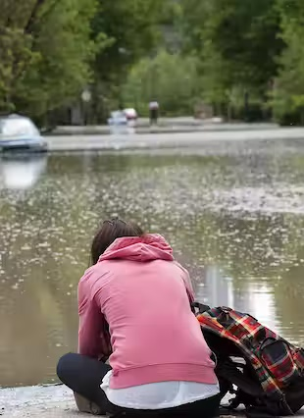
Women face more systematic violence that escalates during periods of instability.
Challenges in finding safe spaces for women displaced from their home and communities
Social instability and upheaval of livelihoods can precipitate early marriage or forced prostitution
Greater risk of mental health problems, poor medical resources
Women are more vulnerable and at risk:
Notes:
During periods of instability, such as when homes, crops, business are lost or damaged, anger and frustrations leads to more domestic violence, and more violence in communities.
Challenges staying safe in disaster shelters, such as during Katrina, or tent cities for climate refugees
Economic problems from a disaster can force women into prostitution or girls into child marriage
Women face greater mental health problems or poorer medical attention, especially maternal care

Slide 14
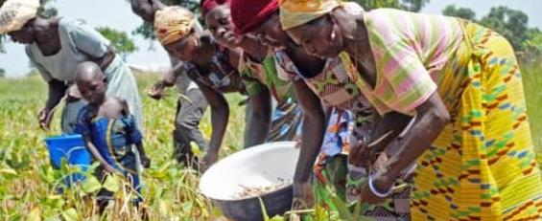
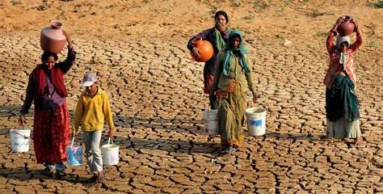
Women face greater challenges in the face of climate-driven disasters:
Women are responsible for 50-80 % of world food production but own less than 20% of land
Globally women have less socioeconomic power and fewer economic opportunities than men and are more at risk of unemployment, so it is harder for them to recover from disasters
Women are more likely than men to be illiterate or poorly educated, and less likely to use the internet for information or financial systems
Most of the world’s 1.2 Billion poor people live in water-scarce countries without access to safe and reliable supplies of water -- two-thirds are women.

Slide 15
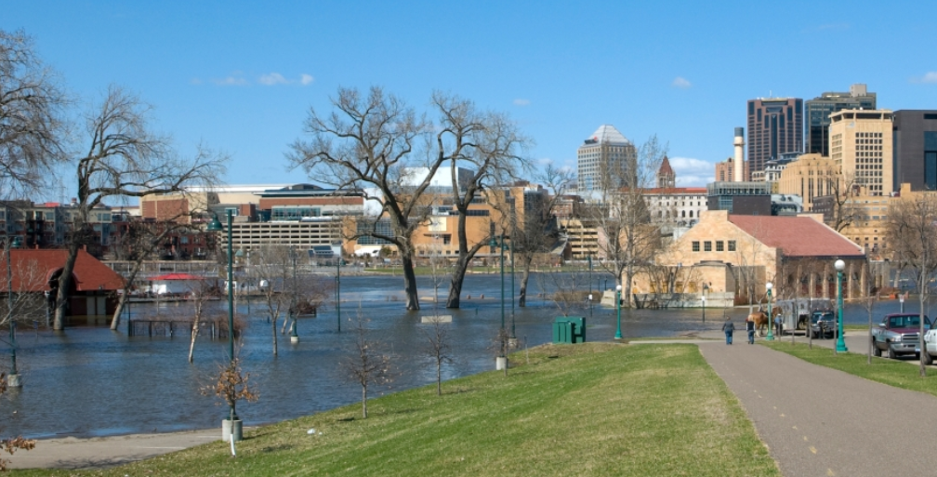
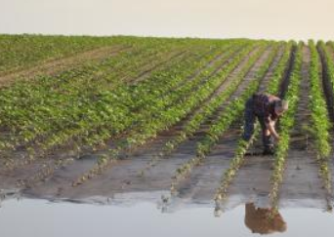
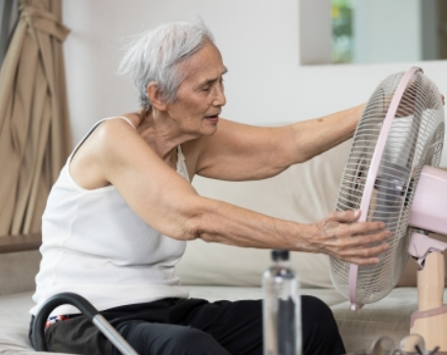
How is climate change affecting your own state and community?
Minnesota has warmed by 3.0°F between 1895 and 2020, while annual precipitation increased by an average of 3.4 inches
How can we adapt and plan to deal with these changes?
Child care? Ability to work? Health? Economic costs/resources? Cost of living? Domestic violence?
Notes:
Ok, you are thinking- how does this apply to me in the Midwest; we don’t have many of those problems, it won’t affect me….. Well, stop and think about how climate change is affecting your state and community --- and how it then will affect women.
Damages to infrastructure like roads and bridges from floods; extreme storms taking out power lines or damaging homes. Costs to fix and replace, affecting individuals and communities. How do we prepare for such disasters?
Croplands hit by floods, drought, and heat, reducing farm income and increasing food costs. Which in turn can intensify family stress
Periods of high heat increasingly frequent and long – particularly hard on older people, and those who can’t afford air conditioning
Think for a while about how these impacts affect women in our communities. AND how can we adapt and plan to deal with these changes.

Slide 16
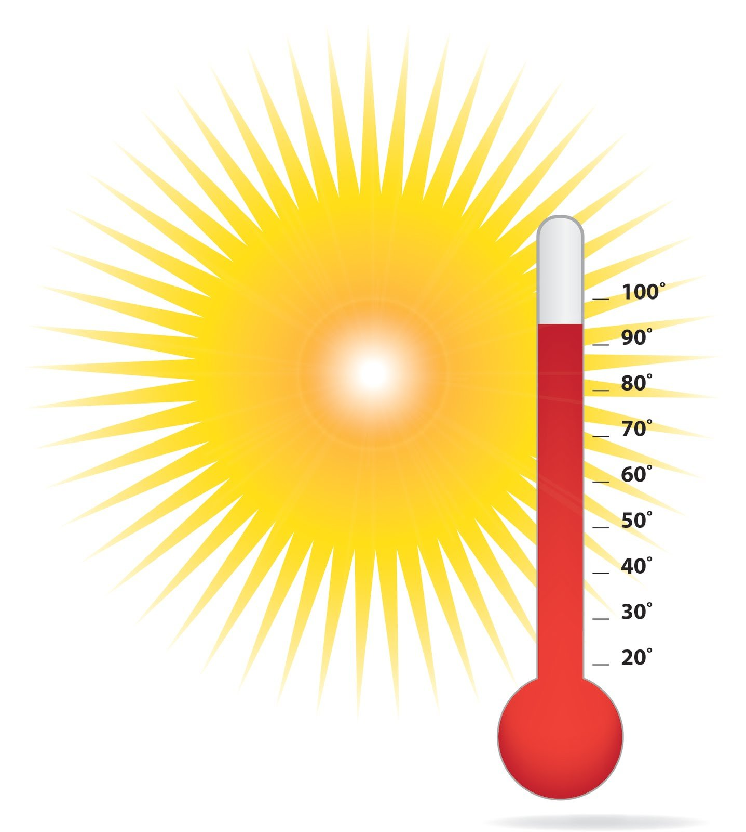
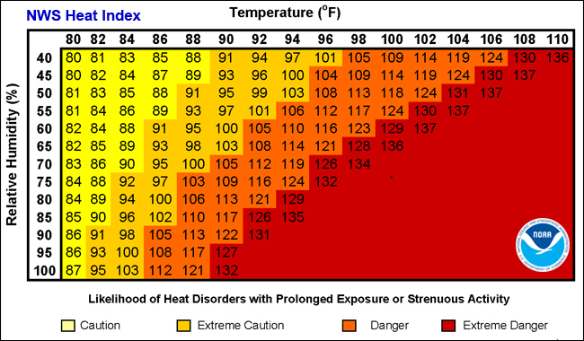
Heat Stress and “wet-bulb” temperatures: high temperatures with high humidity
Toward the end of the 21st century, if current trends continue, projected effects are for more scorching summers:
• Missouri: More than 100 days per summer with highs over 90°F and almost a month and a half of days over 100°F.
• Minneapolis-St. Paul would experience almost 70 days per summer with highs over 90°F and almost a month of days per summer over 100°F
Union of Concerned Scientists https://ucsusa.org/mwclimate
Organ failure and death
Notes:
One of the most obvious images is heat -- Extreme levels of heat stress have more than doubled over the past 40 years. That trend is expected to continue, and really impact the southern states and urban areas in our district.
once you approach wet-bulb temperatures of 93-to-97 degrees Fahrenheit, it doesn’t matter what you’re doing. You can’t survive for extended periods of time. Nor can your vegetable garden remain productive.
If our heat-trapping emissions continue unabated, heat waves of historic proportions are projected to become routine in parts of our district

Slide 17
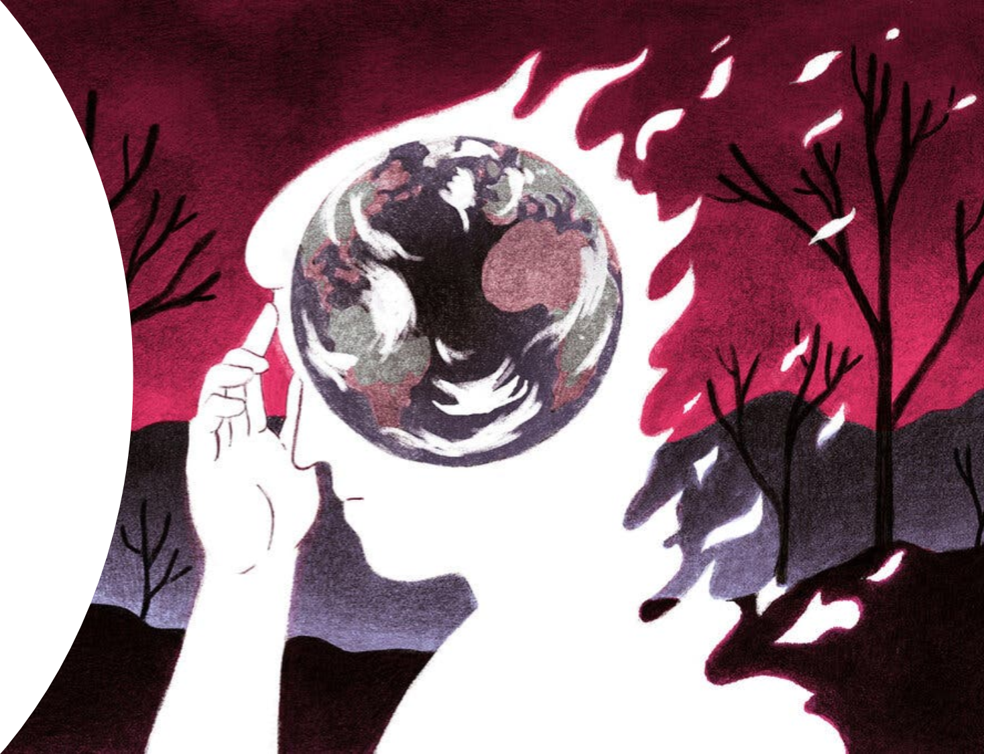
Dealing with Climate Anxiety
Notes:
So, with all this distressing news, how do we deal with it and the anxiety it produces?

Slide 18
Calming Climate Anxiety
Your feelings about climate are justified
Connecting with other supportive people is key
Stay connected with Nature
ACTION is the main antidote to Anxiety
Be the change & allow optimism
The one thing we need more than hope is action. Once we start to act, hope is everywhere – Greta Thunberg
Notes:
Ways to calm climate Anxiety:
Recognize your feelings about climate are justified—it is a real.
Connecting to other people is key, including those in your immediate circle of family and close friends as well as other like-minded people who are supportive.
Stay connected with nature – it is always a healing space
Action is the main antidote to Anxiety—Be the change and allow optimism

Slide 19
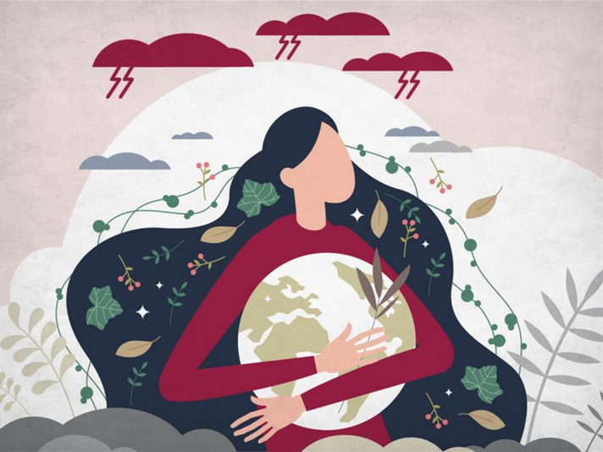
Zonta Says NOW to Gender-Equal Climate Action aims to accelerate Zonta’s mission to close the gender gap and slow climate change so women will have a chance to achieve their full potential and not live in fear of violence

Slide 20
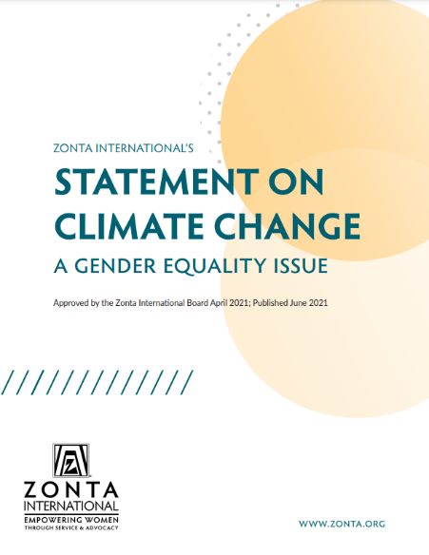
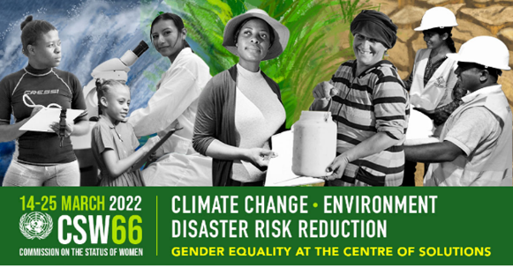
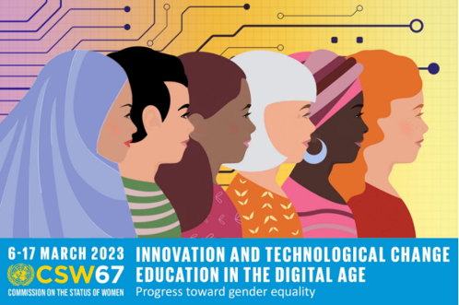
Notes:
Zonta International issued our Statement on Climate Change in 2021 with a number of recommendations. Please take the time to read!! – a key resource to understand what and why Zonta is taking a strong stance on climate change.
The Commission on the Status of Women also play a key role in achieving gender-responsive solutions. The CSW66 in 2022 focused on climate change and the environment, particularly disaster risk reduction. The CSW67 focused on the importance of education and technical changes in the digital age.

Slide 21
Zonta International calls on its members to:
Increase their own awareness of climate change and on its gender-related
consequences and raise awareness locally.
Include gendered climate change advocacy actions in their advocacy plans.
Support the inclusion of women at the national and local tables of decision-making on environmental sustainability.
Promote girls’ education and the inclusion of climate literacy in schools, as well as to promote girls’ science, technology, engineering and mathematics (STEM) studies to increase gendered scientific and technical contributions to climate change mitigation.
Advocate for national policies that take into account women’s economic opportunities and ensures their full and equal participation in the economy.

Slide 22
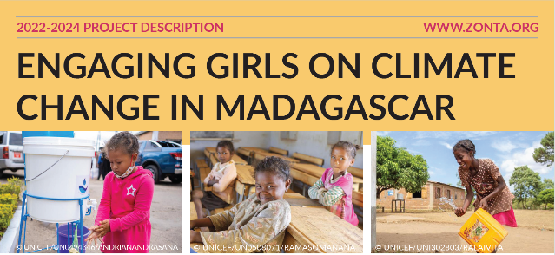
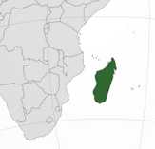
ZI International Program
“Let Us Learn Madagascar”
Educating girls in learn in a safe and inclusive environment, building environmental and climate literacy and STEM skills
Training on climate and environment, sanitation and hygiene practices, clean school environment and the development of disaster risk plans to enable learning to continue during natural disasters.
Building healthy empowered lives with more choices to build climate-resilient communities
Supports Madagascar to meet Sustainable Goals for water, sanitation, and hygiene
Notes:
Madagascar, off the eastern coast of Africa, has experienced extensive deforestation and other human impacts. The northern half has been hit by severe flooding, displacing tens of thousands, while the southern half has experienced deep and long-term drought. Only 41% of the population has access to basic water services, 23% to basic hygiene services.
Zonta’s International programs, started in 2016, is supporting girls and their communities by providing environmental education in Madagascar through girl-friendly schools, teaching sanitation and hygiene, and disaster risk planning. Ultimately to enable children to learn in safe and inclusive environments and empower them to take actions to build climate-resilient communities.

Slide 23
16 Days of Advocacy
SERVICE
With gender-equal climate action we narrow the gender gap and lessen violence
International Women’s Day
ADVOCACY
End Child Marriage
EDUCATION via Scholarships:
Women in STEM
Women in Business
Women in Public Affairs
Amelia Earhart Fellowship
Notes:
We are familiar with the core of Zonta’s mission and activities –
With gender-equal climate action we can narrow the gender gap and lessen violence

Slide 24
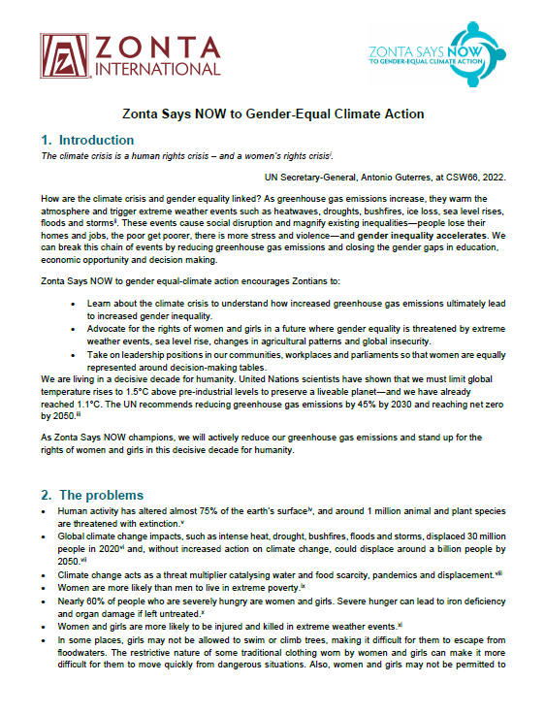
Zonta Says NOW to Gender-Equal Climate Action
ZI Fact sheet
Introduction
The Problems
The Solutions
What can WE do?
Get the facts
Lead by example
Add our voice
Advocate
Collaborate
Two pages of references and links
www.zonta.org/Web/Causes/ZontaSaysNOW/Resources
Share with you club members and prospective members
Use the Fact Sheet and Action Framework as a focus of a club meeting and planning
Notes:
The Zonta Says Now Working Group put together a Fact Sheet to explain why and what.
It focuses on The Problems, the Solutions and What WE can do……. use five components of a framework for action: get the facts, lead by example, add our voice, advocate and collaborate.
The fact sheet is a reference document – with reference material – all based on sound information and science. The many references will provide opportunities for any further research that Zontians may wish to undertake.
Please share the Fact sheet and Action Framework sheet with your members and prospective members
And use them in club discussions on what actions you can take

Slide 25
Gather the Facts
ZI & CSW: Seven Recommendations for Climate action and Gender Equality
Learn about issues so you can understand from all perspectives
Research climate action by NGOs, corporations, state legislators, and the issues in our community and district
Advocate
Develop advocacy plans
Host events to highlight issues and solutions
Lead by Example
Reduce your carbon footprint
Mentor young women on STEM subjects
Take on leadership positions in your club, community, & workplace
Add Our Voice
Give presentations, write articles, do Legislative Action Alerts
Write to and talk with your elected officials
Letters to editors
Talk with community members, family, neighbors, & coworkers
Collaborate
Like-minded organizations in community, state, & nation
Help find solutions with local & state governments
Co-host events and training
Notes:
we have a framework to think about our way forward to action ---

Slide 26
Framework for Action : Five Pillars for Gender-Equal Climate Action
Use the Framework to accelerate our mission in all areas of Zonta
 | Gather the facts | Lead by example | Add your voice | Advocate | Collaborate
Educating Girls
Advocating for Women’s Rights Gender Equality Climate Action End Violence Against Women
Inspire more Women Leaders
Notes:
The Framework is intended to be used for thinking about actions, looking at each part of Zonta’s mission – educating girls, advocating for women’s rights, reducing violence, and inspiring more women in leadership and decision-making. Can be used broadly, or for specific issue, such as thinking about preparing for disasters in your community, for finding ways to reduce risks during severe heat waves

Slide 27
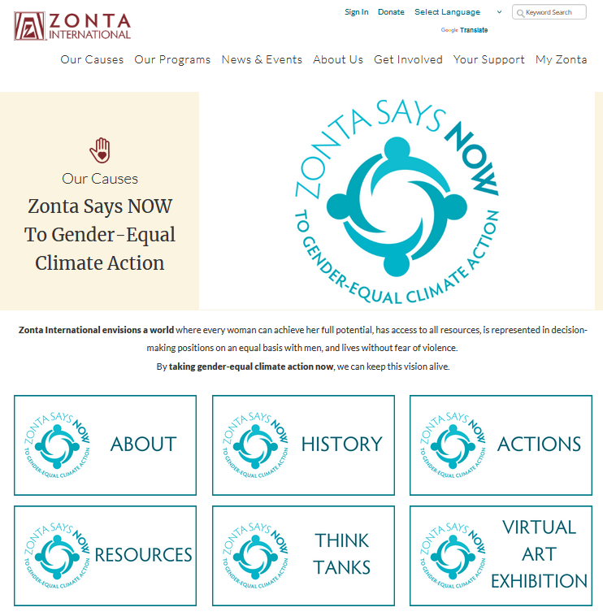
Zonta.org web page
Key information and resources
https://www.zonta.org/Web/Causes/ZontaSaysNOW_home
Notes:
ZI has elevated Zonta Says NOW to Gender-Equal Climate Action at the international level through the Zonta Says NOW Working Group and added to the ZI website has added a Zonta Says NOW section, including the Fact Sheet, intercontinental think tank presentations, references, how we got here, and in the future, sharing art as another means of communication

Slide 28
Resources Mentors Guidance Activities
Zonta USA Caucus https://zontausa.org/zonta-says-now-to-climate-action/
Website, Think Tank presentations, 16 Days of Advocacy, Fast Action Friday
D23 ZontaSaysNow http://ZontaSaysNOW.org.au
Comprehensive website featuring actions aligned with the Zonta Says NOW framework and links to books, videos, and podcasts; D23 leaflets, bi-monthly newsletters, videos of Think Tank meetings, and videos of guest speakers
District 8 – Website, climate pledge, presentations, climate committee
District 12 – Website, e-Resource library, Live Book Discussions, educational materials, climate committee
Notes:
Also online are great resources from the USA Caucus and District 23 …….includes a climate website, think tank presentations, opportunities for advocacy. Also District 8 and 12 have lots of great resources for more information, presentations, and ideas

Slide 29
Earth Day -- April 22
What can you do? A little bit of everything to reduce emissions
Educate yourself about climate change, plastics, energy sources
Reduce plastics in your life, especially single-use plastics
Replace your lightbulbs with LEDs
Improve the insulation of your home and office for both heating and cooling
Plant trees and native vegetation
Look into installing solar panels or heat pump for your own home
Petition your community to switch to LED street lights or add solar panels on municipal buildings
Talk with your elected officials to find a clearer path to net-zero
Talk with others in your community to engage more to take action and make a difference
More ideas at www.earthday.org

Slide 30
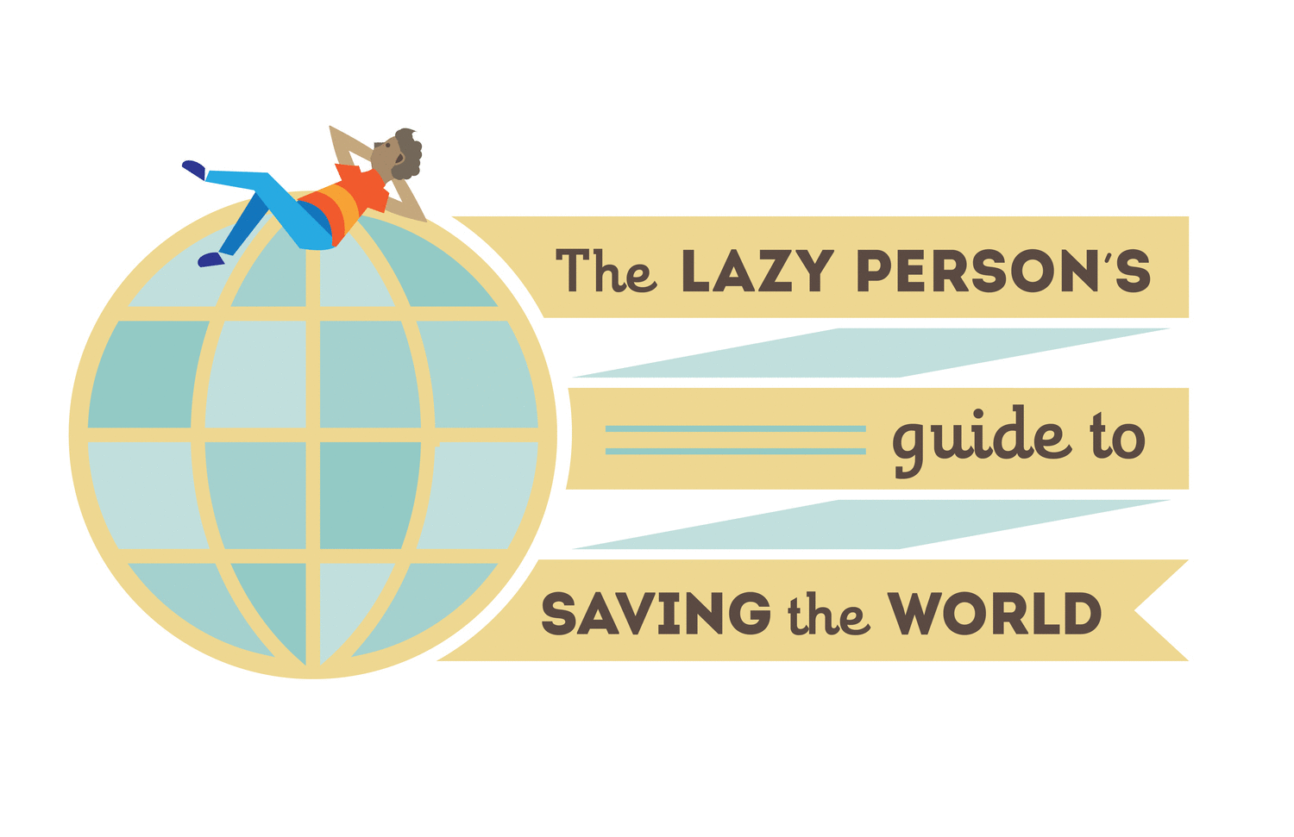
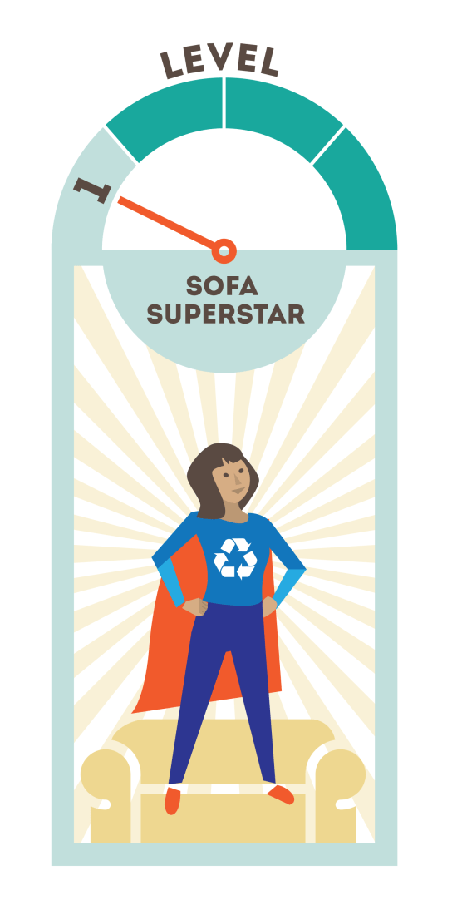
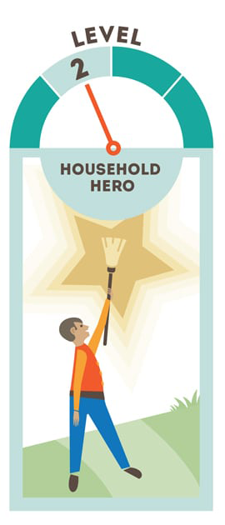
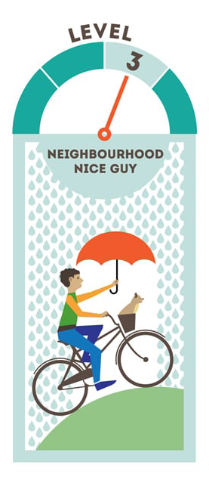
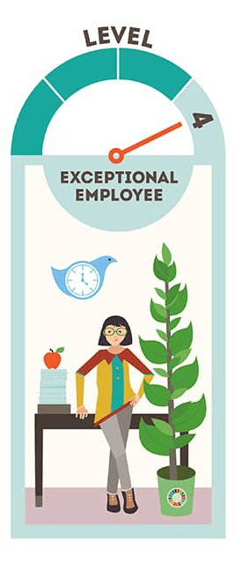
www.un.org/sustainabledevelopment/takeaction/
Notes:
Another great source of ideas of what we as individuals can do can be found on the UN’s Sustainable Development Goals page. Every small step makes a difference

Slide 31
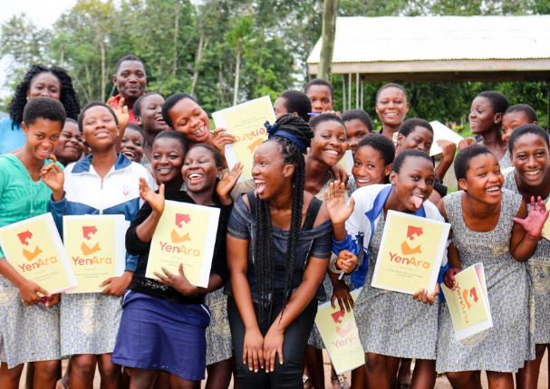
Climate Change is a Gender Equality Issue
Climate Change is an issue of human rights
Climate Change has a detrimental effect on health and safety
Women’s involvement is needed
Girls’ Education is Key
Equal Economic Opportunities are needed
Listen to the voices of the next generations
Notes:
A synopsis of key take-home points -

Slide 32
Never doubt that a small group of thoughtful, committed, citizens can change the world. Indeed, it is the only thing that ever has.
Margaret Mead
Questions?
Comments?

