Slide 1
United Nations & Zonta: Making a Global Impact
Marie Stodolka
Zonta Club Minneapolis St. Paul Area

Slide 2
Agenda
United Nations (UN) Trivia
Zonta & The United Nations – More Trivia!
Getting Involved
Questions/Discussion

Slide 3
Trivia – How well do you know the UN?
1. The United Nations was officially established in which year?
1918
1945
1962
1991

Slide 4
Trivia – How well do you know the UN?
2. How many countries were represented at the first session of the United Nations General Assembly?
15
24
38
51

Slide 5
Trivia – How well do you know the UN?
3. What is the name of the document which sets out the main objectives of the UN and the rights and obligations of each member state?
The United Nations Treaty
The United Nations Charter
The United Nations Rulebook
The United Nations Agreement

Slide 6
Trivia – How well do you know the UN?
4. How many member states make up the United Nations today?
86
122
193
217

Slide 7
Trivia – How well do you know the UN?
5. Which institution of the UN is like a parliament of nations which meets to consider the world's most pressing problems?
Security Council
General Assembly
The Secretariat
The Economic and Social Council

Slide 8
Trivia – How well do you know the UN?
6. The United Nations has its headquarters in New York City. It also has three main offices in other cities in the world. They are:
Geneva, Vienna, and Nairobi
Geneva, Paris, and Kenya
Geneva, Stockholm, and Johannesburg
Geneva, The Hague, and Sarajevo

Slide 9
Trivia – How well do you know the UN?
7. How many official languages does the United Nations have?
5
7
6
8

Slide 10
Answers

Slide 11
Trivia – How well do you know the UN?
1. The United Nations was officially established in which year?
1918
1945
1962
1991

Slide 12
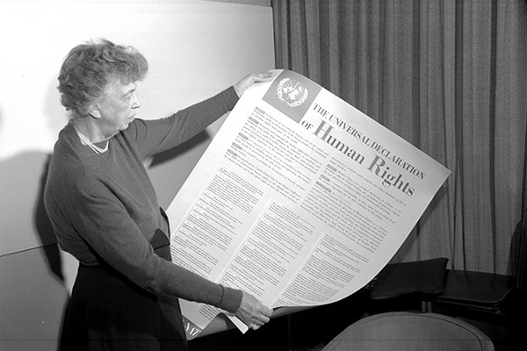
Trivia – How well do you know the UN?
The United Nations emerged from the United Nations Conference on International Organization, which took place in San Francisco from April to June 1945, near the end of World War II.

Slide 13
Trivia – How well do you know the UN?
2. How many countries were represented at the first session of the United Nations General Assembly?
15
24
38
51

Slide 14
Trivia – How well do you know the UN?
3. What is the name of the document which sets out the main objectives of the UN and the rights and obligations of each member state?
The United Nations Treaty
The United Nations Charter
The United Nations Rulebook
The United Nations Agreement

Slide 15
Trivia – How well do you know the UN?
4. How many member states make up the United Nations today?
86
122
193
217

Slide 16
Trivia – How well do you know the UN?
5. Which institution of the UN is like a parliament of nations which meets to consider the world's most pressing problems?
Security Council
General Assembly
The Secretariat
The Economic and Social Council

Slide 17
Trivia – How well do you know the UN?
Security Council
Deals with keeping peace throughout the world, trying to settle disputes peacefully, or using military measures if necessary
The Secretariat
Carries out the day-to-day running of the UN
The Economic and Social Council
Coordinates the work of the specialized agencies, like UNICEF

Slide 18
Trivia – How well do you know the UN?
6. The United Nations has its headquarters in New York City. It also has three main offices in other cities in the world. They are:
Geneva, Vienna, and Nairobi
Geneva, Paris, and Kenya
Geneva, Stockholm, and Johannesburg
Geneva, The Hague, and Sarajevo

Slide 19
Quiz – How well do you know the UN?
7. How many official languages does the United Nations have?
5
7
6
8
The United Nations has six official languages. These languages are Arabic, Chinese, English, French, Russian, and Spanish.

Slide 20
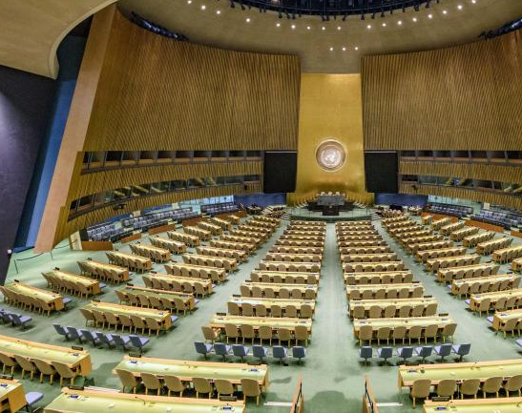
Zonta & The United Nations

Slide 21
Zonta & The United Nations?
In 2012 the United Nations developed the 17 Sustainable Development Goals. Which Goal does Zonta primarily focus on?
5
7
10
12

Slide 22
Sustainable Development Goals
The 17 Sustainable Development Goals (SDGs) address key challenges such as poverty, inequality and violence against women. These goals guide world leaders and the global community as we work together to realize the human rights of all people.

Slide 23
SDG No. 5
No. 5: Achieve gender equality and empower all women and girls.
Sustainable Development Goal No. 5 Targets
End all forms of discrimination against all women and girls everywhere
Eliminate all forms of violence against all women and girls in the public and private spheres, including trafficking and sexual and other types of exploitation
Eliminate all harmful practices, such as child, early and forced marriage and female genital mutilation
Full List of Goal No. 5 Targets

Slide 24
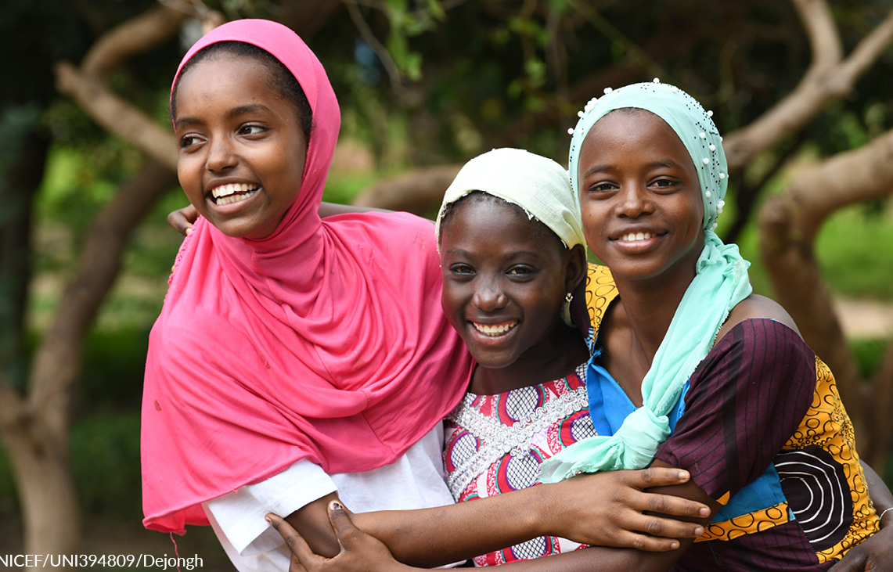
Supporting SDG No. 5
Engaging Girls on Climate Change in Madagascar
Ending Child Marriage
Adolescent Girls’ Health and Protection in Peru
Her Health and Dignity, Our Priority

Slide 25
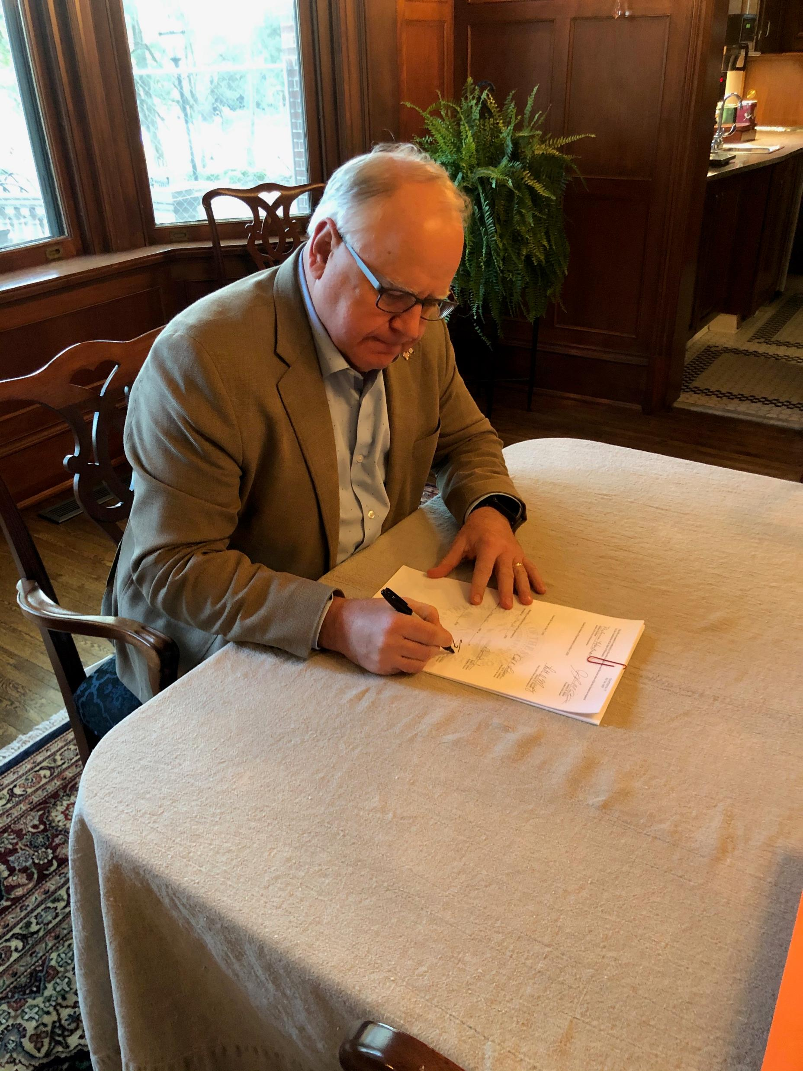
Supporting SDG No. 5
Governor Tim Walz of Minnesota signing the Marriage Bill eliminating marriage for anyone under 18 years of age – no exceptions!

Slide 26
Zonta & The United Nations?
In 1969, the United Nations granted Zonta International the highest level of status for a non-government organization. That status is call?
Consultative Status
Referring Consultative Status
General Consultative Status
Civil Society Consultative Status

Slide 27
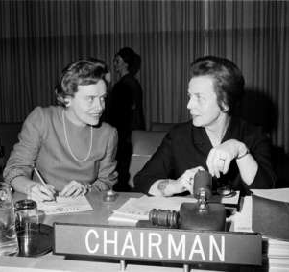
General Consultative Status
Of the 6000+ non-governmental organizations (NGOs) with consultative status at the United Nations, only 141 have General Consultative Status, the highest status an NGO can have at the UN
Zonta International was granted General Consultative Status in 1969
Zonta Past International President Helvi Sipilä (1968- 1970), the first woman Assistant Secretary-General of the UN (1972-1980), served as Secretary General for the First World Conference on Women 1975 in Mexico

Slide 28
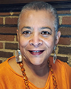
General Consultative Status
The Zonta International UN Committee teams represent Zonta in New York at the UN Headquarters and its offices in Geneva, Vienna, Paris, Nairobi, and Bangkok
The Committee team ensures Zonta’s priorities are presented and that the Zonta voice is heard in mission-related meetings
Zonta works with decision-makers from UN agencies and countries where Zonta has funded projects and/or where Zonta clubs reside
Zonta is invited each year to the Commission on the Status of Women (CSW)
Pamela Morgan
Chair, Zonta International UN Committee

Slide 29
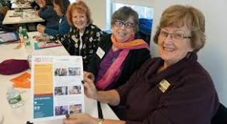
United Nations Commission on the Status of Women (CSW)
The Commission on the Status of Women (CSW) is held annually at the New York headquarters and centers around a priority and review theme

Slide 30
United Nations Commission on the Status of Women (CSW)
During the Commission’s annual two-week session, representatives of UN Member States, civil society organizations (Zonta) and UN entities gather at UN headquarters in New York.
They discuss progress and gaps in gender equality, as well as emerging issues that affect gender equality and the empowerment of women
Member States agree on further actions to accelerate progress and promote women’s rights
The outcomes and recommendations of each session are forwarded to the Economic and Social Council for follow-up

Slide 31
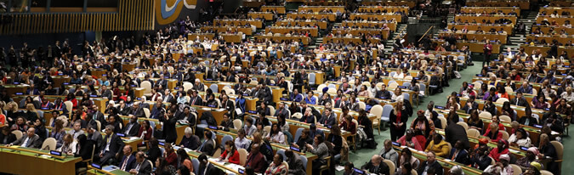
United Nations Commission on the Status of Women (CSW68)
The sixty-eighth session of the Commission on the Status of Women will take place from March 11 to 22, 2024.
Priority theme: Accelerating the achievement of gender equality and the empowerment of all women and girls by addressing poverty and strengthening institutions and financing with a gender perspective

Slide 32
Zonta & The United Nations?
Can anyone attend the Commission on the Status of Women?
Yes*
No

Slide 33
United Nations Commission on the Status of Women (CSW68)

Slide 34
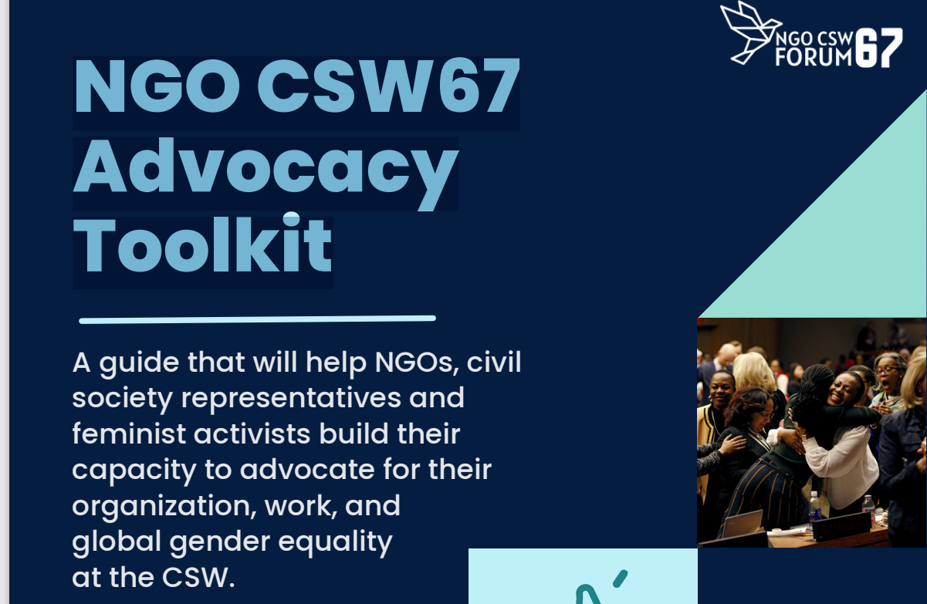
United Nations Commission on the Status of Women (CSW68)
NGO CSW67 Advocacy Toolkit

Slide 35
Questions/Discussion

