Slide 1
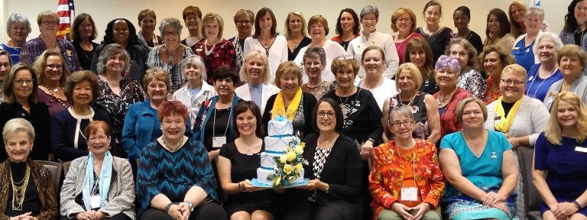
Membership
Jane Austin
D7 Lt Governor

Slide 2
Current Membership in District 7
May 31, 2023
If each of our 16 clubs increases membership by just 2 more members by May 2024:
409
If we are successful in creating three new clubs this biennium:
+45 new members!
Let’s go for 450
by the end of this biennium!

Slide 3
Who & Where We Are in District 7
May 31, 2023
Interested individuals who like what we do but don’t quite have the time but, or are stepping away?
Encourage them to be a
Supporting Member!

Slide 4
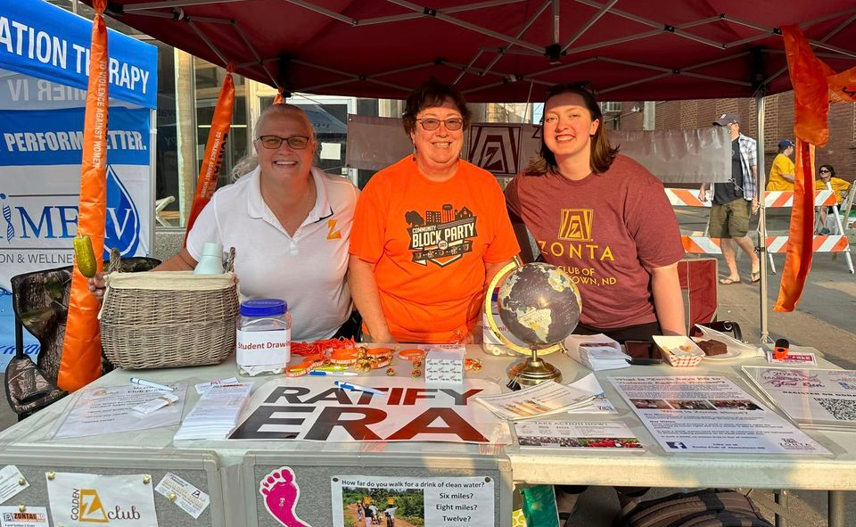
Members are key to doing –
Supporting International service projects with funds
Supporting local service projects – hands-on and funds
Raising our voice for advocacy
Not just about bringing in new members but
keeping our members!
New Member Video and online training (available monthly)
Orientation – not only for new members
Our mission
What we do
How ZI – District – Area – Clubs are organized and function
The Zonta Why
Recognize and celebrate your members!

Slide 5
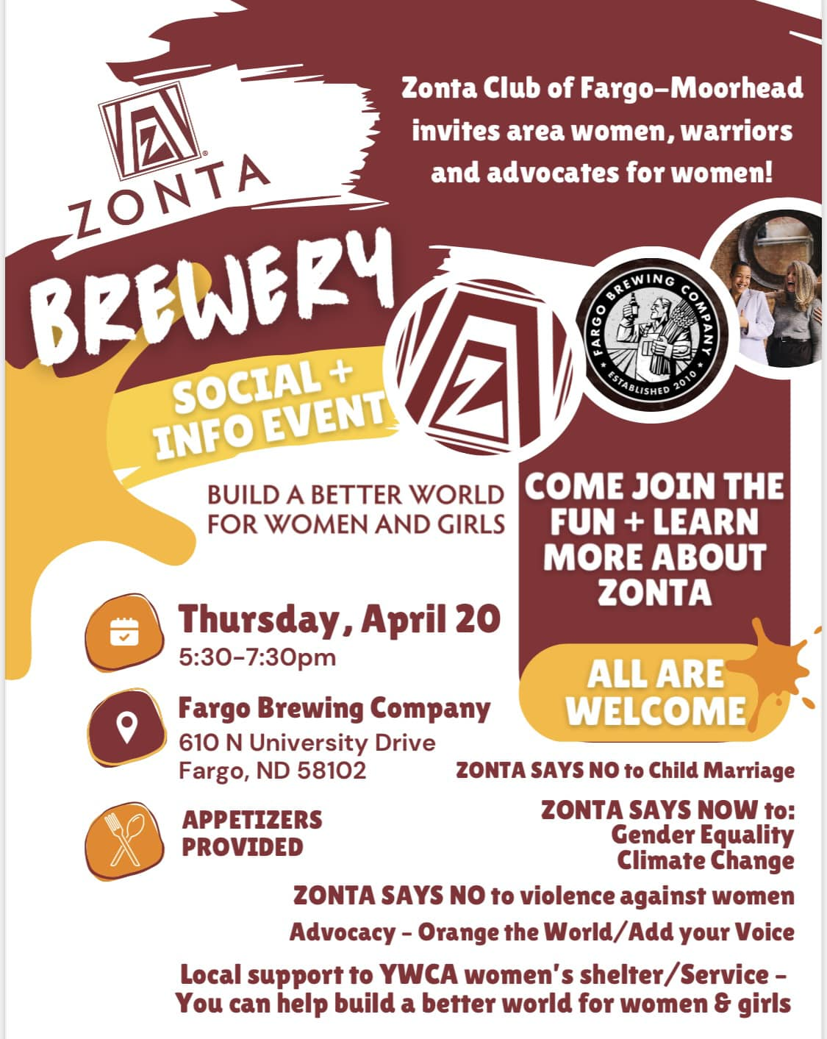
District 7 Membership Plan
Grants for activities to build membership: Funds still available!
Information and forms online at
www.zontadistrict7.org >> Resources
What clubs are doing with grants:
KCII: Membership Lunch at Strawberry Hill Museum
Mankato: Service/Membership, Kits for Women in
Safe Haven, April 17
Fargo: Membership event at the Fargo Brewery, April 20
Minneapolis: Membership “English tea”, April 25
Breckenridge-Wahpeton: Banner for “Headwaters Day” Parade Float, September 9
Club Creation: Table at Women of Iowa conference, Des Moines, Oct 18

Slide 6
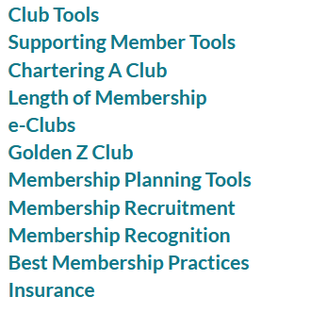
Resources Online:
https://www.zonta.org/Web/My_Zonta/Tools/Membership_Tools_Home
Leadership Development Tools: Core Competency Program and Leadership Program
https://www.zonta.org/Web/My_Zonta/Tools/Leadership%20Development%20Tools%20Home

Slide 7
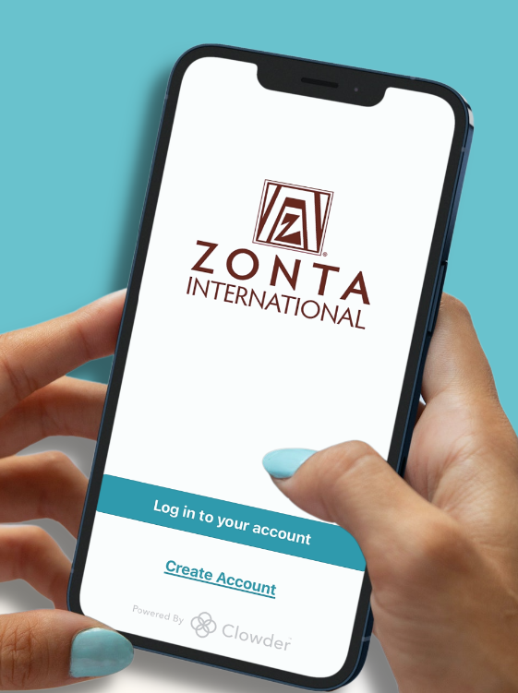
Connect with the Zonta Mobile App
News feed with the latest updates from ZI
Calendar of Zonta events
Discussion forums tailored to your Zonta role and special interests
Easy access to essential member resources
A member directory with instant private and group chats

Slide 8
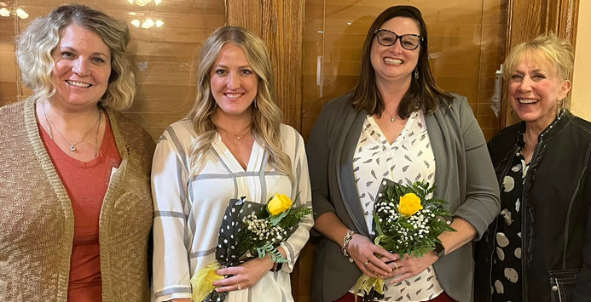
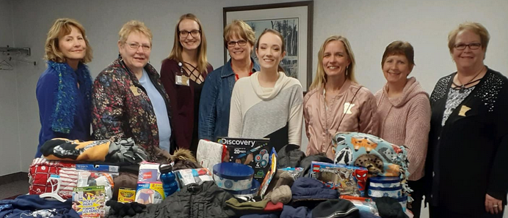
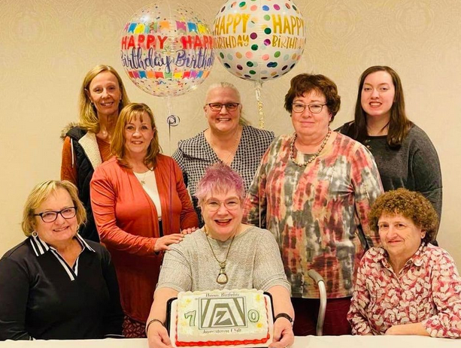
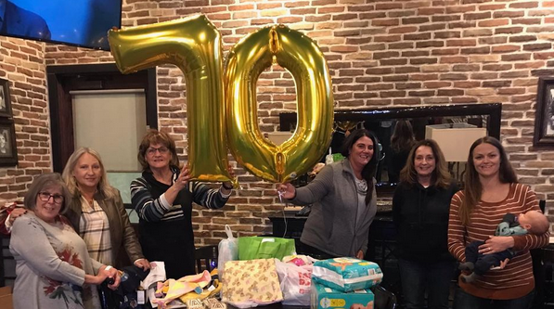
Questions?

Slide 9
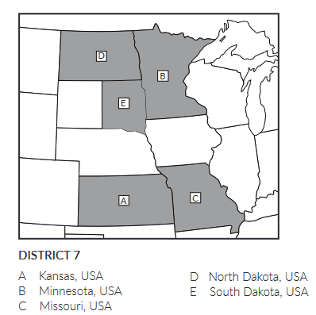
Club Creation
Gayle Borchert - District Club Creator
Team: Jane Austin, Sue Dege, Sue Keirstad, Deb Kellerman, Shelley Schultz
Starting new clubs:
Des Moines, Iowa
Lincoln, Nebraska
Springfield, Missouri
D12
D6

Slide 10
Basic steps to creating and chartering a new club:
Request ZI approval for new club and name, new club logo
Develop contact list for potential members, community leaders
Plan and invite to informational events
Zoom meeting(s)
In-person events
Follow up with interested individuals
Create club social media accounts and basic website
Hold organizational event
Celebrate new club charter!
Mentoring by nearby clubs will help put the new club on their feet
We would love your help!!

