Slide 1


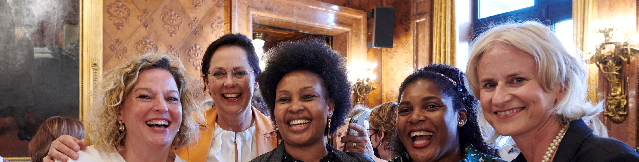
^{Zonta, Gender Equity, and}
^{a Vision for 2030 & Beyond}
Strategic Plan Goals and Strategies 2023–2030

Slide 2
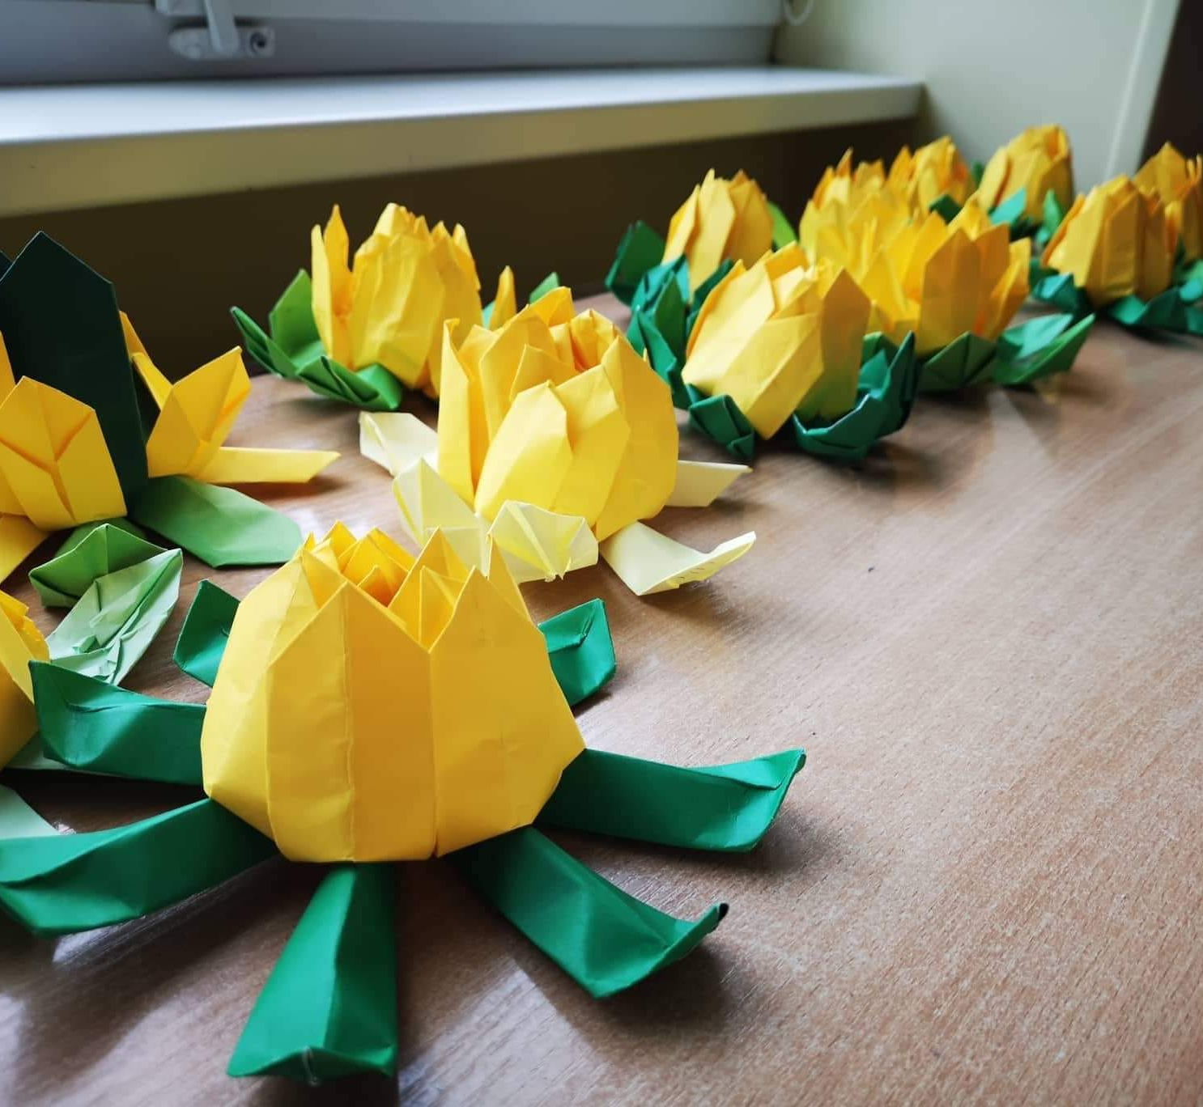

Develop a new strategic plan to meet the needs of Zontians while opening new pathways
for other gender equity advocates who care about our causes to engage with Zonta.
The plan will be developed in year one of the biennium and shared with all members.
THE
OBJECTIVE

Slide 3
Zonta must expand its credibility
and visibility in the world on key advocacy issues.
For Zonta to be successful, there must be faith in the clubs and members must enjoy a healthy club life.
Zonta must seek out new members, allies and partners who are like-minded in the drive to build a better world for women and girls.
KEY
PRINCIPLES

Slide 4
At the core, Zonta will not change and will remain a place where globally minded individuals connect, collaborate and demand change to build a better world for women and girls.
But we must remain relevant for the future and open to change to continue as a sustainable and strong community of individuals working together to fight for gender equity.
KEY
PRINCIPLES

Slide 5

Update to Mission
Zonta International is a leading global organization of individuals working together to build a better world for women and girls.

Slide 6
2023-2030: Our Mission & goals
Mission: Zonta International is a leading global organization of individuals working together to build a better world for women and girls.
Goal 1: Credible and Visible Voice
Zonta acts as a credible and visible voice on gender equity and delivers initiatives addressing
education equality, climate justice, ending gender-based violence, and ensuring women are
represented in decision-making positions on an equal basis with men.
READINESS FOR THE FUTURE WILL REQUIRE…
Goal 2: Club Success
Clubs serve as a welcoming and inspiring environment to those who wish to work to empower women and girls and create information and resources necessary to focus on the most important issues facing women and girls.
Goal 3: International Leadership
& Sustainability
Zonta manages its resources, including both time and money, to meet the vision and ensure the organization’s long-term viability and success. Zonta modernizes its governance structure to align with its strategic plan, ensure innovative thought and allow for effective decision-making.
Goal 4: Engagement of Audiences & Alliances
Zonta creates customized pathways to connect to Zonta, develops collaborations with like- minded organizations,
and expands revenue streams to further our mission and extend our voice.

Slide 7







EQUITY
EQUALITY
Resources given based on needs
Everyone gets the same resources
Situation focuses on everything being fair,
in regards of current status
Situation focuses on everything being the same, regardless of current status
Outcome is equal
Outcome is not equal
www.zonta.org

Slide 8
2023-2030: Our goals
1
Credible and Visible Voice
Zonta acts as a credible and visible voice on gender equity and delivers initiatives addressing education equality, climate justice, ending gender-based violence, and ensuring women are represented in decision-making positions on an equal basis with men.
1
Credible and
Visible Voice
2
Club
Success
3
International Leadership
& Sustainability
4
Engagement of
Audiences and Alliances

Slide 9
FOUR KEY ISSUES
1. Education equality
2. Climate Justice
3. Gender-based violence
4. Women in decision-making positions

Slide 10
2023-2030: Our goals
2
Club Success
Clubs serve as a welcoming and inspiring environment to those who wish to work to empower women and girls and create information and resources necessary to focus on the most important issues facing women and girls.
1
Credible and
Visible Voice
2
Club
Success
3
International Leadership
& Sustainability
4
Engagement of
Audiences and Alliances

Slide 11
2023-2030: Our goals
3
International Leadership & Success
Zonta manages its resources, including both time and money, to meet the vision and ensure the organization’s long-term viability and success. Zonta modernizes its governance structure to align with its strategic plan, ensure innovative thought and allow for effective decision-making.
1
Credible and
Visible Voice
2
Club
Success
3
International Leadership
& Sustainability
4
Engagement of
Audiences and Alliances

Slide 12
2023-2030: Our goals
4
Engagement of Audiences and Alliances
Zonta creates customized pathways to connect to Zonta, develops collaborations with like-minded organizations, and expands revenue streams to further our mission and extend our voice.
1
2
Club Success
3
4
Engagement of
Audiences and Alliances
Credible and
Visible Voice
International Leadership
& Sustainability

Slide 13

The timeline
February
March
April
May
June
July
August
September
October
November
The Board meetings to finalize strategic plan.
Prepare the strategic plan for publication.
Publication of the strategic plan.
Informational presentations
at the interdistrict meetings
April to June 2023.
Member webinars on final strategic plan July – September 2023.
Zonta International Board representatives deliver presentations at district conferences.
Potential Zonta International Bylaws possible
amendments investigated June – November 2023.

Slide 14
We need your support!
All Zontians have a role to play and are key to the success of this plan.
Strategies will be aligned at international, district and club levels.
Resources will be developed for districts and clubs to support alignment.

Slide 15
Q&A

Slide 16
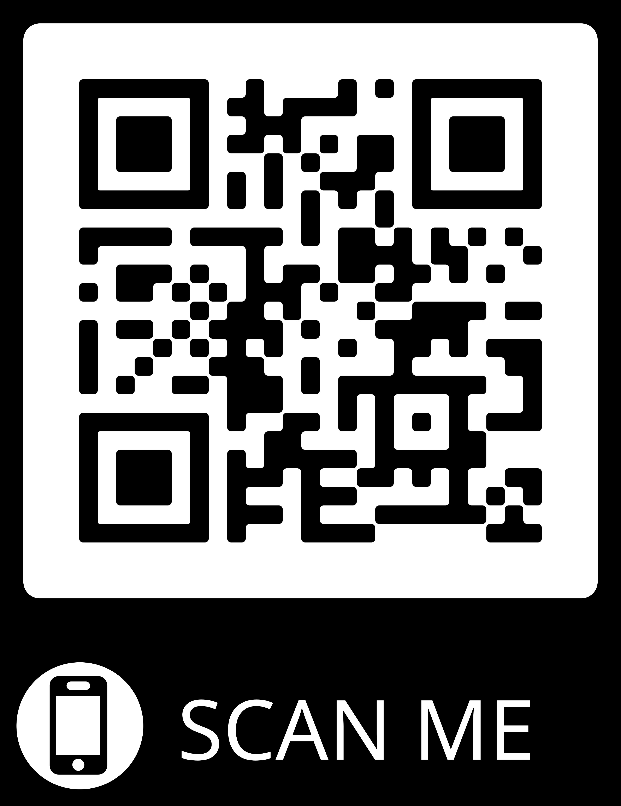
Find more information and follow the process at www.zonta.org/StrategicPlan.
FOLLOW
ALONG

