Slide 1
Zonta USA Caucus 2018-2024
Update! Who we are and what we do!
Dr. Penny Briese, with permission from Bobbee Cardillo, Zonta USA convener
Zonta USA Caucus
September, 2023
pbriese@uj.edu

Slide 2
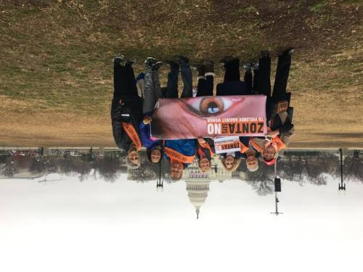
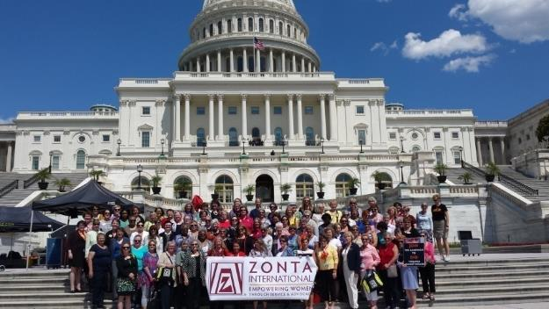
-- 2017 Women’s March; CSW, NAIDM Virginia -- Founded by ZI Board Feb 2018; under auspices of ZI Advocacy Committee -- 2018 Established Committees
HISTORY

Slide 3
Goals
Encourage development, consideration and passage of appropriate legislation by
the US Congress, its members and committees and
by state legislatures.
Take action in support of, or in opposition to, proposed or enacted legislation and executive orders and regulations that directly or indirectly impact the lives of women and girls.
Promote women’s representation in decision-making positions on an equal basis with men.

Slide 4
How do we operate?
Under auspices of ZI Advocacy Committee, non-voting Convener appointed to lead Caucus
13 Governors with US clubs appoint a Delegate and Alternate to represent them
Governors “Always welcome; never expected”
Meet Monthly
Work done by Committees and through Coalitions
Every Delegate and Alternate must participate in one committee
1 Vote per District:
for business decisions—Majority
or public-facing Statements, Testimony, etc-- 100% Districts

Slide 5
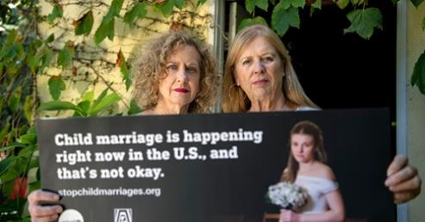
2018-19
Joined
US Women’s Caucus at UN
ERA (Equal Rights Amendment) Coalition
Coalition on Child Marriage
National Steering Committee Member

Slide 6
2018-19 Continued….
Established website:www.zontausa.org
Created USA Advocacy Action Center
on ZI website
Took action on Title IX – petition
Letters on VAWA renewal legislation
Sponsored Virginia ERA bus
Logo and screen backgrounds

Slide 7
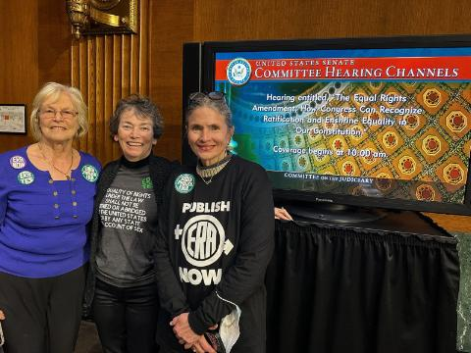
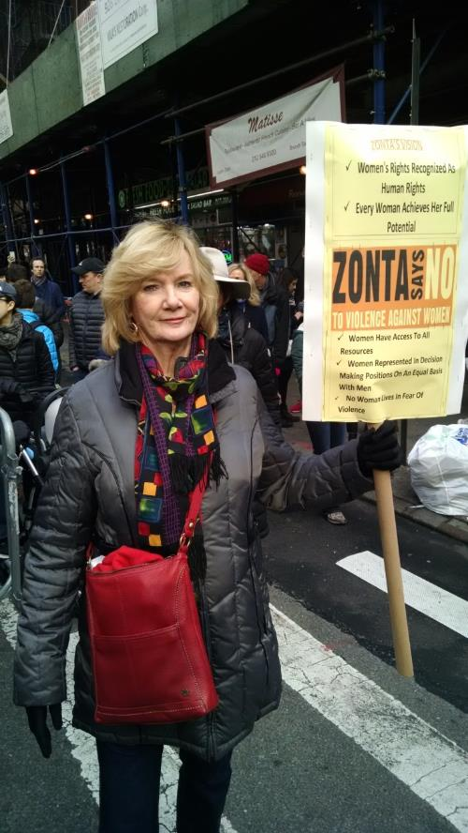
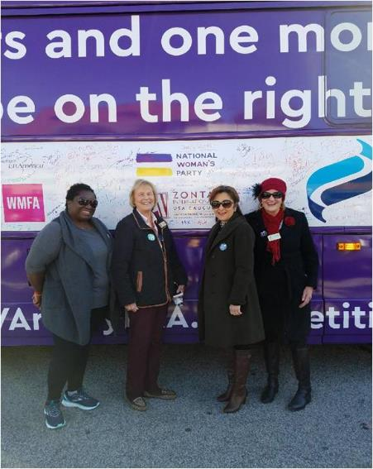
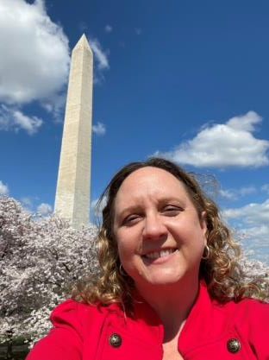

Slide 8
2020-2022
Created Partisan/Non-Partisan video

Slide 9
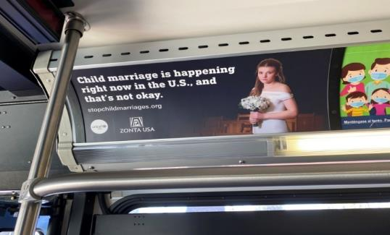
Child Marriage Billboard and Awareness Campaign
Billboards today in Lansing MI
Joined Amicus Brief supporting the ERA
Zonta Says NOW USA Think Tanks inMarch & May on topic of Water
6 Statements issued
Adopted Rules of Procedure
Service and Advocacy Project ideas on website
Templates of social media posts on VAW

Slide 10
Fast Action Friday Alerts
Why important: Membership
Competing US NGOs use quick action buttons for advocacy: AAUW, Planned Parenthood, LWV, National Fed Bus and Prof Women, Unicef USA
Impact since 1/22
55 bills supported
20,000 emails sent to officials
335 Zontians taking personal action EVERY mo
Legislation Passes
Members feel empowered to Make a Better World for Women and Girls!

Slide 11
Zonta USA Caucus 2022-2023
See your handout! So many things!
Looking for outside committee members!
You can be a part of the bigger picture!

Slide 12
JOIN Zonta Says NOW USA Think Tank

Slide 13
Child Marriage Action
Michigan Rally
In Statehouse

Slide 14
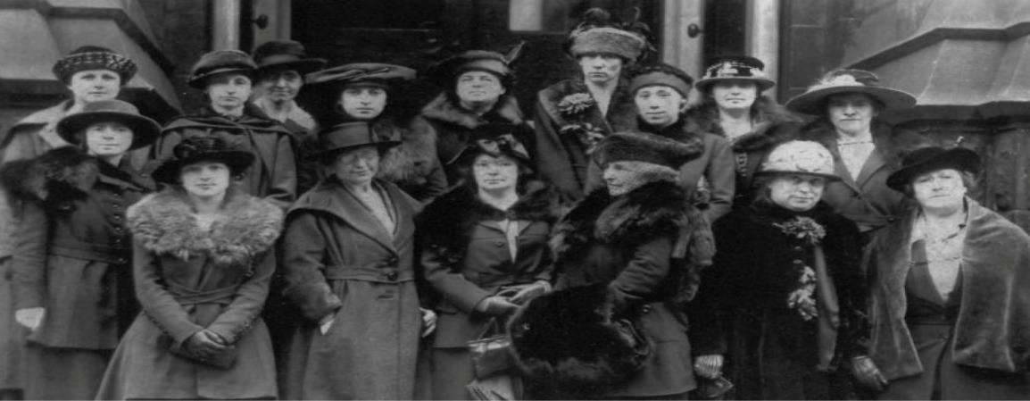
Goals for 2023-24
Committees ?
Speakers ?
Complete work in progress
Other ?

Slide 15
Zonta USA Caucus
Q & A ….
11/9/23
D7 Conference
St. Cloud, MN

