Slide 1
Area Meeting 2024
WELCOME

Slide 2
Governor’s Report
Tania Hughes-Kremers
District 7 Area Meetings: April 2024

Slide 3
Welcome to Area Meeting!
MISSION
Zonta International is a leading global organization of individuals working together to build a better world for women and girls.
VISION
Zonta International envisions a world in which women's rights are recognized as human rights and every woman is able to achieve her full potential.
In such a world, women have access to all resources and are represented in decision-making positions on an equal basis with men.
In such a world, no woman lives in fear of violence.

Slide 4
Let’s talk about leadership
Women continue to be underrepresented at all levels of political leadership:
As of 1 November 2023, women’s representation in national Parliaments ranged from 0 to 61.3%, with the average standing at 26.7%.
As of October 3, 2023, there are 25 women U.S. Senators
As of November 28, 2023, there are 126 women in the U.S. House of Representatives making women 29% of the total.

Slide 5
Women’s Leadership Dilemma
Women, unlike men, are rarely perceived to be both likeable and competent.
Leadership qualities such as assertiveness and decisiveness, go against societal norms of what it is to be a likable woman.
Female leaders are judged more harshly, even when they outperform their male counterparts.
Robin Hauser, TED Talk 2019

Slide 6
Focus on being awesome!
“Be a smart, compassionate, effective leader that will redefine the stereotype of what a female leader is.” – Robin Hauser
Today we will:
Discover our personal leadership strengths – be the best me
Hear from women leaders in Zonta and our communities
Focus on the unique contributions that we each bring to the table

Slide 7
District 7 Dashboard
379 Active Members
16 Clubs in 4 States
1 club decrease
2 clubs in formation
Des Moines, Iowa
Lincoln, Nebraska
Biennium Budget Highlights
$8,448 in profit (from 2021 & 2023 Conferences and in-kind donations)
$90,955 total cash in bank as of January 31, 2024
18 Young Professionals
360 Standard Members
1 Past Int’l President
Ended 2020-2022 Biennium at 380

Slide 8
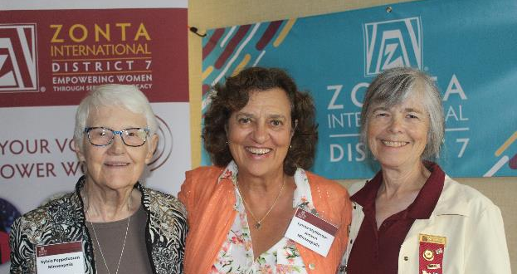
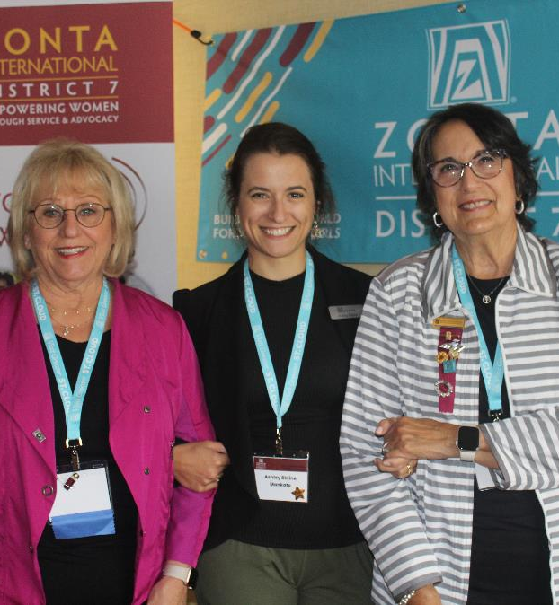
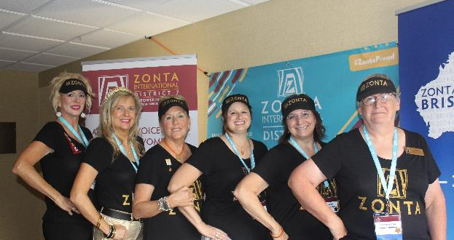
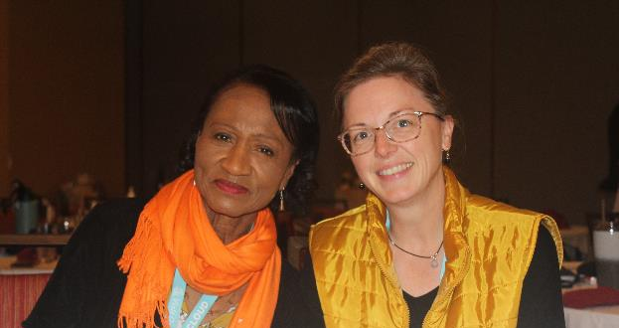
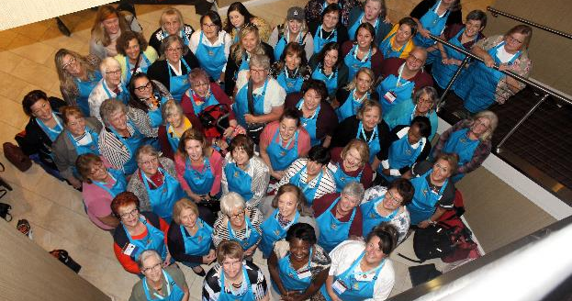
2023 Conference

Slide 9
2023 Conference
Zonta International President, Ute Schultz
Theme: Zonta Proud
Host Club: St. Cloud, MN
Attendees: 52 from 9 Clubs
Farthest Travelled Award: Cape Girardeau
Funds Raised For Zonta Foundation for Women: $7,500
Highlights: Pub Crawl, BBQ/Distillery/Trivia Night, AE Fellow Speaker, University President Speaker, workshops, and more!

Slide 10
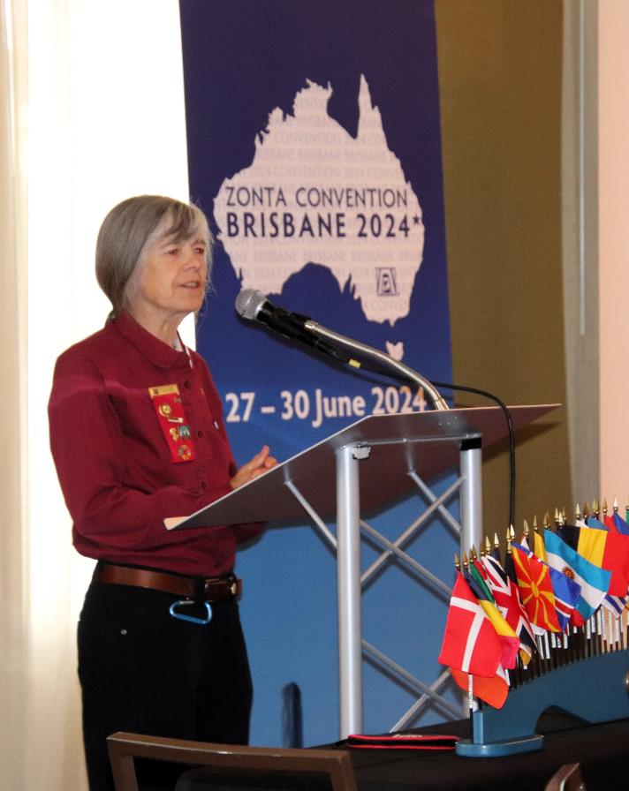
2024-2026 District Leadership
Governor: Jane Austin, Minneapolis/St. Paul
Lt. Governor: Penny Briese, Jamestown
Treasurer: Peggy Jensen, Jefferson City
Area 1 Director: Nancy Pranke, Jamestown
Area 2 Director: Ruthi Sturdevant, Jefferson City
Area 3 Director: Debra Kellerman, St. Cloud
Area 4 Director: Marcia Charney, Johnson County
Nominating Committee: Gayle Borchert (Chair),
Jackie Forck, Mary Reed

Slide 11
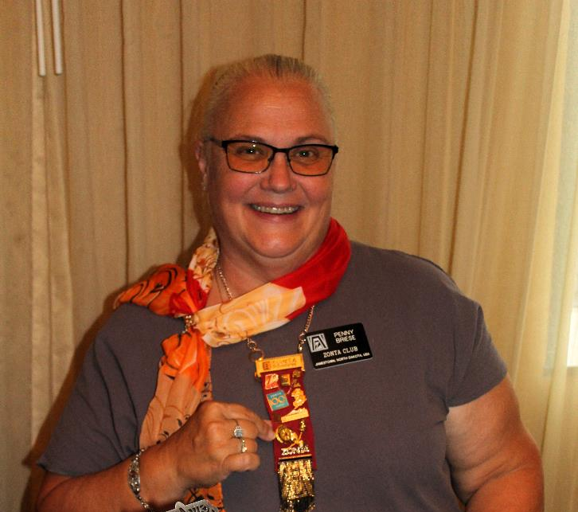
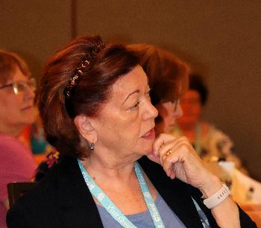
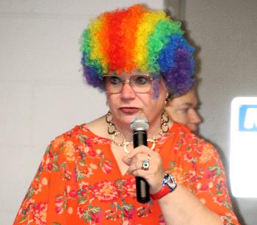
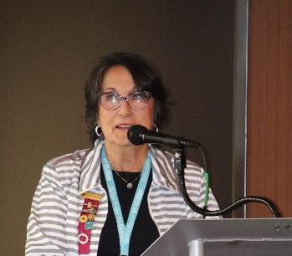
2023 Conference

Slide 12
Brisbane Convention
June 27-30
2024 Club Mailing Now Available!
Delegate and Proxy form completion is ONLINE ONLY and due by May 15th at midnight Central Time.
Delegates must be registered to participate in person at the 2024 Zonta International Convention.
Information can by found on My Zonta at:
Convention Business (zonta.org)
2024ClubMailing (zonta.org)
D7 Convention Delegate/Attendee Meeting – Thursday, June 27, at 7:30 am. Location pending.
D7 Group Photo: time will be assigned by the ZI home office and shared as soon as available.

Slide 13
QUESTIONS?
Contact Governor Tania
Tania Hughes-Kremers
Find me on the Zonta App!
Call or text: 612-845-8737
Email: taniahughes@yahoo.com

