Slide 1
Area Meeting 2025
WELCOME!

Slide 2
Governor’s Report
Jane Austin
District 7 Area Meetings: April 2025
Notes:
Welcome: -- Today we will:
Give some district highlights – our board, educational awards…..
Advocacy refresher, in these tumultuous times
Explore women’s mental health and well being
Empower us with knowledge for financial resilience
Hear from women leaders in Zonta and our communities
Explore our Core Values – what unites us in Zonta
Share our Zonta stories
Have Fun with a Purpose

Slide 3
Welcome to our Area Meeting!
MISSION
Zonta International is a leading global organization of individuals working together to build a better world for women and girls.
VISION
Zonta International envisions a world in which women's rights are recognized as human rights and every woman is able to achieve her full potential.
In such a world, women have access to all resources and are represented in decision-making positions on an equal basis with men.
In such a world, no woman lives in fear of violence.

Slide 4
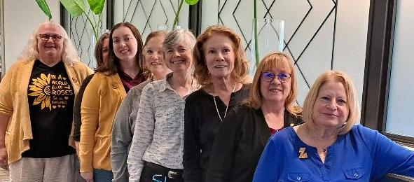
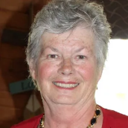
2024-2026 District Leaders
Penny Briese, Sue Dege, Jaime Czapiewski, Tania Hughes, Jane Austin,
Ruthi Sturdevant, Nancy Pranke, Marcia Charney, and Deb Kellerman

Slide 5
What’s happening at district level:
Sharing information from ZI and USA Caucus
Connecting with club presidents and ZI Liaison Sandy Venn Brown
District education awards
Membership development funds to clubs
District-wide webinar on Brisbane (August)
District webpage redesign underway – check us out! → Zontadistrict7.org
Connecting across clubs via area meetings and Fall Conference
Club creation
Managing district budget to make this all work

Slide 6
District budget
Biennium budget based on 400 members, approve at 2023 fall conference
Dues per member: $26.50 + 3.50 for fall conference
What your funds support:
District website
Virtual platform (district Zoom)
Membership development grants
Club creation
District board meeting
Expenses for governor, Lt. governor, and area directors
Fall conference
Annual financial compilation, theft insurance, misc supplies

Slide 7
Recognizing emerging women leaders
Young Women in Leadership (annual, district submission deadline April 1)
Women in Business Leadership acknowledges and celebrates women who demonstrate exceptional leadership, entrepreneurial spirit, ethical conduct and make significant contributions to their respective industries while addressing global or local issues affecting women and girls or climate justice. (Sep 15, 2025)
Amelia Earhart Award (Nov 15, 2025)
Zonta Women in STEM Award uplifts innovation and celebrates the remarkable accomplishments of women between 18-35 years of age in science, technology, engineering and mathematics (STEM) fields and acknowledge their groundbreaking research, pioneering discoveries, and/or exemplary contributions to advancing knowledge and innovation in a STEM field. By recognizing and supporting these exceptional women, Zonta aims to inspire future generations and foster inclusivity and diversity in the world of STEM. (Dec 15, 2025)

Slide 8
Other ways to promote education equality and opportunities
COMMUNITY ENGAGEMENT:
Partner with community groups on issues like poverty, housing, health care to address educational access.
PROMOTE LITERACY PROGRAMS WITH LOCAL SERVICE ACTIONS:
Host book drives, reading clubs, family literacy events, and your local library to encourage early reading skills and literacy.
EDUCATIONAL AWARDS:
Support ZI educational awards and international service projects. Provide vital financial assistance via club awards, including awards to support GEDs, CAN, and similar opportunities for educational and vocational advancement
ADVOCATE:
Advocate for policies and programs that support equitable funding for schools, access to quality early childhood education, and programs addressing learning gaps.

Slide 9
Advocacy – Raise our Voices!
Advocacy is the expression of support for, or opposition to, a cause, argument or proposal.
Advocacy actions may include influencing laws, legislation, or attitudes.
Zonta advocacy is taking action in the public interest or for the greater good with respect to advancing the status women and girls and their human rights, --- the principles and public issues having a bearing on the objectives of Zonta International.

Slide 10
Political vs Partisan

Slide 11
https://zontausa.org

Slide 12
Don’t keep Zonta a secret -- Share your Stories!
Online:
Club social media
D7 website
FB - Zonta USA Share Brags and Brilliance
Zonta’s “Share Your Story” -- https://www.zonta.org/ShareYourStory
Press releases and photos to local newspapers
Tell us about your action!
Who was at your event?
What did you do?
Where and when was this held?
Explain why this action is important to advance Zonta’s mission?
How did you achieve your goals for the action?
Why is this event important to your local community?
Include quotes from attendees/ beneficiaries.
Photos!!
https://www.zonta.org/ShareYourStory
Zonta Says NO to Violence Against Women
Local Service and Advocacy

Slide 13
https://zonta.org/Web/News_Events/Event/Earth_Day
Recognize local sustainable groups and businesses.
Take action to ensure your community addresses the unique needs of women and girls within their disaster-ready plans.
Lead the conversation on how Earth Day is about gender equality.

Slide 14
North American Interdistrict Meeting (NAIDM)
16 workshops
Two keynote speakers to inspire
Network with Zontians from around North America and the International board
Friday 20th:
Two longer sessions on programs: Michigan strategy to end Human Trafficking and Climate Justice
Hands-on service project
Fun summer camp activities that you won’t want to miss!
www.zontanaidm.org

Slide 15
Save the Date! 2025 District Fall Conference
Powered By Purpose: Educate – Engage - Empower
September 19-21, Cape Girardeau, MO
Hotel Venue
Drury Plaza Hotel Cape Girardeau
Airports
Flights directly into Cape Girardeau (CGI) from Chicago (ORD).
May be a cheaper option than flying into St Louis and renting a car.
Notes:
The Zonta Club of Cape Girardeau is excited to host the District 7 Conference in September! Mark your calendars now for an exciting and fun time in Cape Girardeau. More details to follow.

Slide 16
District Zonta Spirit Awards
Recognizing those who exemplify the Zonta spirit, who keeps the passion or flame of Zonta alive and growing, and cultivates strong, inclusive culture of community, fun, and friendship.
Club boards: submit one name and description of why they were identified by 30 July.
One individual from each club and one District awardee will be honored at the Fall Conference.

Slide 17
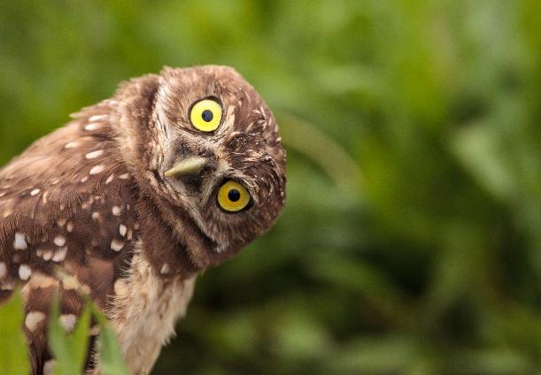
QUESTIONS?
Jane Austin
Call or text: 715-969-8082
Email: j_austin08@yahoo.com

