Slide 1


Zonta District 7 Conference
September 19-21, 2025
Cape Girardeau, Missouri
Powered By Purpose:
Educate – Engage - Empower
WELCOME!

Slide 2

District 7 Committee Chairs
Tania Hughes-Kremer | Zonta Foundation for Women
Nancy Pranke | Advocacy / USA Caucus representative
Sue Keirstead | Scholarship and Awards
Susan Dege | Bylaws
Peggy Jensen | Finance & D7 Facebook
Gayle Borchert | Nominating Committee Chair
Mary Reed | Website and Zoom support

Slide 3

Our Hosts: Zonta Club of Cape Girardeau
Polly Holten and Linda Greaser, Co-chairs
Key committee chairs:
Jan Roupp, Registration
Casey Brunke, Voting/Credentials/Timekeeping
Megan Cattoor, AV
Kim Keser, Club basket raffle
…. And many other Cape members contributing

Slide 4

Recognizing district leaders and long-time members

Slide 5
First Business Session
Welcome & Introductions
Roll Call of Clubs
Report of the Credentials Committee
Presentation of Standing Rules & Rules of Procedure
Presentation and Adoption of the Conference Program
Report of the Nominating Committee
Candidate speeches
Voting Instructions
Evening & Saturday Announcements

Slide 6
Nominations for the District 7 officers
2026-2028 Biennium
Governor
Lieutenant Governor
Treasurer
Area Directors
Nominating Committee
Lisa District 7 Treasurer Video.mp4

Slide 7

Evening Social / Candidate Mixer / Cash Bar
Dogwood/Redhawk Room
Reconvene here Saturday at 8:45 am

Slide 8

Second Business Session
Roll Call of Clubs
Report of Credentials Committee
Approval of Minutes from the 2023 conference
Report of District Treasurer
Presentation of Budget for Upcoming Biennium
Video message from ZI President Salla
Sandy Venn-Brown, ZI Vice President
Workshop: Strategic planning for clubs

Slide 9
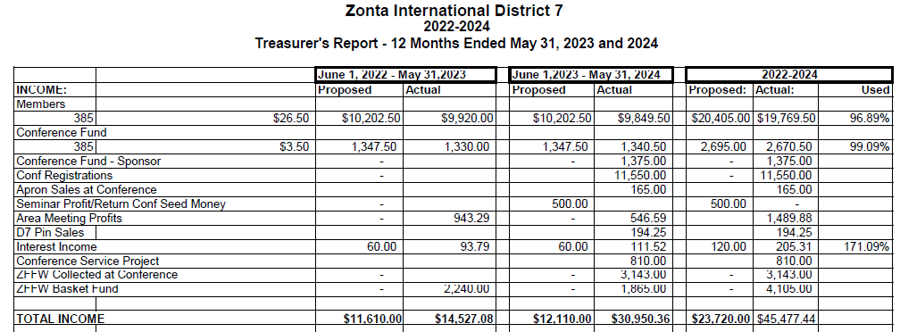

District 7 Final Budget Report for 2022-2024 Biennium

Slide 10
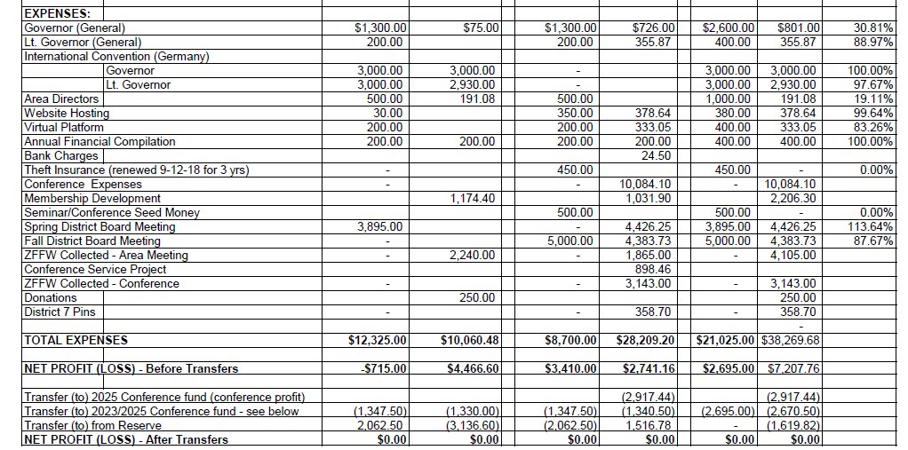
District 7 Final Budget Report for 2022-2024 Biennium

Slide 11
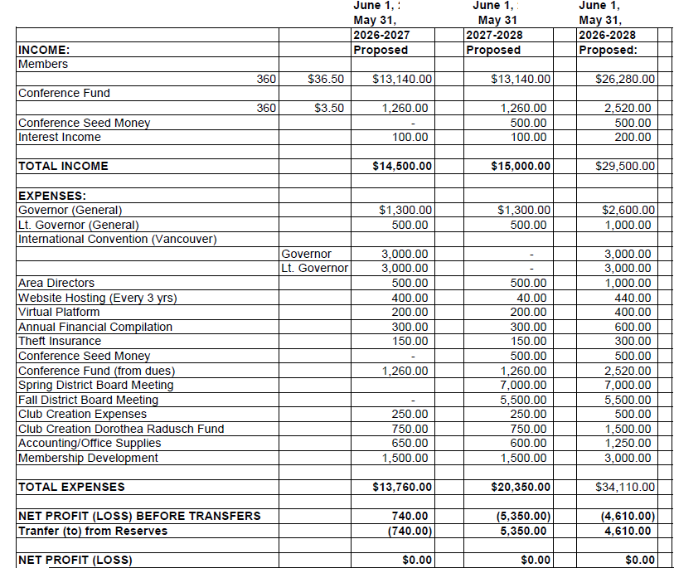

District 7
Proposed Budget
2026-2028 Biennium

Slide 12
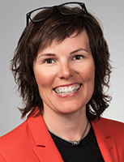
Salla Tuominen
President
Helsinki I, Finland
District 20
PresidentSallaVideo.mp4

Slide 13
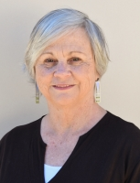
Sandy Venn-Brown
Vice President
Stanthorpe Inc, Australia
District 22

Slide 14

Break
&
Marketplace!
Please return by 10:30 for 1st part of the
Strategic Planning Workshop

Slide 15
Lunch
&
Guest Speaker
Holly Thompson Rehder

Slide 16

Break
&
Marketplace!
Please return by 1:15 for 2nd half of the
Strategic Planning Workshop
Delegates! Please remember to check in prior to the workshop

Slide 17
Third Business Session
Roll Call of Clubs
Final Report of Credentials Committee
Report of Election Results
Membership & Club Creation Report
Zonta Foundation Report

Slide 18
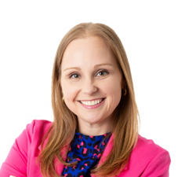
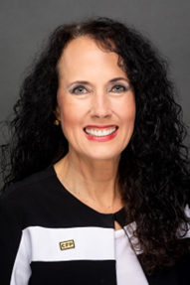
Financial Resilience
Amanda Smith
Law Office of Amanda L. Smith, PLLC
Cheryl Mothes
Edward Jones

Slide 19
Break
&
Marketplace
Please return by 3:30

Slide 20

Zonta Membership in D7
2025 Fall Conference
20

Slide 21
Current Membership in District 7
As of 10 September
21

Slide 22

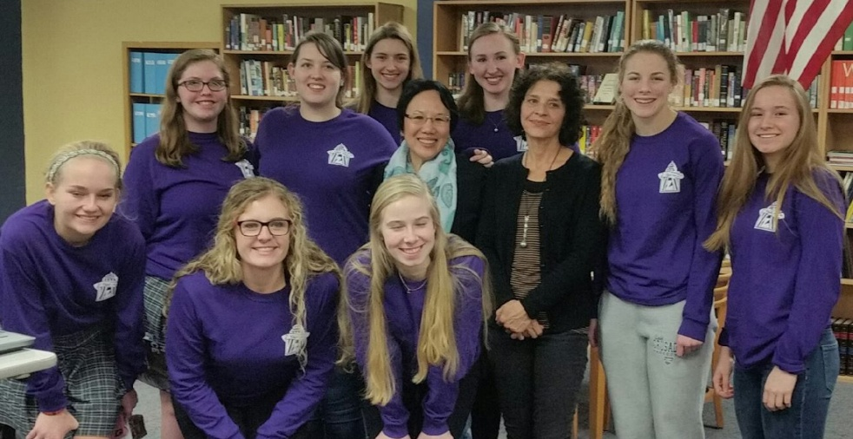

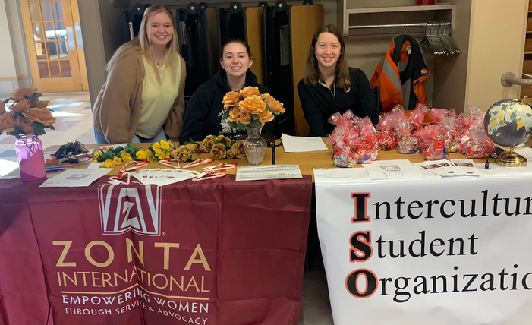
Z and Golden Z clubs in D7: Our future Zontians
A To Z Club (Austin)
Granite City (St Cloud)
Jefferson City High School (Jefferson City)
Jefferson City (Jefferson City)
Maryville University (St Louis)
Southeast Missouri State University (Cape Girardeau)
University of Jamestown (Jamestown)
22

Slide 23
District 7 Membership Plan
Grants for activities to build membership: >$3000 still available!
Information and forms online at
www.zontadistrict7.org >> Resources
Current requests:
The Zonta Club of Jamestown, ND will be hosting an evening event/membership drive on November 5th at the Arts Center in Jamestown, ND, focusing on what Zonta is, how we support women and girls globally and how the club serves the community.
23

Slide 24
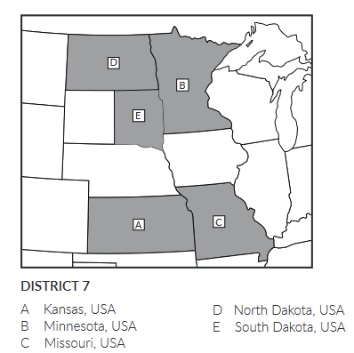

Club Creation
Past discussion:
Lincoln, NE
Des Moines, IA
Springfield, MO
Working on creating
new or re-established clubs:
Bismarck-Mandan - on hold
FARGO!!
D12
D6
24

Slide 25
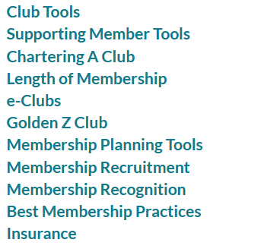

Resources Online:
https://www.zonta.org/Web/My_Zonta/Tools/Membership_Tools_Home
25

Slide 26
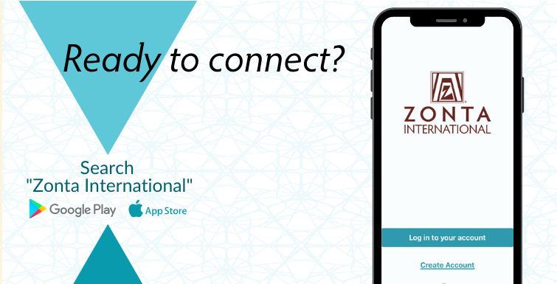
Connect with the Zonta Mobile App
News feed with the latest updates from ZI
Calendar of Zonta events
Discussion forums tailored to your Zonta role and special interests
Easy access to essential member resources
A member directory with instant private and group chats
26

Slide 27
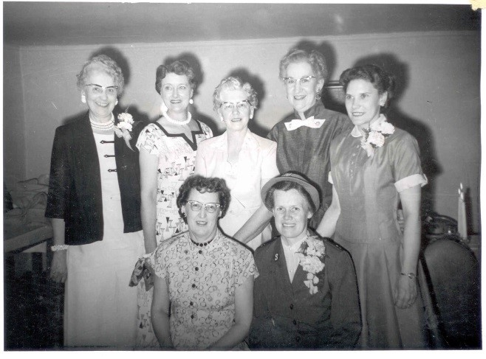
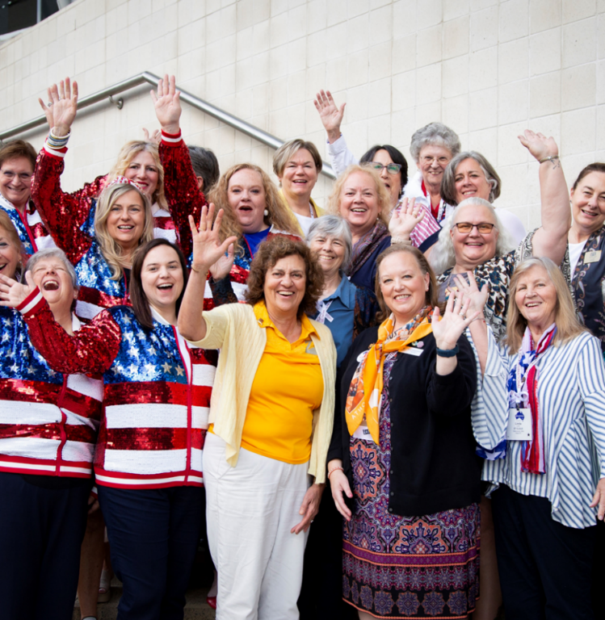
All are Welcome! https://www.zontadistrict7.org/
?page_id=208
From where we were…
…to where we are going!
District 7 Zonta Members at the 2024 International Convention in Brisbane, Australia

Slide 28


ZONTA VALUES
Zonta International is a membership organization that espouses professional standards and values, focusing on respect and building a better world for women and girls.
Notes:
Within just the past month, a working group from Zonta International has come out with the Zonta Core Values and I would like to share them with you. These values are important for each and every one of us to remember, in order for clubs to focus on the mission and work together more efficiently.

Slide 29
Although we have a clear understanding of our mission and vision, there is not a clear vision of the core values, or organizational ethics that guide us when making decisions, building relationships and solving problems within our clubs and districts.
Clubs grapple with managing interpersonal conflict or inappropriate behavior between club members.
Such conflict invariably results in resignations and/or reputational damage.
During the last two biennia work was undertaken through the Resolution 2 work program and development of the 2030 Strategic Plan (Zonta, Gender Equity and a Vision for 2030 and Beyond)
to analyze and assess aspects of Zonta’s membership.
Notes:
Up until now, Zonta has not had a clearly defined statement of our core values or organizational ethics. As humans, we often find ourselves in conflict with one another over various issues. Such conflicts within clubs can and often do result in resignations and/or reputational damage. We all know that our stated mission is to Build a Better World for Women and Girls, but how?
As part of the 2030 strategic plan, the core values working group has analyzed and assessed the membership of Zonta collecting input from members and creating these core values.

Slide 30
RESOLUTION 2 MEMBERSHIP WORKSTREAM FOUND:
Zonta needs to differentiate itself from other service clubs advocating for women and girls.
This includes having a clear description of who we are and what we do so that our members can easily echo our elevator pitch to others who they meet, to encourage member recruitment.
This reminder of our shared purpose will help members recognize the importance of the work ZONTA is doing and hopefully, allay some of the conflicts within clubs.
Notes:
The Zonta values working group found that Zonta needs to differentiate itself from other service clubs who are also focusing on women’s and girl’s issues, including having a clear description of who we are and what we do as Zontians. This is vital to having a unified vision and ability to pitch Zonta to others, encouraging new members to join. Reminding us all of our shared purpose will help clubs refocus and, hopefully, allay some of the conflicts within clubs.

Slide 31
THE WORKSTREAM MADE THE FOLLOWING RECOMMENDATIONS
Define our value proposition, enhance it and promote it among members, which includes a renewed ZONTA spirit of empathy and friendship among members
Give a clear description how we want to be seen from outside
Notes:
The recommendations that emerged from the working group include:
Defining our value proposition, and 2. Enhancing and promoting it among members, including a renewed sense of Zonta spirit, empathy and friendship, and overlapping these actions with a clear description of how we want to be seen from the outside.

Slide 32
In developing the 2024-2026 Biennial Goals, International President Salla believed it was essential to create and promote a set of core values that clearly articulate how our members (and prospective members) are expected to interact with each other and the broader community.
BIENNIAL GOAL 2 HAS THE FOLLOWING STATEMENT:
To nurture the Zonta spirit, the Zonta International Board will, together with the members, prepare the core values of Zonta and a Membership Code of Conduct to foster a culture of mutual understanding and respect as well as support healthy and thriving Zonta clubs.
Notes:
President Salla felt it was essential to create these core values, and biennial goal 2 states the following: “To nurture the Zonta spirit, the Zonta International Board will, together with the members, prepare the core values of Zonta and a Membership Code of Conduct to foster a culture of mutual understanding and respect as well as support healthy and thriving Zonta clubs.”

Slide 33
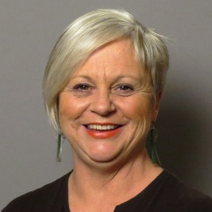
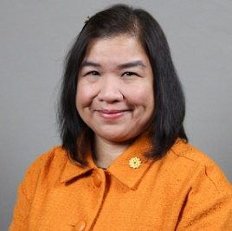
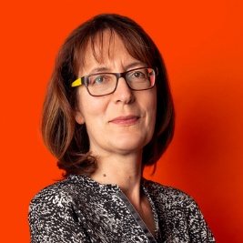
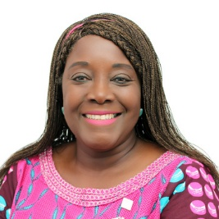
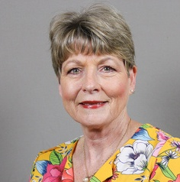
MEET THE CORE VALUES WORKING GROUP
SANDY VENN-BROWN
LIA BAUTISTA
CHRISTINE DERSCH
Vice President
(Chair)
Director
Director
ANNE-MARIE FRENCH CUJOE
DEB LAL
Past Director
Membership Committee Chair
Notes:
These are the members of the core values working group. As the D7 Lt. Governor, I and the other district Lt. Governors have been meeting with Deb Lal over this past year, providing input collected from club presidents regarding club membership concerns and club membership successes within our individual districts.

Slide 34

AUGUST
OCTOBER
DECEMBER
Terms of Reference developed for Core Values Working Group.
  Interactive presentation planned for 2025 Area meetings.
  Working Group explored key tenets of a Code of Conduct.
  Highlights from Board meeting circulated to Governors and ICCs.
  Presentation to Past International Presidents
  Email sent to Governors and Lt Governors. advising them of work commencing on the development of the Core Values and upcoming presentation.
  ZI Leadership update featured information on the Core Values.
1
3
5
TIMELINE 2024
2
4
SEPTEMBER
NOVEMBER
Presentations given to Lt. Governors and the International Board on Core Values development.
Monthly meetings of the Working Group commence.
Notes:
As you can see here, the timeline of actions was put in motion in August of 2024 and has been steadily moving forward. Personally, I felt like this was a very well-organized process that kept all of us thinking about what it really means to be a Zontian.

Slide 35
JANUARY
MARCH
MAY
  Presentation to International Board.
  Last area meetings held.
  Total of 1,825 members responded to the Core Values presentation with over 7,266 responses.
  Core Values statement and Code of Conduct prepared.
  Implementation strategy considered.
  Presentation to International Board.
  Area meeting presentation finalized and sent to Area Directors, Governors and Lt Governors.
  Presentation delivered to two groups of Lt. Governors at monthly Leaders in Membership meeting.
Presentation given at Governors’ and ICCs’ call.
Area meeting workshops underway
6
8
10
TIMELINE 2025
7
9
11
FEBRUARY
APRIL
JUNE
  First data received from area meetings.
  Work began on developing an implementation strategy for members.
  Highlights from Board meeting circulated to Governors and ICCs.
Work began on the Core Values, including feedback from more than 1200 members (4,807 responses) from around the world.
16 Members selected from around the world included in two focus groups
International Board approval of both documents
Notes:
Work continued into 2025, again with slow and steady forward momentum. Please make note of the inclusion of individual member input and feedback throughout the process. I found it very valuable to hear that many districts shared the same problems, as well as to learn about ways to overcome and be successful in our membership efforts.

Slide 36
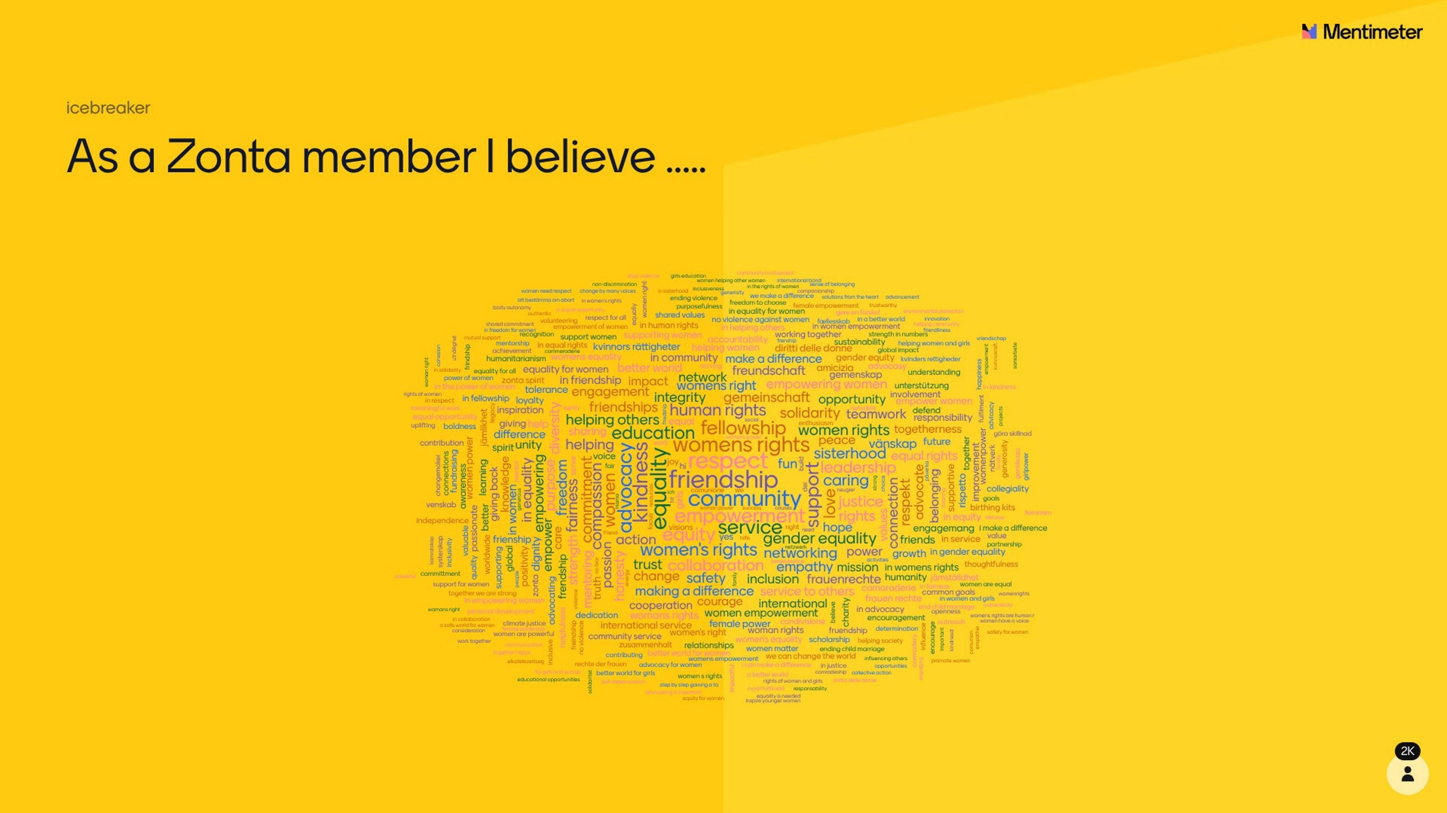
Notes:
The use of Mentimeter was something new, at least to me, as a way of gathering member input on what they believe are the core values of Zonta. Many of you may remember participating in this activity. The more a term was input, the larger it showed up on the board.
Personally, I love that friendship and community were two of the most mentioned values of Zonta, as those are two core values I hold very dear.

Slide 37
ZONTA CORE VALUES
GLOBAL COMMUNITY
We believe in creating healthy, caring and lasting relationships between our members and our communities. We are at our best when we work together and support each other. Valuing the contributions of like-minded organizations to help us achieve our mission reflects humility, wisdom, and a commitment to collective progress. The Zonta community is world-wide. Together, we achieve something bigger than we could alone.
FRIENDSHIP
The more we engage and work closely together to achieve our mission, the more we develop a special bond. The mission unites us and leads to friendship. We build friendships by treating each other with respect, being honest, and trying to understand one another. We work jointly and learn to appreciate each other. We care for and support each other. We work hard but also find time to have fun. And we value friendships that grow stronger and deeper through time.
EQUALITY AND INCLUSION
Everyone deserves to be treated equally and have the same opportunities to participate in our work. All members are seen, heard, valued and uplifted by their Zonta membership. Equality and Inclusion allow for healthy debate and create a harmonious club.
RESPECT
We treat everyone with respect, dignity, fairness and kindness. Respect is the foundation upon which interpersonal relationships and personal growth are built. We appreciate diverse perspectives, and all members are treated with empathy and compassion. By being respectful of our friends, allies, supporters and members we build better relationships.
INTEGRITY
Integrity is the foundation of trustworthy behavior, ethical conduct, and strong character. It is the key to establishing and sustaining trust. Zontians encourage open, truthful communication and ethical decision making. We are guided by and stay true to our principles. We are honest and straightforward about our mission to make the world a better place for women and girls.
Notes:
From this data, the working group developed the following core values and descriptors. We are indeed a global community of friends, who treat one another with equality, inclusion and respect, holding ourselves to the highest level of integrity in order to present Zonta, who’s very name means honest and trustworthy, to the public and to potential new members.

Slide 38
ZONTA CORE VALUES
GLOBAL COMMUNITY
Our external focus
FRIENDSHIP
Our internal focus
EQUALITY AND INCLUSION
Our vision
RESPECT
Our mutual understanding
INTEGRITY
Our foundation
Notes:
So how do all these pieces fit together?
(Click and read each one.)

Slide 39
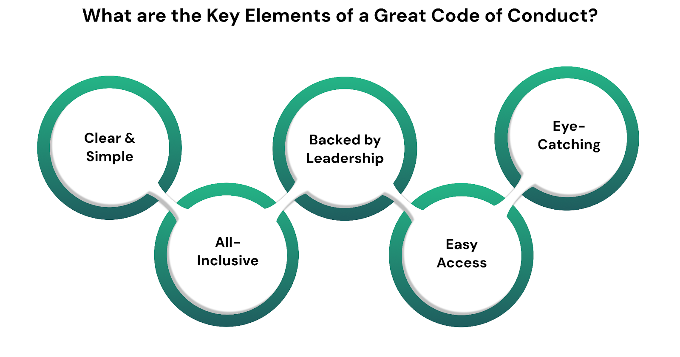
Notes:
What makes a code of conduct great? That it is clear and simple, all-inclusive, backed by leadership, easy to access and is eye-catching.

Slide 40
Importance of a
CODE of CONDUCT
A Code of Conduct is not just about preventing bad behavior; it also promotes positive actions, such as open communication, respect for our values, and professional behavior of our members.
It is impossible to cover every aspect of the organization’s operations in the Code
The Code is based on the five tenets of the Core Values Statement
Our code of Conduct refers to:
Zonta International Bylaws; Guidelines; and Policies
Local laws
Universal declarations
Notes:
So how are core values different from a Code of Conduct? How we conduct ourselves and represent Zonta not only discourages negative behavior but also provides guidelines on how to positively promote ourselves through communication, respect and behaviour. The Code of Conduct is based on the five Core Values and refers to the ZI bylaws, guidelines and policies, local laws and universal declarations.

Slide 41
Our Code of Conduct sets the expected behavior of our members.
It is a contract our members agree to when they join.
It is our way of holding our members to account for their behavior towards each other and externally of Zonta.
STEPS TO INTEGRATE VALUES and CODE of CONDUCT
Communicate
Ensure buy-in
Enforcement
Review and reinforce
Notes:
Our Code of Conduct sets the expected behavior of our members.
It is a contract our members agree to when they join.
It is our way of holding members accountable for their behavior towards each other and towards those external of Zonta.
In order to successfully integrate these core values and code of conduct, we must communicate them, ensure buy-in, enforce, review and reinforce them. Because we are all working towards the same goal; to make the world a better place for women and girls.

Slide 42

Questions?
Comments?
Feedback?
Notes:
Questions?

Slide 43
Zonta Foundation for Women
District Ambassador Tania Hughes-Kremer

Slide 44
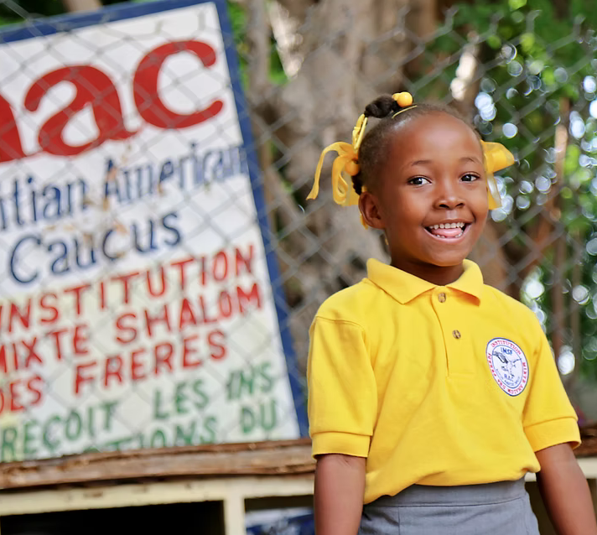
Haiti Project
Empowering Women through Education and Support
Cheryl Mothes

Slide 45

Our evening entertainment:
Dogwood/Redhawk Room
5:00 – 5:15 Group photo!
5:00 – 6:00 Happy Hour and Socializing
6:00 – 10:00 Evening Dinner & Cash Bar
Basket Raffle
Governor’s Purse
Zonta Zingo

Slide 46


Slide 47

More details coming soon at zontastlouis.org

Slide 48
Final Session
Final Credential report
Final Registration Report
Conference Committee Report
Installation of new officers
Activity: Living in a changing world
Final Marketplace / check-out time
Governor’s Report & Spirit Awards
Call to Convention: Vancouver, British Columbia July 2026

Slide 49
Living in a changing world:
Connecting with the four goals of Zonta
Notes:
We live in challenging times, where things seem to be shifting rapidly, contributing to fears and concerns about our community and world. It can be difficult to see ways to we can make a difference, and to find the confidence and skills to move forward. The goal of this final activity is to bring together our Zonta “Why” (why we joined and why we are still here), our shared concerns and challenges, with Zonta’s four goals and our service and advocacy–– for ourselves and our clubs.

Slide 50
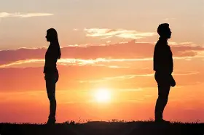
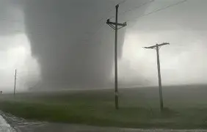
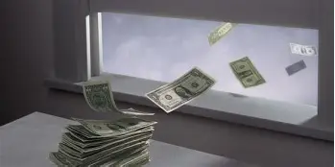
FEARS
AND
CONCERNS
Notes:
The intent of this exercise is to acknowledge that all of us have fears and concerns that affect our daily lives. Some fears are intense and keep us up at night and may make us feel powerless. Other concerns may make us feel overwhelmed as we don’t know where to begin to fix the problem.

Slide 51
Personal
Domestic Violence
Community
No Safe Shelters
Global
Rising Temperatures
what are yours?
Notes:
whether they are about our personal lives, things in our community, or international issues. Take a few minutes and think of your fears concerns.
In the Center of your table there are sticky notes., write down your own fears or concerns.

Slide 52
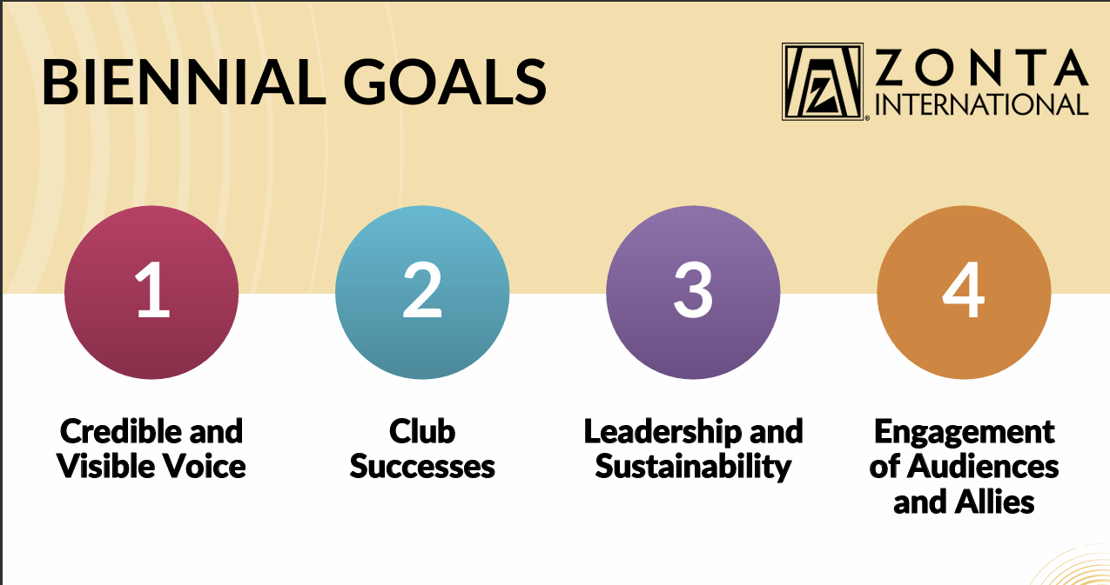
Notes:
Discuss the fears and concerns that are at your table and group them by the 4 pillars.
Choose someone from your table to bring the notes forward and place them on correct pillar
Discuss responses; why did your group choose that pillar

Slide 53
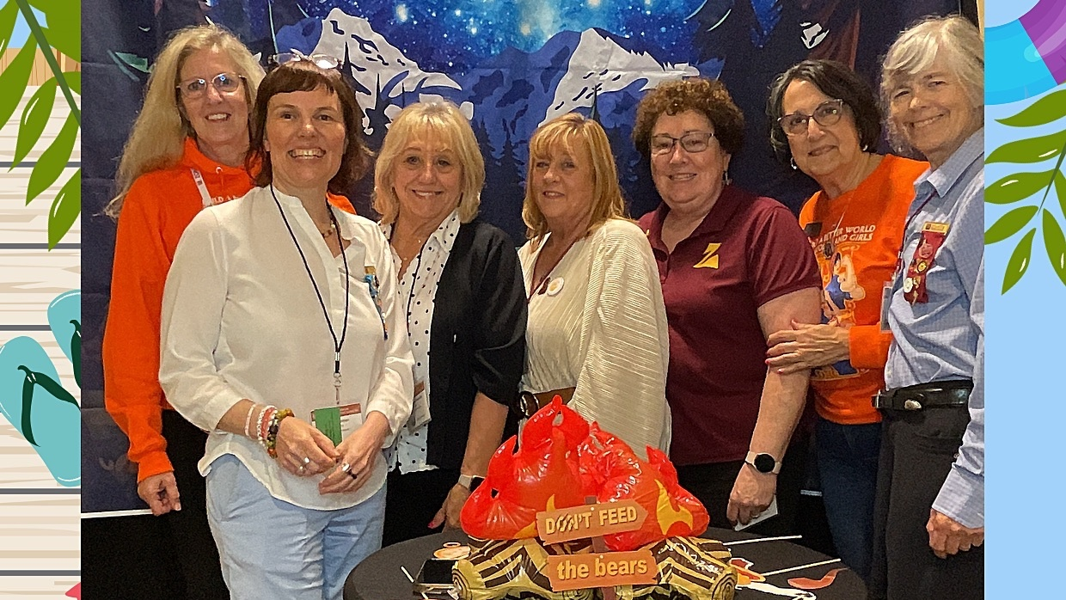
Through zonta we have opportunities we have a voice we have hope

Slide 54
Final Break
&
Final Market Place!
Please return at 10:30

Slide 55
Governor’s Report
We are
Powered By Purpose:
Educate
Engage
Empower

Slide 56

District 7
Zonta Spirit Awards
Recognizing those who exemplify the Zonta spirit, who keeps the passion or flame of Zonta alive and growing, and cultivates strong, inclusive culture of community, fun, and friendship.

Slide 57

Thank You!
Empowered by our members

Slide 58


Slide 59

Notes:
https://www.youtube.com/watch?v=ichH4FrWS4I

Slide 60

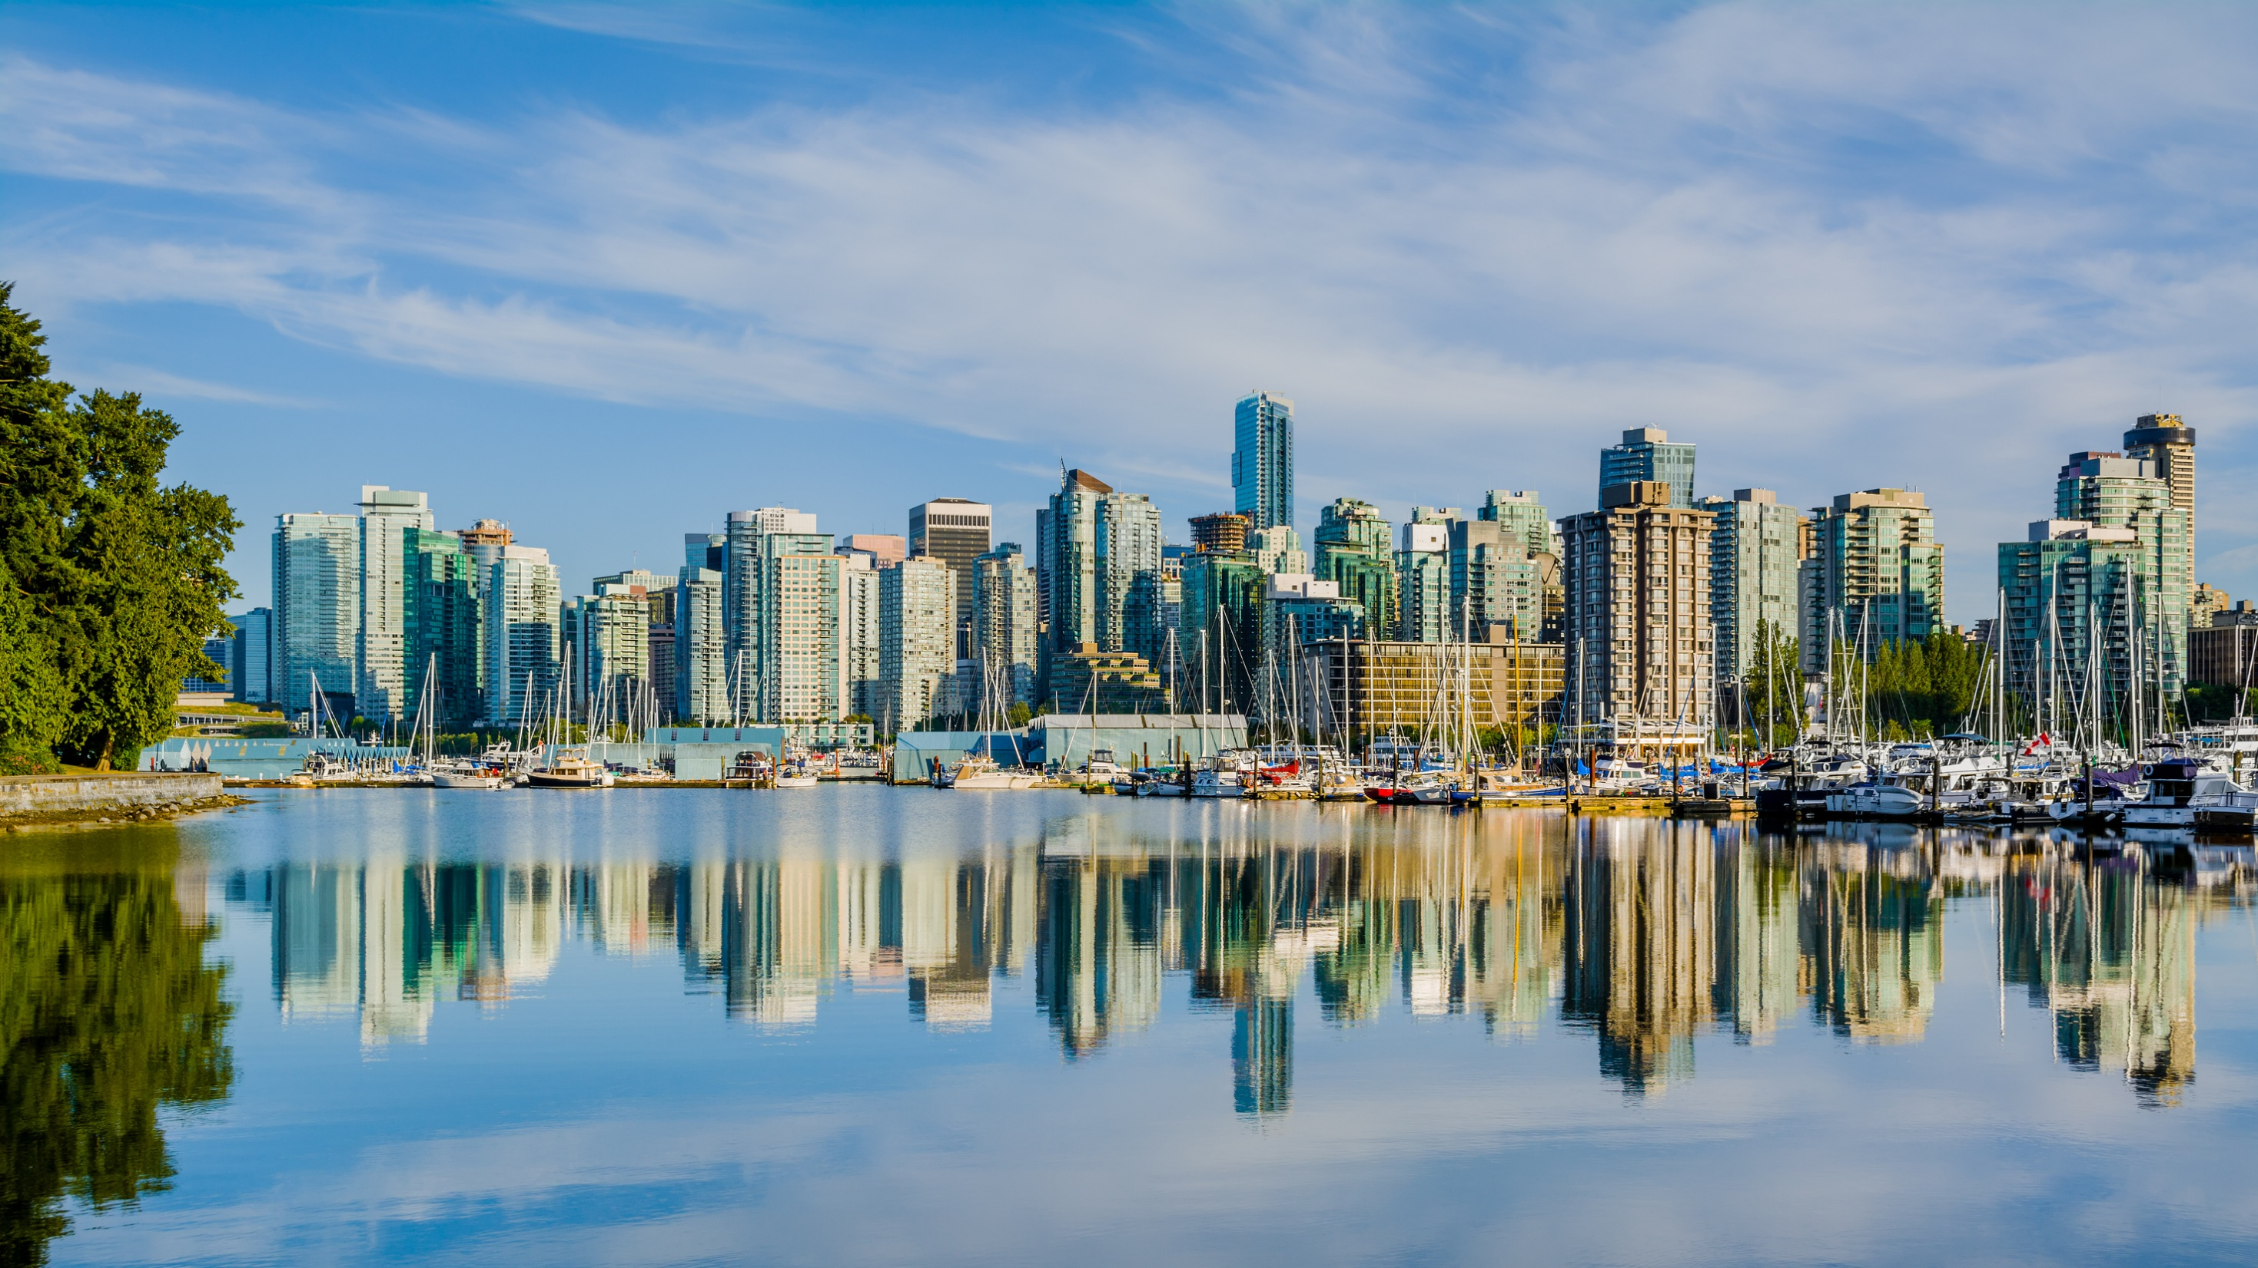


Slide 61

The Wyrd Sisters -- Warrior

Slide 62
.

Slide 63
MISSION
Zonta International is a leading global organization of individuals working together to build a better world for women and girls.
VISION
Zonta International envisions a world in which women's rights are recognized as human rights and every woman is able to achieve her full potential.
In such a world, women have access to all resources and are represented in decision-making positions on an equal basis with men.
In such a world, no woman lives in fear of violence.

Slide 64



