Slide 1

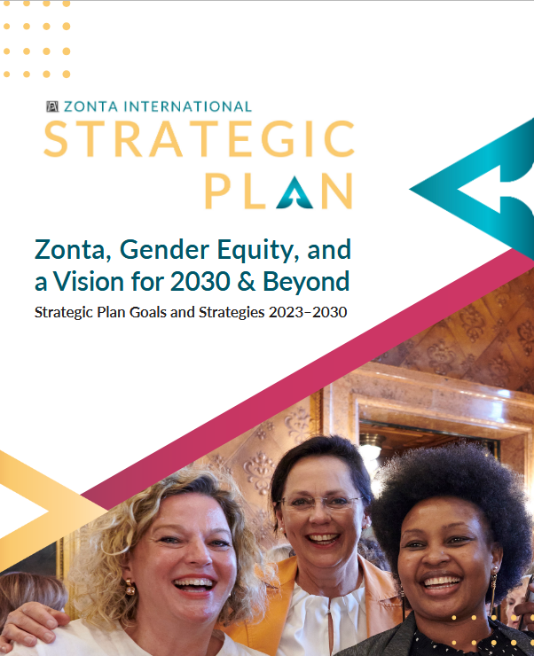
^{Strategic Planning – Part I}
Jane Austin and Debra Kellerman
Notes:
JANE: Welcome to our first workshop, focusing on strategic planning -- how our district and our clubs can better plan for a sustainable, effective and productive future. Much of this workshop is based on the Zonta International’s 2023 Strategic Plan, which you can find on the ZI Website, under Governance.
Deb and I developed this workshop as two parts. The first, this morning, provides an introduction to the process of strategic planning, using the district as the focus, while the second half, after lunch, will focus on the club level. This will be very interactive, with lots of opportunities to think, discuss, and share along the way, and provide us guidance for the district.
DEB → [explain the activities]

Slide 2


Why should we do strategic planning?
Strategic planning is the path from the present ideas to new and different courses of action to achieve our goals for the future
Provides a comprehensive and understandable basis for decision-making within a framework of priorities and resources.
Notes:
JANE: We do not live in a static world. New members come in, others depart, with different interests and talents. Our communities, our social and political environments change. We need to be able to understand and respond to those changes to best meet our Zonta mission.
Strategic planning provides a process to think through where we are, what is changing, explore and come to a consensus on what we want to achieve, and the best ways to achieve our goals.
→Strategic planning is the path from the present ideas to new and different courses of action to achieve our goals for the future.
→ and it provides a comprehensive, and understandable basis for decision-making within a framework of priorities and resources.
The board – whether our district board or your club board, will be the ones ultimately to put the results of this process into action, so boards need to be actively involved in the process. But not just for the board – it is essential that we reach out more broadly to a diversity of individuals to ensure we are hearing from different perspectives and roles.

Slide 3
Basic steps in the strategic planning process
PESTLE analysis: What are the factors affecting women and girls? What is changing?
Relate the factors affecting women and girls to ZI mission and goals
Select which goals on which to focus strategies and actions
Develop strategies for each goal
Develop implementation plans for each strategy
Notes:
JANE: There are 5 basic steps to strategic planning. We will be focusing on the first three most important, and perhaps most challenging parts to work through.
First, so-called PESTLE analyses – what are the driving factors that are affecting women and girls? Local-regional or state- national and global – and what is changing?
Second, think about how to those factors relate to our Zonta mission and goals.
Third, through discussion and assessments, identify which of those goals to prioritize, to best focus our strategies and actions.
Fourth, develop the strategies for each goal, and
Finally, develop the implementation plans – the specifics.
We will take you through this process step by step.

Slide 4
Step 1: PESTLE Analysis
STEP 2: What are the factors affecting women and girls relative to ZI mission and goals?
Political
Economic
Social
Technology
Legal
Environment
Policies at local, state, and national levels; trade and taxation policies, political leadership, election rules, women’s representation in political offices
Economic changes or factors influencing women and girls locally and nationally such as inflation, housing, employment, Medicare/Medicaid, SNAP, gender pay gap
Social & cultural trends such as social attitudes toward working women, increase in gender-based violence, unpaid care work, cultural barriers, demographics, lifestyle changes
Technological changes or factors such as educational and career opportunities, cyberviolence, AI, data management,, tech innovations
Legal, regulatory or legislative changes -- laws or policies affecting women’s rights, child marriage, unemployment rules, consumer/ health/safety regulations
Environment that we live in that affects physical and mental heath: air and water quality, severe weather events, green spaces, housing quality
Notes:
JANE: First step is the PESTLE analyses – a way to explore the broad environment affecting women and girls in different ways. It is divided into six broad factors:……. Below each are some broad examples of drivers that are or will most affect women and girls in our nation/district/state/your community…..
Changes are happening in each of these.
DEB: Step 2 -- rapid round robin exercise - Identify issues and examples under each of these factors that will affect women and girls in the next three to five years in your club/state/community/our D7. Use crayons on Wallsheets#1 (3)
JANE: Think about the issues within these factors that are affecting women. On your own notepads, add your own examples that come to mind that may be specific to your experience or to your community, and think about --
what do the women and girls in your community really need?
describe using questions that Zontians can do something about
is the more than 1 solution?
what are the consequences of not addressing an issue?
who might be partners with us to take action?

Slide 5
STEP 3: Decide where to focus District 7 actions and resources
Link PESTLE assessment with the four goals identified by Zonta International
CV
CS
Credible & Visible Voice
Club Success
Zonta acts as a credible and visible voice on gender equity and delivers initiatives addressing education equality, climate justice, ending gender-based violence, and ensuring women are represented in decision-making positions on an equal basis with men.
Clubs serve as a welcoming and inspiring environment to those who wish to work to empower women and girls and create information and resources necessary to focus on the most important issues facing women and girls.
LS
EA
Leadership & Sustainability
Engagement of Audiences & Allies
Zonta manages its resources, including both time and money, to meet the vision and ensure the organization’s long-term viability and success. Zonta modernizes its governance structure to align with its strategic plan, ensure innovative thought and allow for effective decision-making.
Zonta creates customized pathways to connect to Zonta, develops collaborations with like-minded organizations, and expands revenue streams to further our mission and extend our voice.
Notes:
Worksheet#1(gold) -- Wallchart#2
JANE: The next step is to relate what we learn from the PESTLE analyses – what are the drivers affecting women and girls -- with Zonta’s 4 core goals, and decide where we need to focus our actions and resources. These 4 goals are in the 2023 strategic plan, and will continue to be Zonta’s focus through 2030. As a district or a club, we may not be able to work effectively on all of them. So where do we focus? What should the district do to support the clubs in working toward these goals?
Within each of these – think about the possible actions or roles that the district can take:
[CV] Credible and visible voice—Think about advocacy, our comm/PR strategies, Scholarships/educational equality; sharing knowledge on women’s rights via programs and initiatives; service projects
[CS] Club success -- welcoming environment to support membership (recruit & retain), Zonta Spirit; Area and D meetings, other events; support and training for clubs
[LS] Leadership and sustainability – Governance (process/how we do things); manage current financial wellbeing and plan for long-term financial sustainability; attract/train/mentor future leaders; retention of clubs, new club development
[EA] Engagement of audience and allies – Collaboration among clubs/areas and with other like-minded organizations; engage outsider partners and community to improve our world for women and girls
These are the main components of what we do as a district. What other components, of what the district can do, are we missing? During break, before afternoon starts, please add items to wall charts and to the gold handout at your table
DEB--Individuals: 1) rank across the 4 goals, 2) Rank within each of the 4 goals the 4 components – using A(5) B (3) C(1) -- high to low priority/concern -- then at each table a rep tallies results on worksheet to identify 3 levels - by table – by consensus at table. 1 table rep records their top 3 items on Worksheets#1
Can add items under each goal – and also add to Worksheets#1
This helps identify district direction as to where D7 leadership needs to consider – and as example of the process for clubs
Create weighted ranks of the top 3 CS, LS, EA should district work on
[collect gold sheets for later summarizing]

Slide 6
Credible & Visible Voice
CV
Zonta acts as a credible and visible voice on gender equity and delivers initiatives addressing education equality, climate justice, ending gender-based violence, and ensuring women are represented in decision-making positions on an equal basis with men.
  Violence Against Women
  Climate Justice
  Women in Decision-Making
  Education Equality
Notes:
JANE– Lets take the Credible and Visible Voice goal to show the next part of the process for refining our priorities. Again, this is a core goal identified by ZI, and likely one of the most important for the district to understand which aspects within it we should best focus on and provide support to clubs and members. Again, some of the potential roles of the district include – coordinating advocacy, Scholarships and education; communication tools,, sharing knowledge on women’s rights and opportunities via programs and initiatives.
Within this goal are 4 focal areas or topics identified by Zonta International where we can focus our actions. Again, we may not have the ability to do all of these effectively, so we may need to prioritize the most appropriate and necessary areas, based on needs in our district and communities, and our capability of making a difference.
Violence Against Women
Climate Justice
Women in Decision-Making
Education Equality
DEB--Ranked exercise -- A(5) B (3) C(1) -- of these 4 focal areas –1 individual from each group record their rankings on wall charts using crayons. Same process – one person from each group record ranking on Wallchart#3

Slide 7
Club Success
CS
Clubs serve as a welcoming and inspiring environment to those who wish to work to empower women and girls and create information and resources necessary to focus on the most important issues facing women and girls.
STEP 4: Turning ideas and vision into action:
What strategies do you want district leadership work on over the next 3-5 years to accomplish this goal?
Notes:
JANE--The next step is turning the goals that we identified as our priorities into action – developing strategies. Club Success, likely an important aspect for the district to work on [club success ranked as xx.]
DEB: Round robin exercise -- Whole Group Brainstorm What strategies for actions (turning ideas into actions) do you want district leadership work on over the next 3-5 years to accomplish this goal? E.g. tools for membership (gain/retain), support/training to clubs, district Service project?, club creation strategies, increase participation in Area/D7 meetings, Zonta Spirit. Record on Wallchart#4

Slide 8
Over Lunch – Preparing for next session
  What are your superpowers?
  What superpowers can you contribute to Zonta?
Collaborator
Numbers person
Detail/facts oriented
Concrete thinker
Big Picture person, focus on ideas, abstract thinker
Worker bee
Creative / innovator
People person
Cheerleader
Actionary…see things through to completion
Strategic thinker
Visionary/dreamer…what if?
Club components –where should your club focus?
Notes:
DEB—After lunch, we will be shifting to CLUB focus, applying these same steps to club level. When you come back sit with your club member(s) [need club tent labels] so we can work on steps for your club
Lunch work Activity~5 min – Individual—Worksheet#2: Love/superpowers (gold copies will be collected; keep your white ones)
What do you love about Zonta?
What are your super powers? Circle terms; can ask for input from others
What you can contribute to Zonta at district level?
Also-- Club Components-Worksheet#3–– Over lunch or just before we gather at 1:15, please individually circle the areas you would like to have your club focus their strategic planning efforts on. Put a dot on the top 5 ones you love.
We will use Weighted averages -- you have and add them up – you have 7 votes, can do up to 3 max on one (3 – 1 – 1 or 3 – 2 or 2 – 2- 1 or can do all 1s. This helps to narrow down from 7 to a workable number for a SP session
JANE-- REMINDER-- What topics are we missing on the wall charts? During break, before afternoon starts, please add items to wall charts

Slide 9
Strategic Planning II – Focus on Clubs
First session -- Demonstrating the process for district
Think about the components of your club:
Does it meet our mission and vision?
What do we do well?
What challenges do you have -- what holds you back?
Any trends/factors that would allow us to do better?
What do we need to overcome?
Look to the future – dreams/vision, legacy for your club
Notes:
JANE—[Brief overview of what we covered, with the focus on district, and following the goals and focal areas identified by ZI to sustain consistent work through 2023…] basic steps to the process:
--Assess what factors are most affecting women and girls, & what is changing
--Relate those key factors to ZI mission and goals
--Select which goals on which to focus your strategies and actions
--Develop strategies for each goal
--Develop implementation plan for each strategy
Before lunch we focused on the first 3, which will be helpful in providing insights for the district over the next 3-5 yrs, taking us to 2030.
Deb will take us through the process for the club level, with examples from the experiences in St Cloud
DEB: Explain StCloud process: …then changed up where they sat and joined a table around each of the 5 areas. SC looked at 5 areas during 6 hours: Advocacy, Finance, Fundraising, Membership, Time Commitment. Outlined the issues in a rapid round robin.
Club components worksheet#3 – Think about which components are most important to meet Zonta’s mission and club goals. And consider PESTLE results for your club ….
Take up this worksheet and now, merge your results – from an individual to a group consensus for your club or group.
Colored worksheets#5with logos at table – Discuss the symbols sheet…make notes on your components worksheet#3. Individual/club could put a star by the components that club does best; could do a SWOT on each component they chose.

Slide 10
SWOT Analysis Quadrants
 | Opportunities (External, Positive) | Threats / Challenges (External Negative)
Strengths (Internal, Positive) | Which of your club’s strengths can be used to maximize the opportunities you identified? | How can you use your club’s strengths to minimize the threats identified?
Weaknesses (Internal, Negative) | Which actions can you take to minimize the club’s weaknesses using the opportunities identified? | How can you minimize your club’s weaknesses to avoid the threats identified?
This can be done individually, then discussed in small groups before being brought to the large group to reach consensus. These are the items that should be considered as you move into the implementation phase.
Notes:
DEB: SWOT:
**what do we do well, (STRENGTHS) club superpowers etc.
**where can we improve (WEAKNESSES) or leverage it to make it work, what holds the item back? (CHALLENGES)
**How can we grow the component? What changes are taking place that might allow us to better achieve our mission and vision (OPPORTUNITIES)
**From PESTLE items, what do we need to guard against or prepare for in accomplishing the great works we do? (THREATS)
Does it meet Zonta’s mission? What are the key areas that are a priority? Of greatest need or greatest challenge?

Slide 11
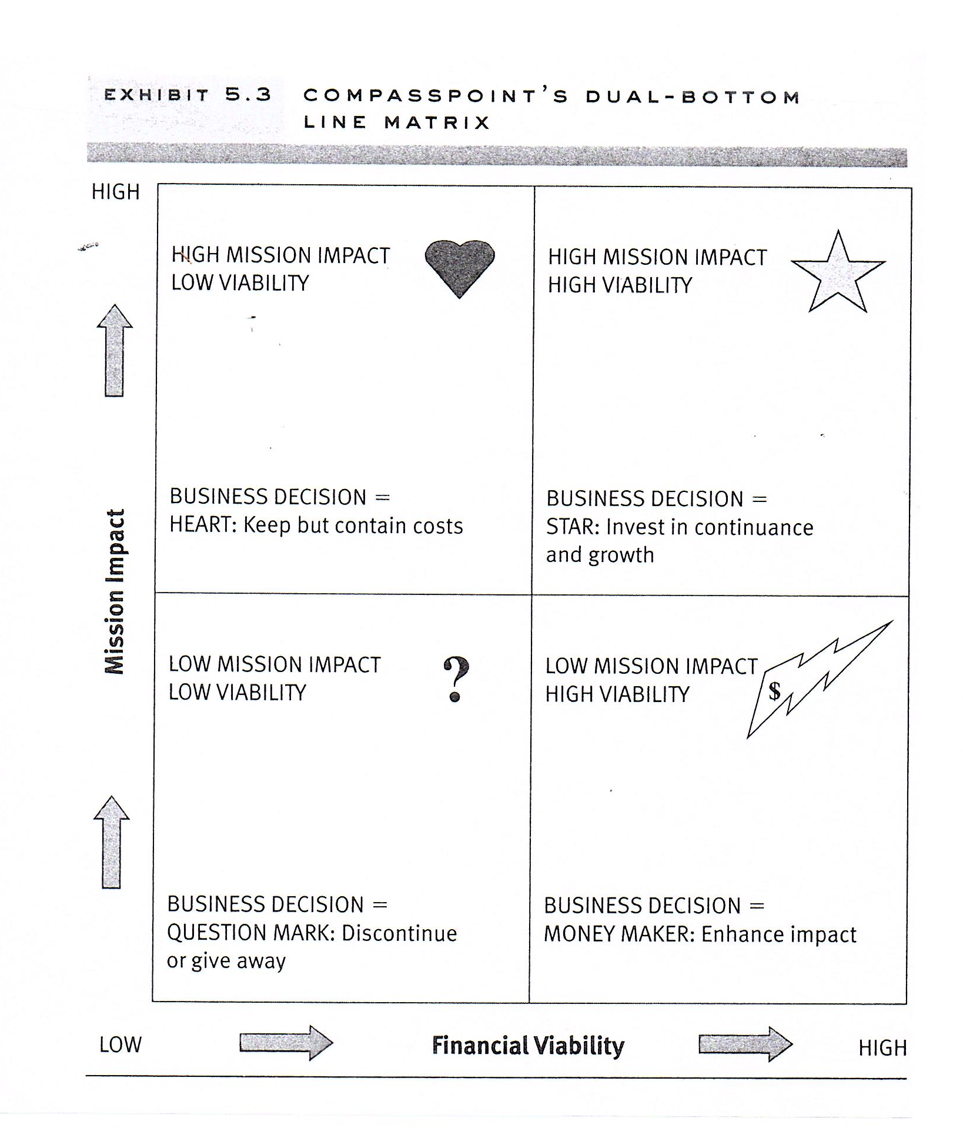
Source: Strategic Planning for Non-profit Organizations. 2nd edition. Michael Allison & Jude Kay. P. 188.
Notes:
DEB: Impact/Viability matrix: Another way to evaluate –
Handout#6 (examples of ranking process + Alt SWOT)– do at Club level
Each folder has personal copies (white) handout#5 (powers/SWOT) to discuss and to take home
If time, as an example. Look at one component, list all your activities, events, factors underneath…because next step would be to flush out those in a SWOT activity.

Slide 12
Decide the goals of your club
Consider the goals identified by Zonta International
CV
CS
Credible & Visible Voice
Club Success
Zonta acts as a credible and visible voice on gender equity and delivers initiatives addressing education equality, climate justice, ending gender-based violence, and ensuring women are represented in decision-making positions on an equal basis with men.
Clubs serve as a welcoming and inspiring environment to those who wish to work to empower women and girls and create information and resources necessary to focus on the most important issues facing women and girls.
LS
EA
Leadership & Sustainability
Engagement of Audiences & Allies
Zonta manages its resources, including both time and money, to meet the vision and ensure the organization’s long-term viability and success. Zonta modernizes its governance structure to align with its strategic plan, ensure innovative thought and allow for effective decision-making.
Zonta creates customized pathways to connect to Zonta, develops collaborations with like-minded organizations, and expands revenue streams to further our mission and extend our voice.
Notes:
DEB-- How do these issues/factors relate to ZI’s 4 goals and club goals?
Handout#4 - matching club components to CV, CS, LS, EA –
Individuals mark up which match to the 4 ZI goals.
How are your components distributed relative to the goals? Distribution of club’s investment across goals and components?
On wallchart#5, use dots to mark the top 1-2 components within each goal

Slide 13

Which goals make the most sense for your club to address, given the issues identified in the PESTLE and SWOT analyses?
Should your club modify club goals to better align with ZI mission and goals?
Is your club set up to be successful into the future?
Notes:
DEB: Consider in light of PESTLE and SWOT analyses – how do those goals and club components match the factors affecting women and girls in your community/state? Where are your club’s strengths/challenges/opportunities?

Slide 14
STEP 4: Turning ideas and vision into action:
Identify the strategies you want your club
to work on over the next 3-5 years
to accomplish your club’s goals
Notes:
JANE: Step 4: Consider those components that are most challenging to the club – ie needing more attention – and those that bring the most success. What strategies (turning ideas into actions) do you want your club to work on over the next 3-5 years to accomplish your goals?
[probably won’t have time but – possible round robin - Chose one component, come up with 1-3 specific strategies – eg identify priority]

Slide 15
Final step: Planning to implement your strategies
Discuss:
What is the goal
What is the strategy?
What are the actions to take?
Whose responsibility is it?
  Think: Does this fall under a committee? Is this a task force that is put together to devise a plan and then sunset once the plan is approved?
Will collaborators be involved?
What resources are needed?(e.g., budget, equipment, location)
People resources: Time commitments for members (when and how long?)
When is the project starting?
What is target end date?
How will you evaluate its success?
Notes:
DEB-- Final step -- Once you have identified strategies –key questions and tools for next steps to implementation – the logistics to map out – handout$7
S16: develop tables or sheets to plan and track your activities
What we learned in St Club -- 10% operating funds from fundraisers (to help carry out our mission) supplement dues allocation to budget, created a committee and a line item in budget for advocacy activities, eliminated one fundraiser—revenues were declining/competition was increasing, we moved to one bus/program meeting a month, one evening a quarter (2x a year) to accommodate members who could not attend noon meetings, streamlined meetings—committee reports into newsletter, started researching establishing a Foundation (est. in 2023)

Slide 16
Final step: Plans to implementing your strategies
Tools to plan and track -- example worksheets:
Strategy | Responsibility/Execution | Resources | Target Start/End | Resources Required/ Budget Line Item Ref. | Evaluation Metric | Status (Date)
Tactics | Steps | Who | When | Results Deliverable/Metric | Resources
Notes:
DEB-[example of worksheets to plan and track]

Slide 17
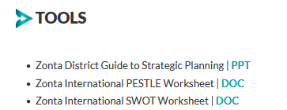
Resources to help you with the strategic planning process:
Zonta District Guide to Strategic Planning
https://www.zonta.org/images/docs/myzonta/governance/strategicplan/ZontaDistrictGuideforStrategicPlanning.pptx
How to find it:
Sign into MyZonta
Open Governance tab
Open Strategic Plan tab
Under tools →
Notes:
DEB-

Slide 18
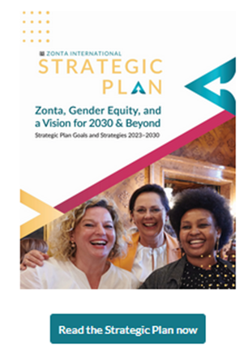
As you move through the process, other ZI resources you can use:
International:
Zonta International Strategic Plan
Resolution 2 Final Report
2020-2022 Executive Summary
2020-2022 Full Report
Notes:
DEB-

Slide 19

What have we learned?
What do we want that we already have? Preserve
What do we want that we do not have? Achieve
What do we not have that we do not want? Avoid
What do we have now that we do not want? Eliminate
Notes:
JANE--Group discussion – please share some thoughts and feedback
What did we learn/questions Round Robin Deb - heck the BIN sheets on wall –missing items to incorporate/talk about

Slide 20


For guidance and assistance in conducting a club strategic planning session, contact:
Jane Austin, D7 Governor
Your Area Director
Notes:
JANE / DEB- offer help by Gov, ADs others…..

