Slide 1
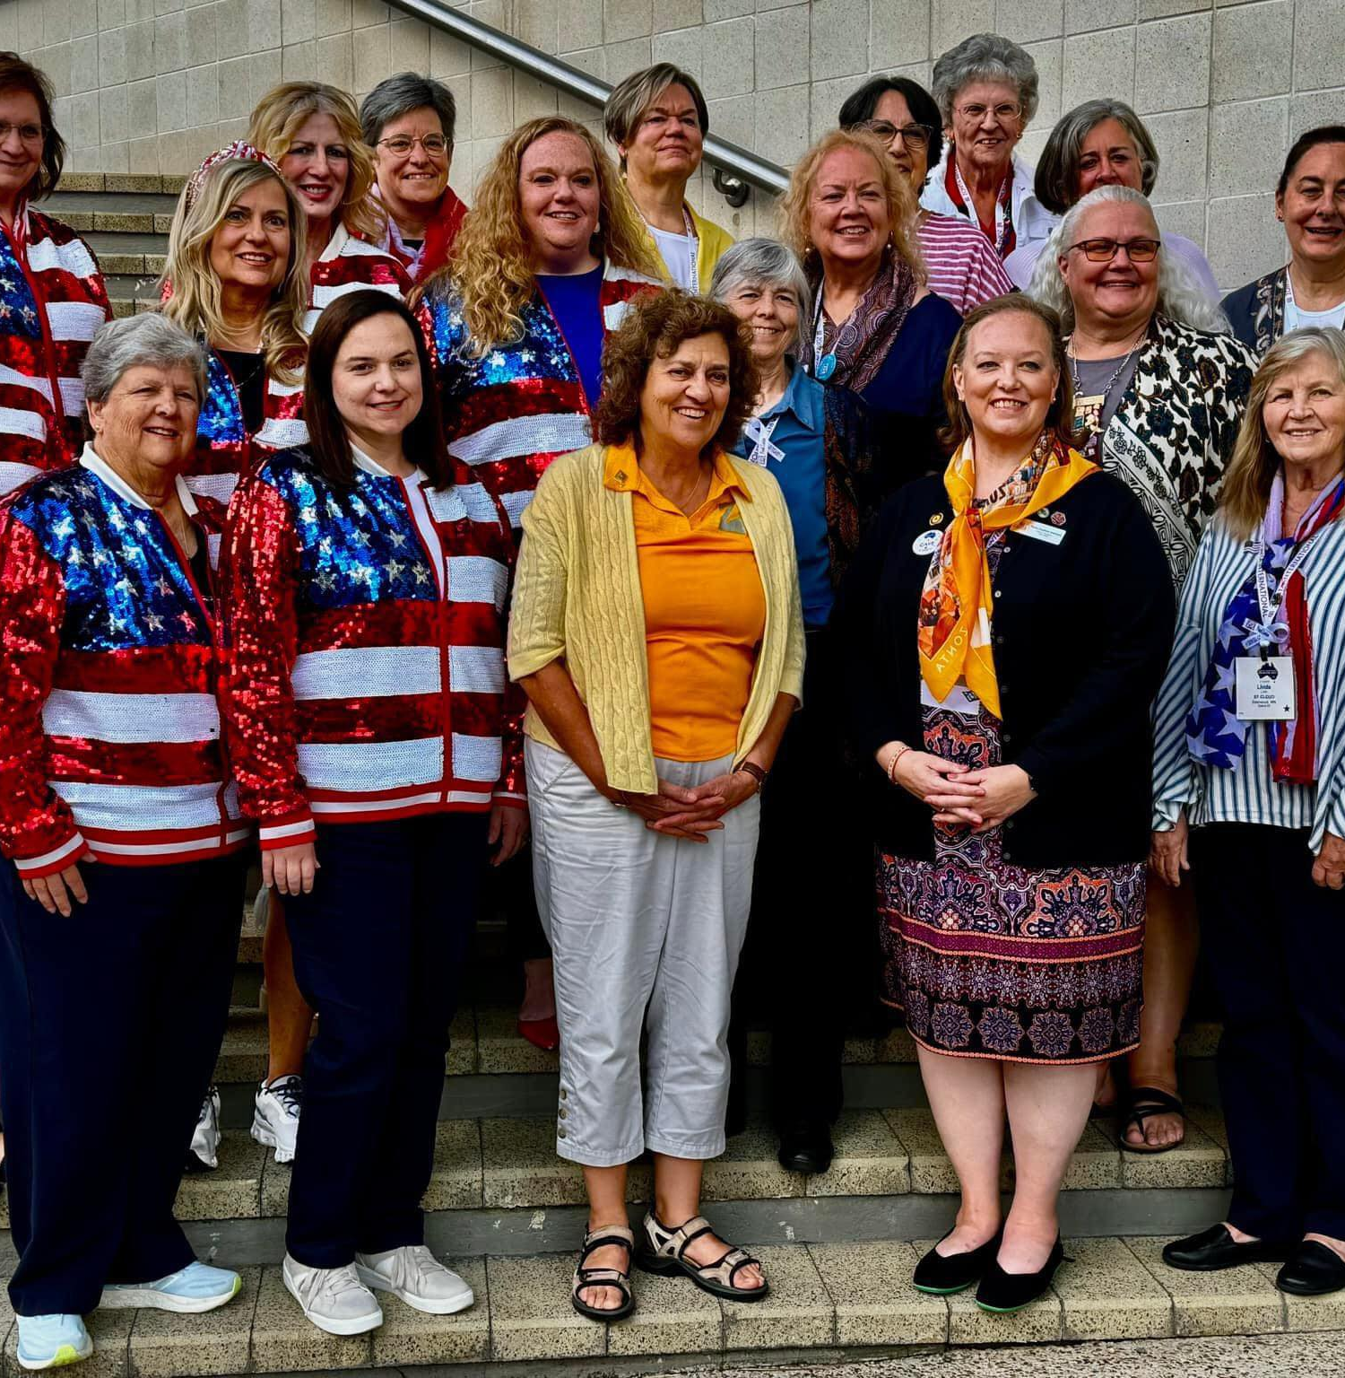
district conference report
Sandy Venn-Brown
Vice President

Slide 2
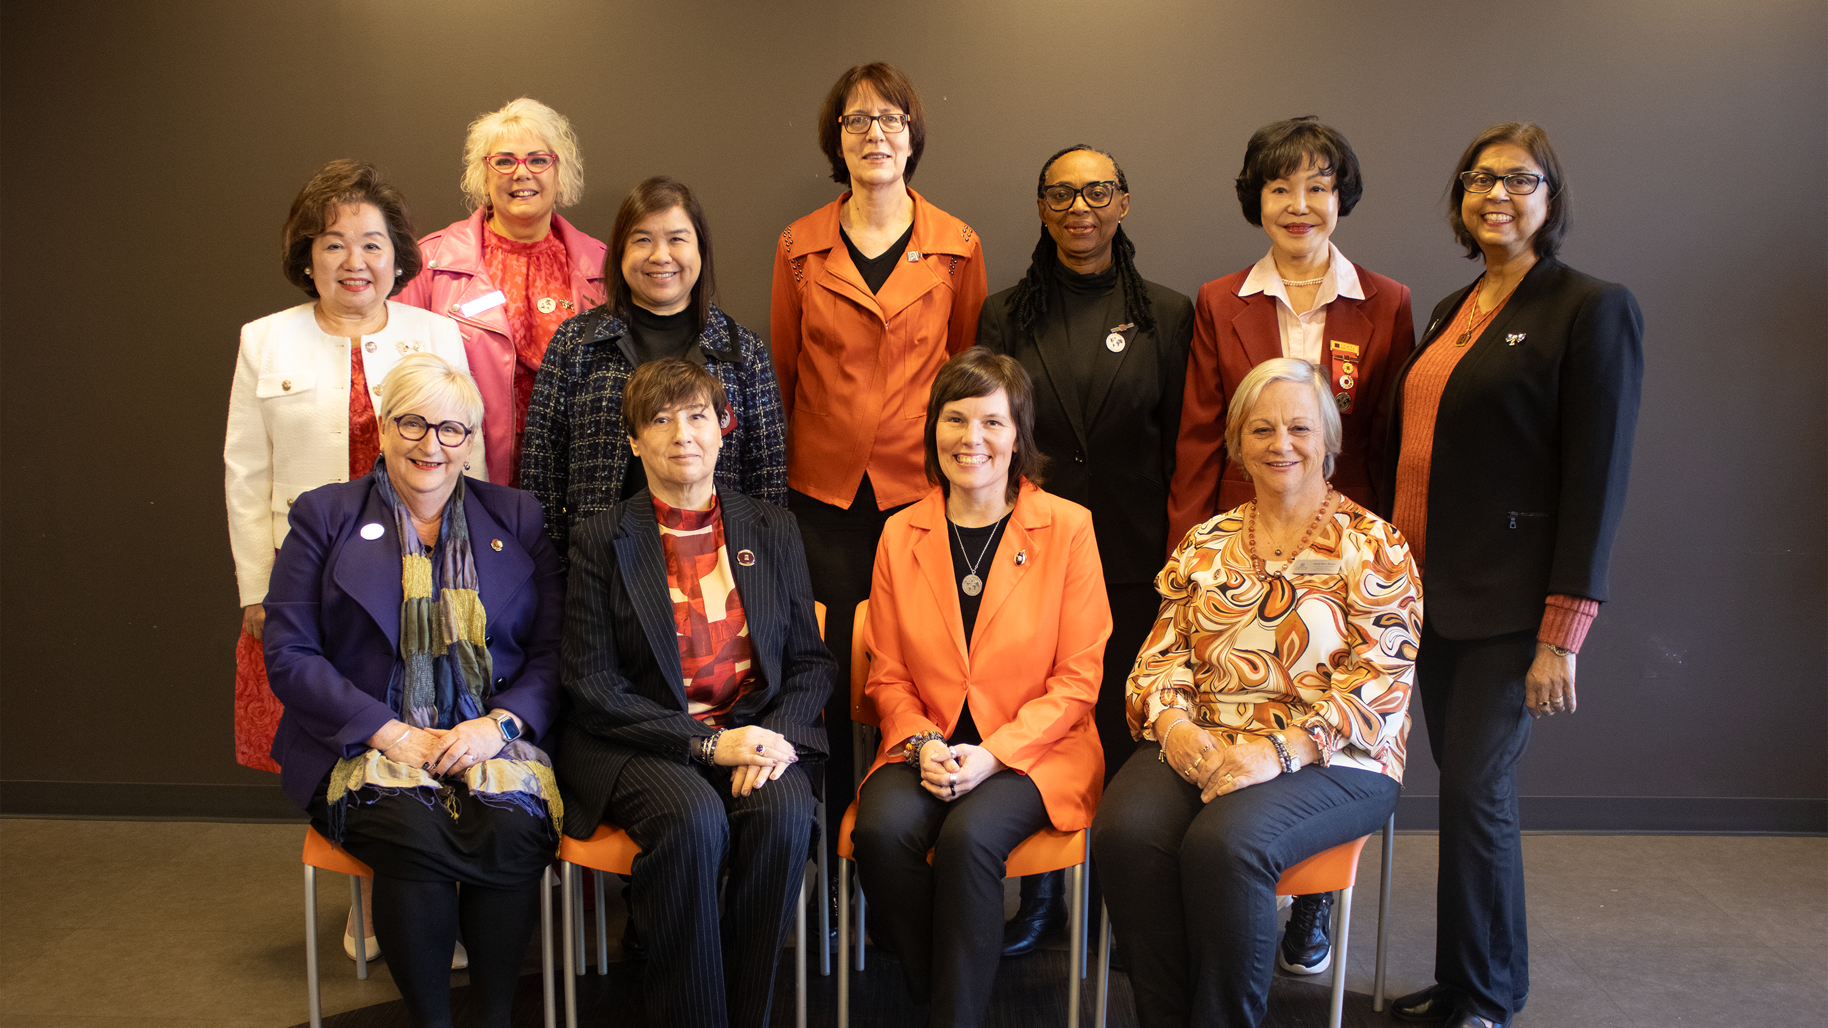
GREETINGS FROM YOUR 2024-2026 INTERNATIONAL BOARD!

Slide 3
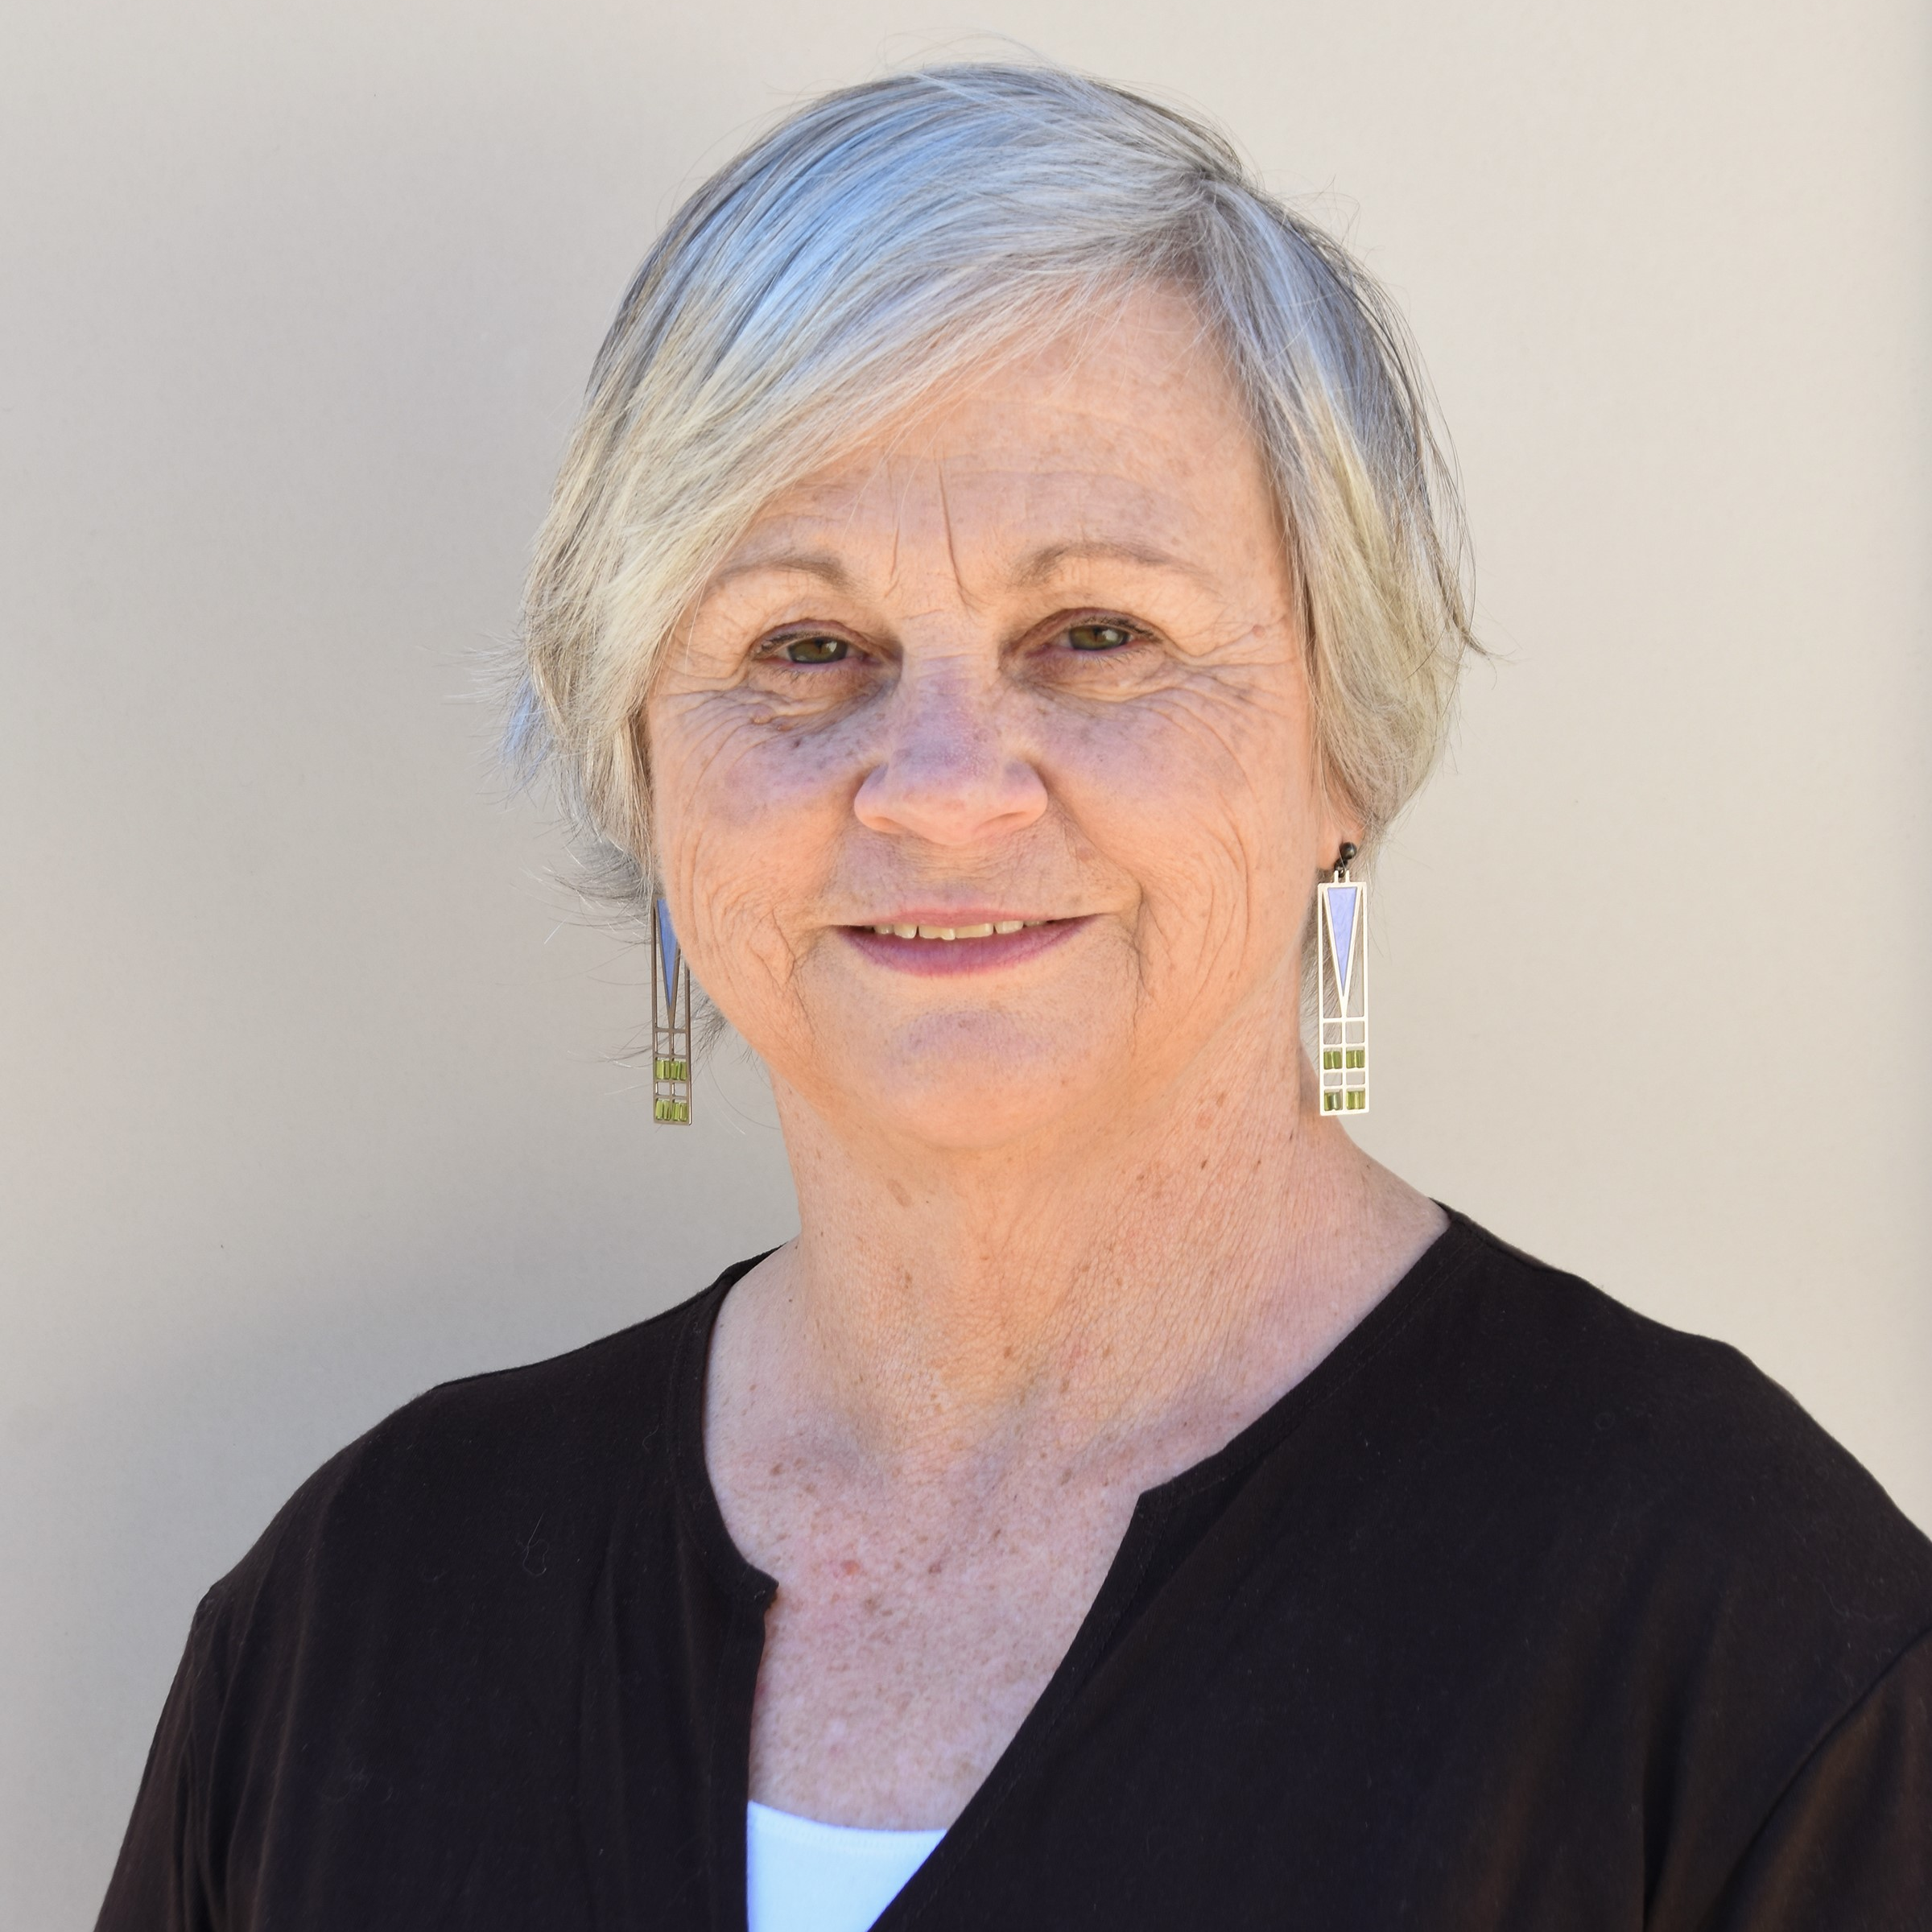
Board Member Introduction
SANDY VENN-BROWN
Vice President
Zonta Stanthorpe Inc, Australia
District 22

Slide 4
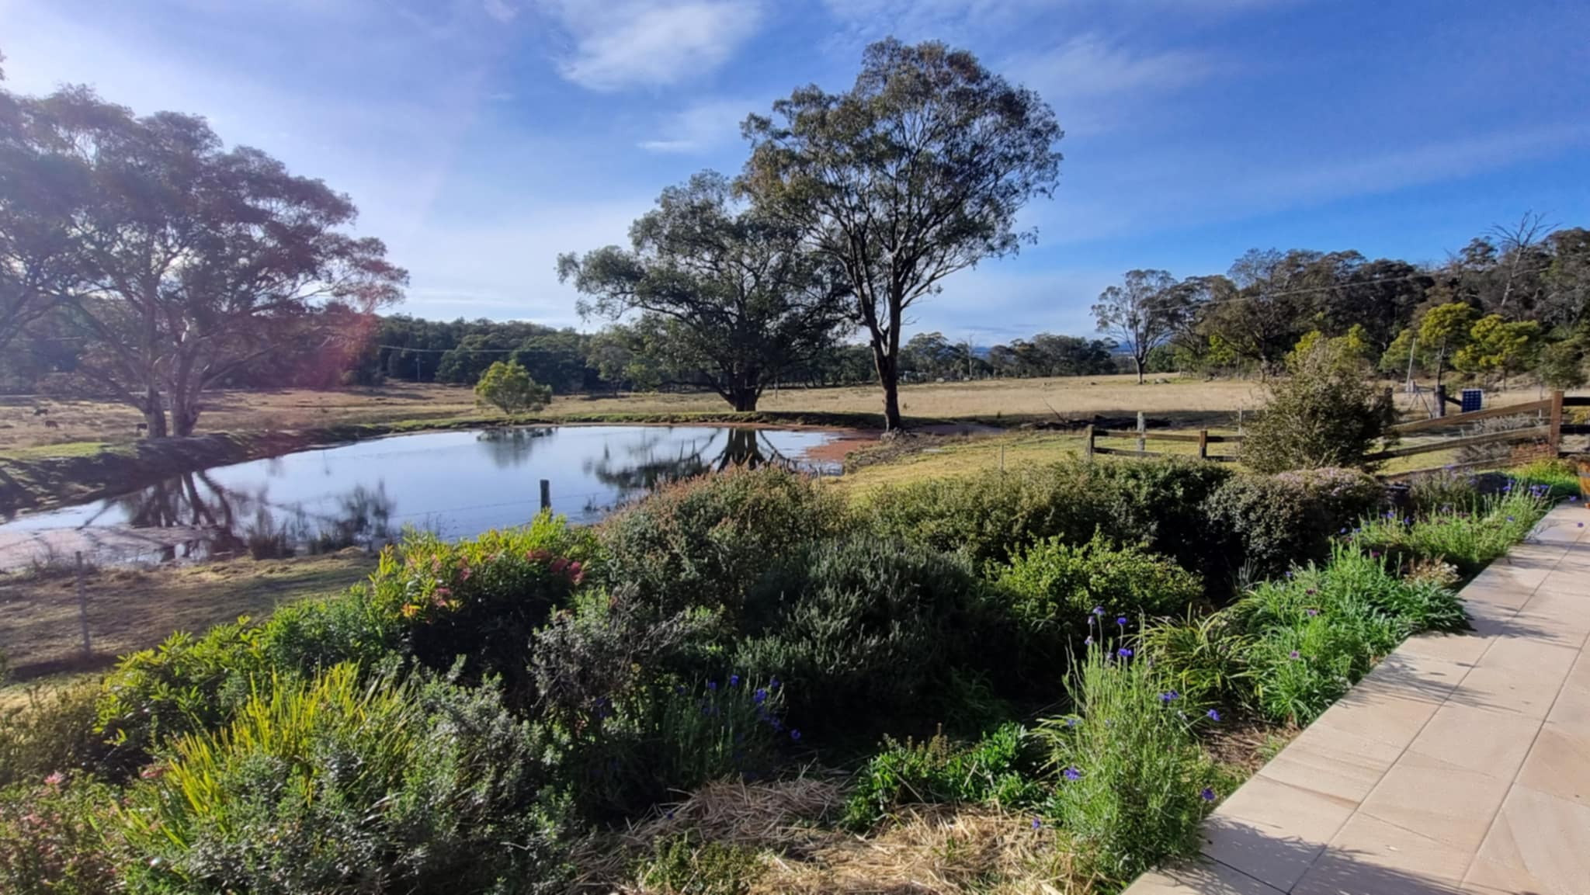
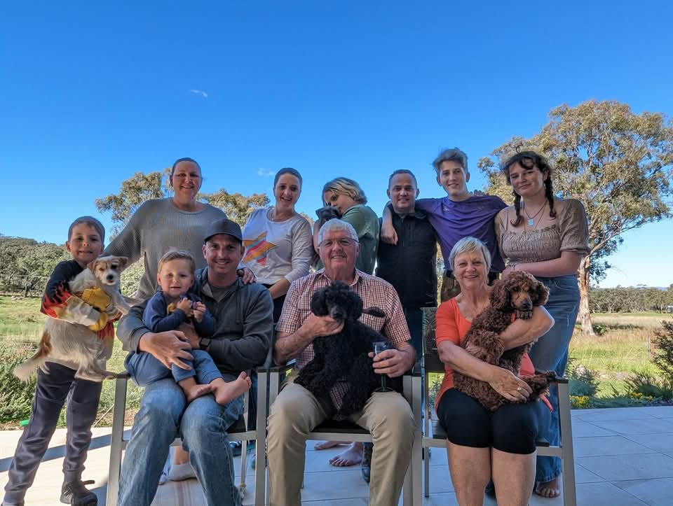
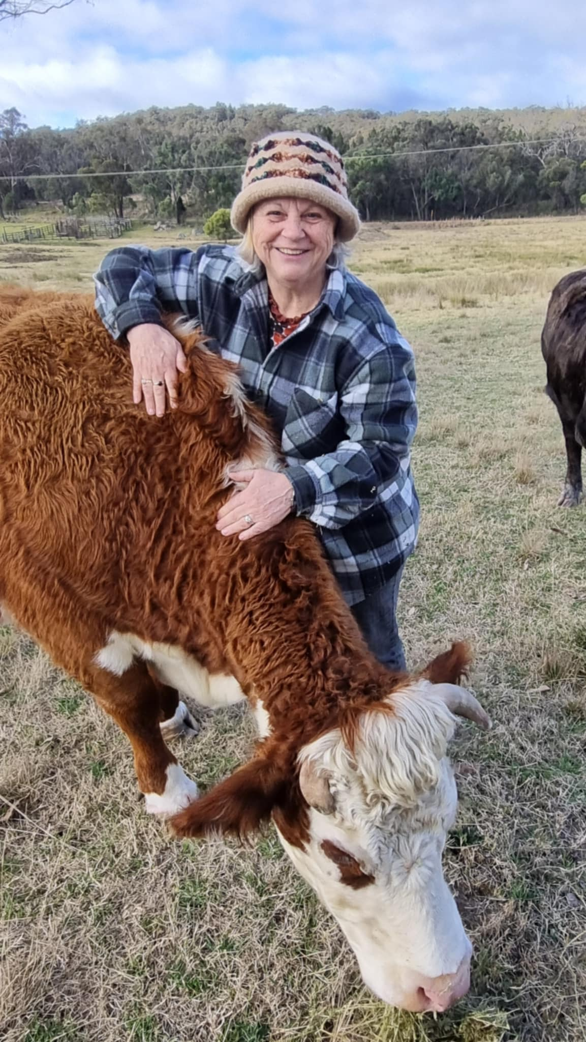


Slide 5
Zonta International Convention
Zonta International President
International Board
Zonta Foundation for Women President
Foundation Board
International Headquarters
International Committees
Districts __________________ Governor
District Boards
District Committees
District Foundation Ambassadors
District Foundation Ambassadors
Areas ______________ Area Directors
Clubs _____________ Club Presidents
Club Board
Club Committees
Club Members

Slide 6
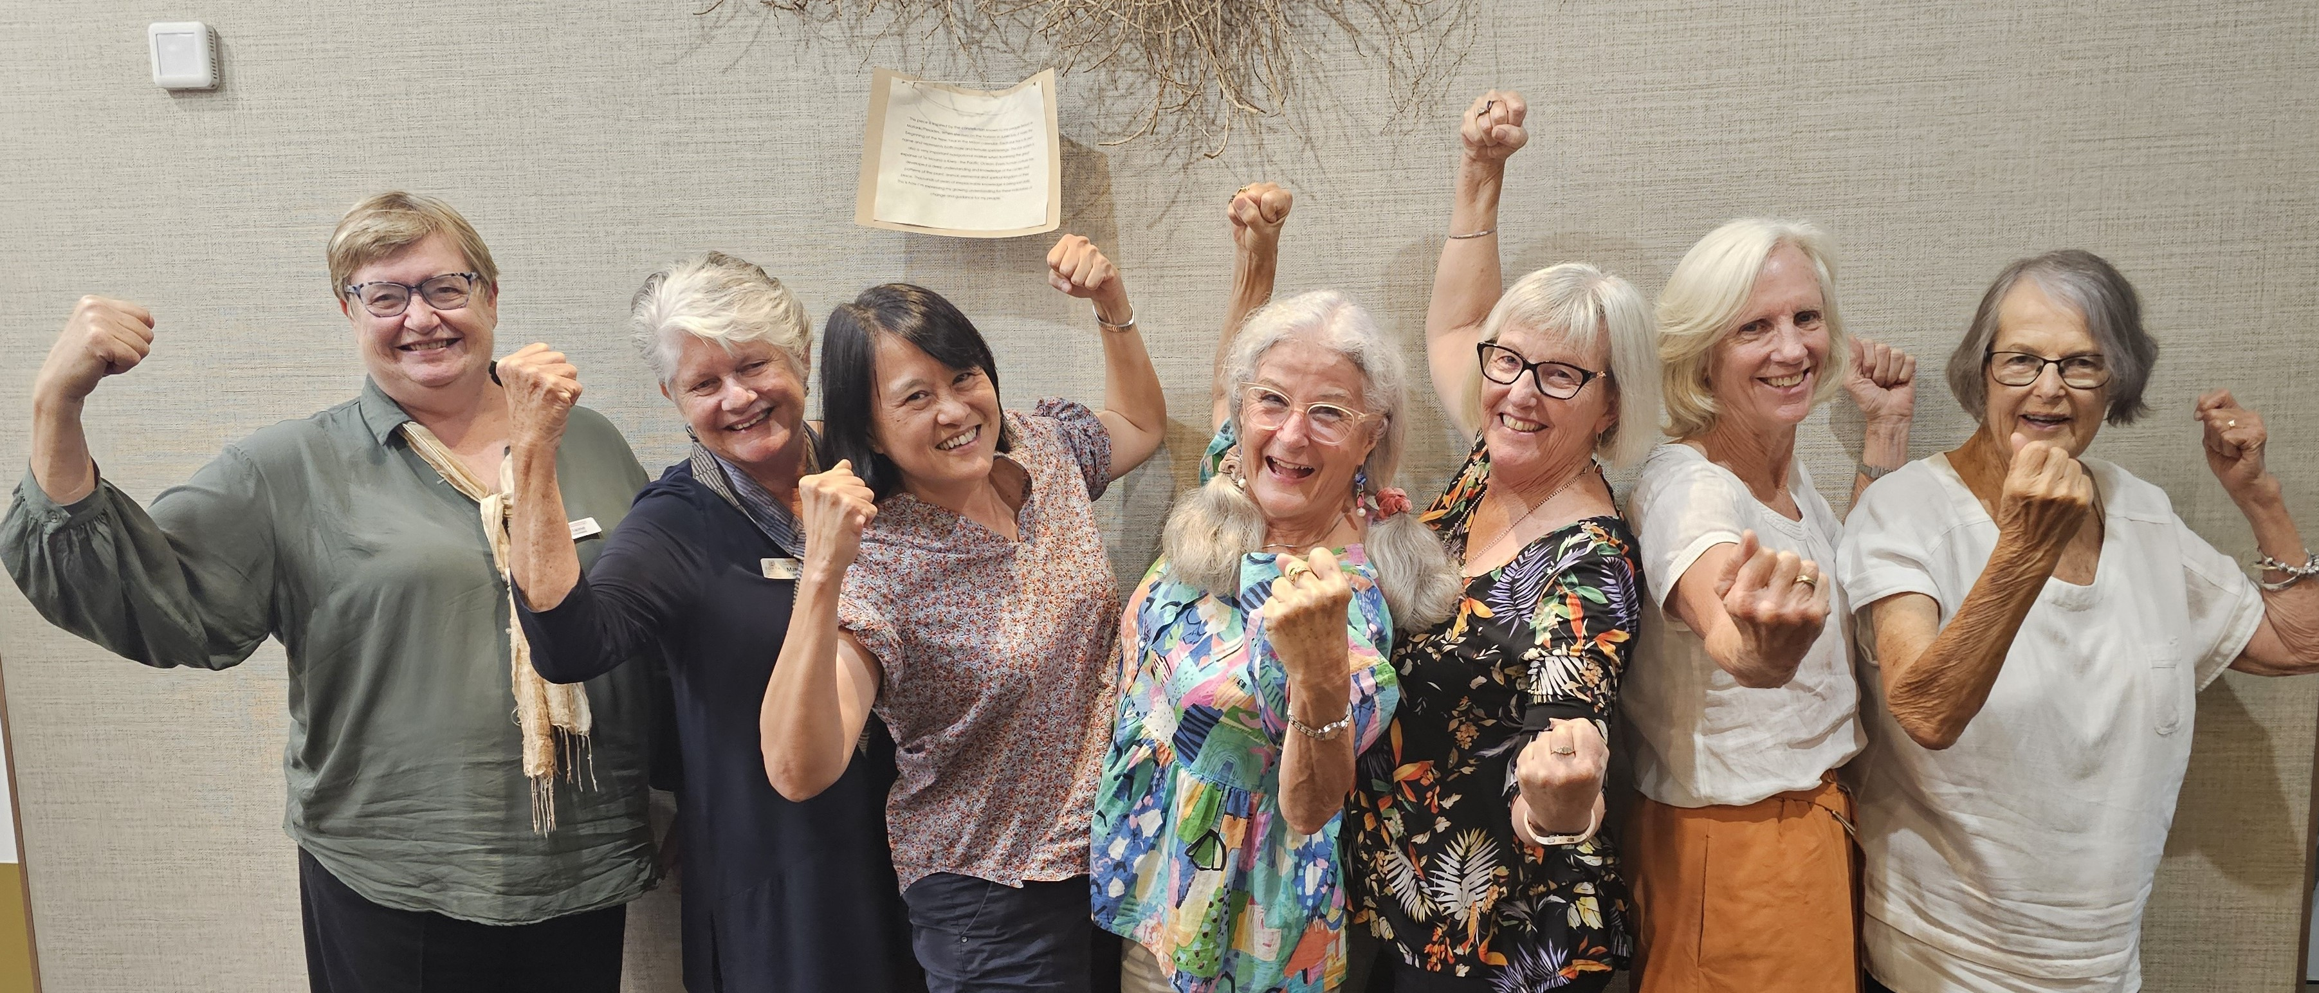
Global Challenges
Rollback of women’s rights
Governments decreasing funds for foreign aid
Global conflict
Climate crises
Zonta Spirit, Sustainability and Speaking up for Human Rights

Slide 7



Recent Zonta International Statements
Zonta International partnerships more important than ever.
March 2025
Zonta International calls for reaffirmed commitment to the SDGs.
March 2025
Zonta International remains steadfast in mission to build a better world for women and girls.
February 2025

Slide 8
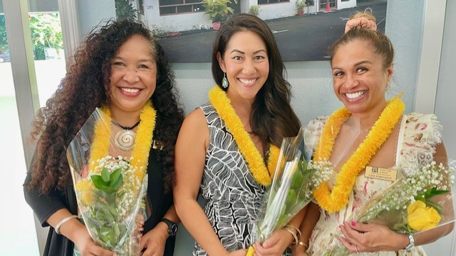
BIENNIAL GOALS: CELEBRATING SUCCESSES!

Slide 9

Goal 1
Credible and Visible Voice
Zonta acts as a credible and visible voice on gender equity, driving change for gender equality.
Zonta Spirit, Sustainability and Speaking up for Human Rights

Slide 10
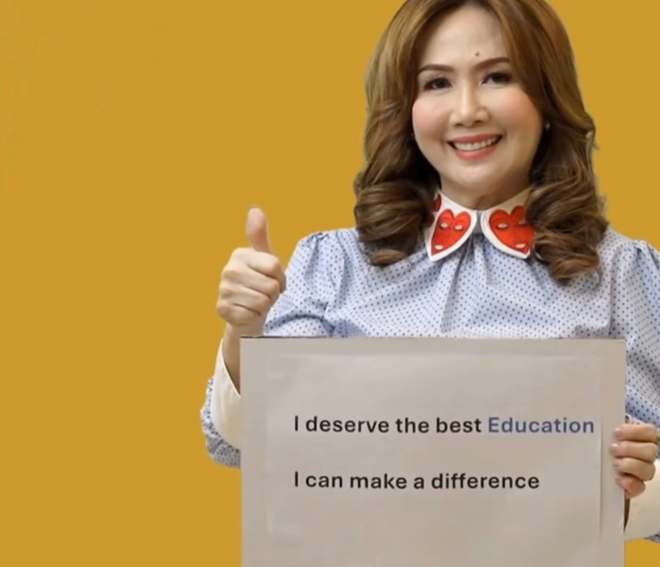


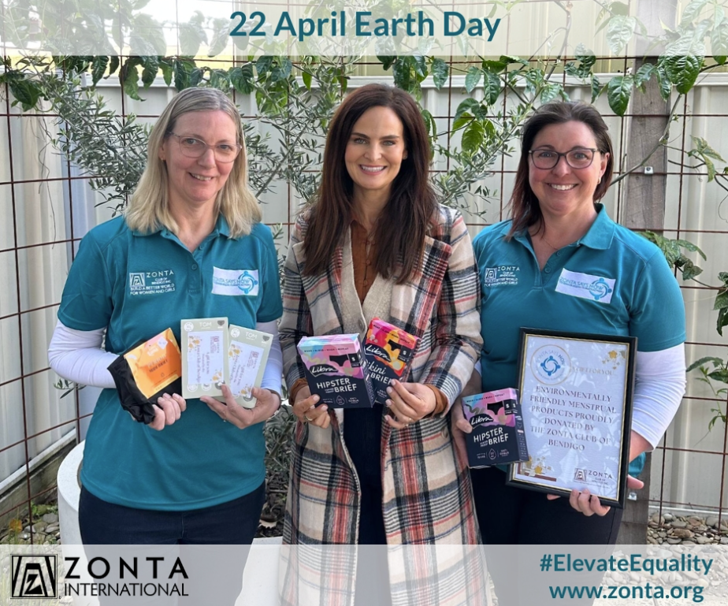
SHARED MOMENTS FOR ZONTA ACTION
11 OCT
25 NOV 10 DEC
8 MAR
22 APRIL
In honor of International Day of the Girl
Flip the narrative and send a message of hope
International Day of the Girl
International Women’s Day
Earth Day
Zonta Says NO to Violence Against Women 16 Days of Activism Campaign
Zonta Spirit, Sustainability and Speaking up for Human Rights

Slide 11
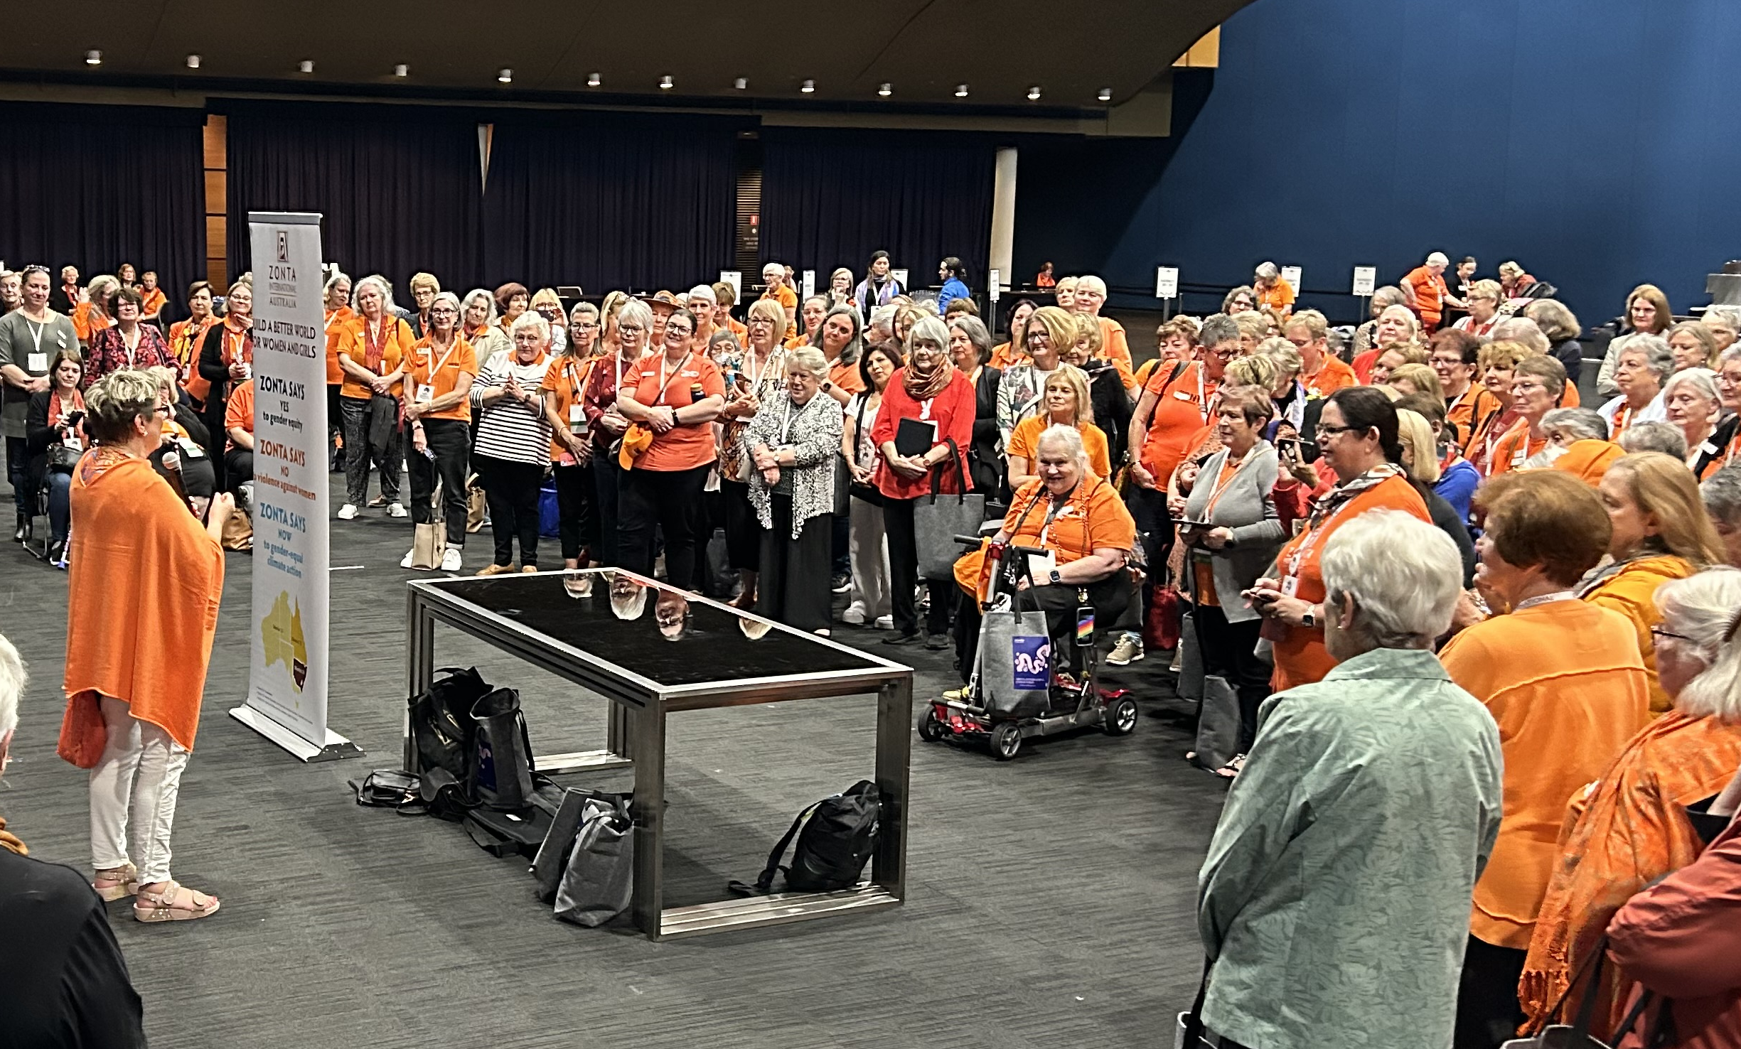


WHAT WE HAVE ACHIEVED
First new country-level advocacy group established in Australia
Quarterly virtual advocacy series
Launch of internal advocacy training program
Zonta Spirit, Sustainability and Speaking up for Human Rights

Slide 12

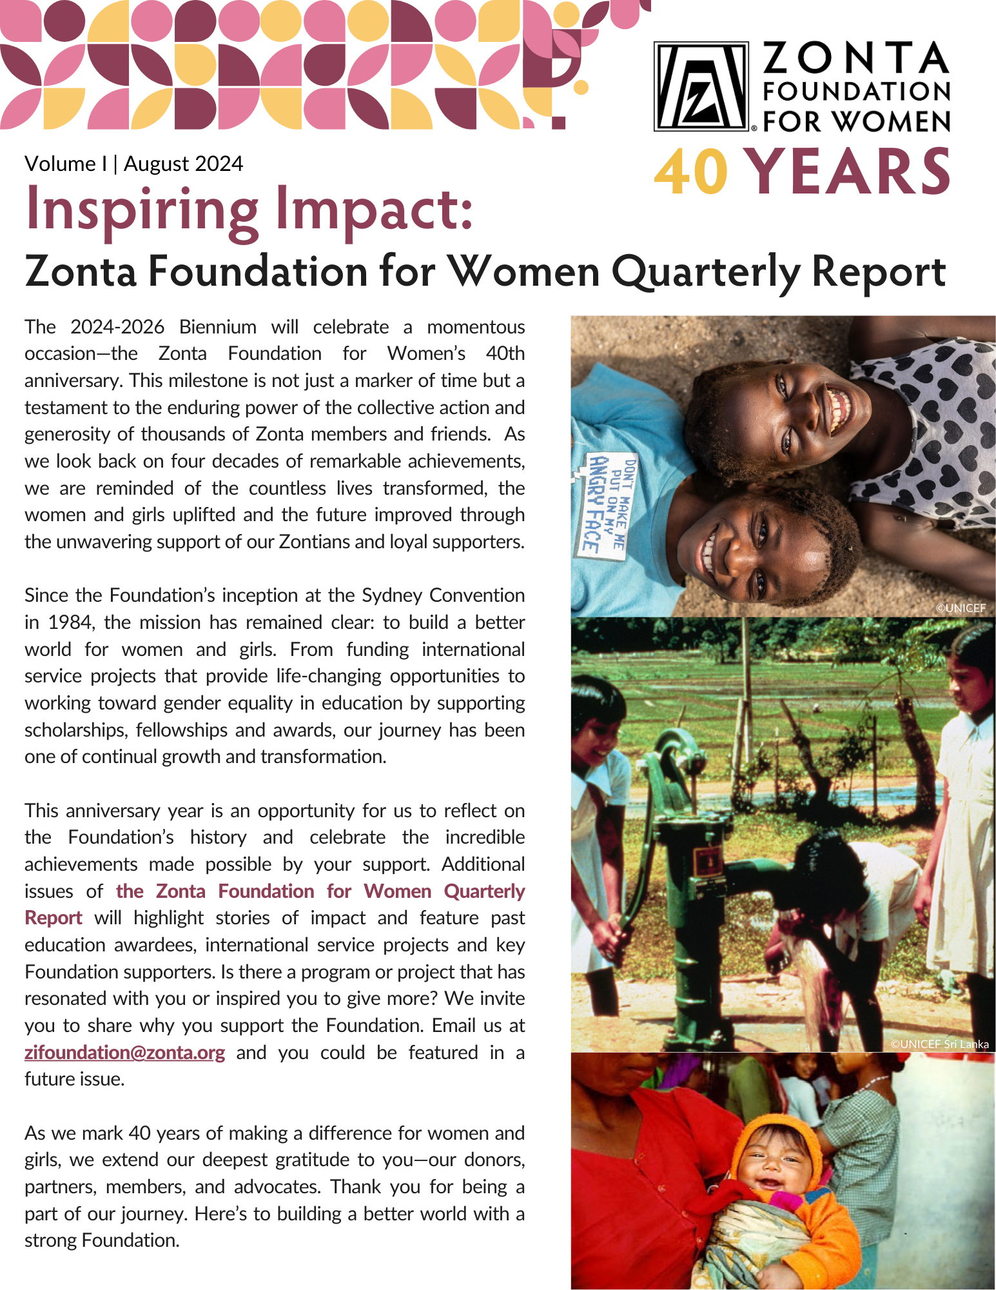
WHAT WE HAVE ACHIEVED
Remarkable Women, Powerful Stories
Inspiring Impact Zonta Foundation for Women Quarterly Report
Zonta Spirit, Sustainability and Speaking up for Human Rights

Slide 13
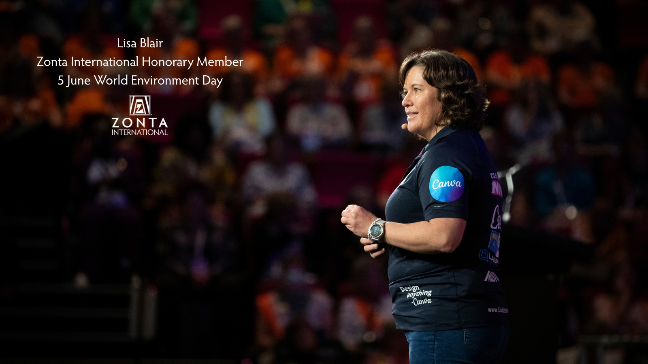
IHM Announcement
Lisa Blair [Insert photo]
“I am incredibly honoured to be awarded an honorary membership to Zonta International, they are taking strong climate action for women and girls, and I am proud to work with them so that together we can amplify the need for sustainability and protection of our planet.”
“I am incredibly honoured to be awarded an honorary membership to Zonta International, they are taking strong climate action for women and girls, and I am proud to work with them so that together we can amplify the need for sustainability and protection of our planet.”
Lisa Blair at the 2024 Brisbane Convention

Slide 14
Goal 2
Club Successes
By focusing on club success, Zonta maintains a strong membership base to support the work we do to build a better world for women and girls.
Zonta Spirit, Sustainability and Speaking up for Human Rights

Slide 15

Core Values and Code of Conduct
Global Community
Friendship
Equality & Inclusion
Respect
Integrity
Our Core Values Statement provides us with the fundamental or guiding principles that are the foundation for our membership. It represents our beliefs and frames how we behave toward each other, our supporters, friends and communities. This statement was developed through feedback from members from across the Zonta world.

Slide 16

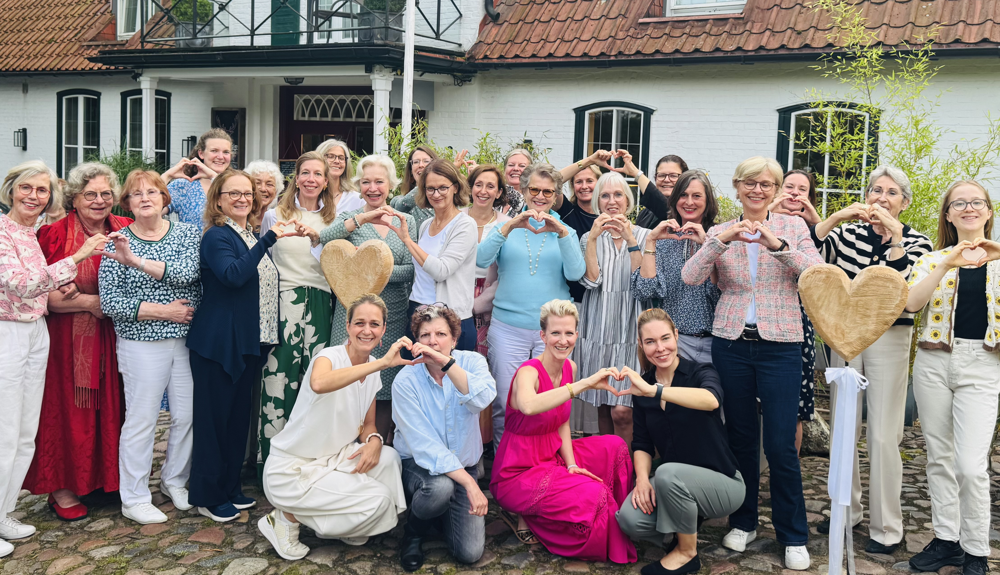

WHAT WE HAVE ACHIEVED
Chartered 18 new clubs this biennium
Membership strategy in progress
Twinning program launched
Zonta Spirit, Sustainability and Speaking up for Human Rights

Slide 17


WHAT WE HAVE ACHIEVED
First virtual Share Your Story Festival
Zonta Community Give Back Grant Feasibility Study completed
Zonta Spirit, Sustainability and Speaking up for Human Rights

Slide 18
Goal 3
Leadership and Sustainability
Zonta manages its resources, including both time and money, to meet Zonta’s vision and ensure Zonta’s long-term viability and success.
Zonta Spirit, Sustainability and Speaking up for Human Rights

Slide 19
WHAT WE HAVE ACHIEVED
Governance review work ongoing.
Environmental, Sustainability and Governance (ESG) review work has started.

Slide 20
Governance working group
Objective: Identify options to streamline and modernize Zonta’s governance structure.
Key Focus Areas
Voting
District role and composition
Board composition
Board operations
Convention / District Conferences
Approach
Examine existing governance arrangements.
Identify areas where change is required.
Propose/evaluate options.
Recommend a preferred option.
Develop roadmap to transition to future governance arrangements.
Supported by:
Three Workstreams
Governance Advisory Team
Those involved to date:
Board members
Past International President
Past International Directors
Past District Governors
Past Committee Chairs
Headquarters team

Slide 21
Progress to date – on track
Governance Blueprint for the Future
Examine existing governance arrangements. COMPLETE
Identify areas where change is required. COMPLETE
Propose options. COMPLETE
Evaluate options. IN PROGRESS
Recommend a preferred option. Q1 2026
Develop a roadmap to transition to future governance arrangements. Q1 2026
Oct 2025 – Feb 2026
Communication
Discussion papers
Communication
Information sessions
July 2026
CONVENTION
Workshops
Business sessions
Feb 2026 – June 2026
Oct 2025 – Feb 2026
Feb – June 2026
July 2026

Slide 22
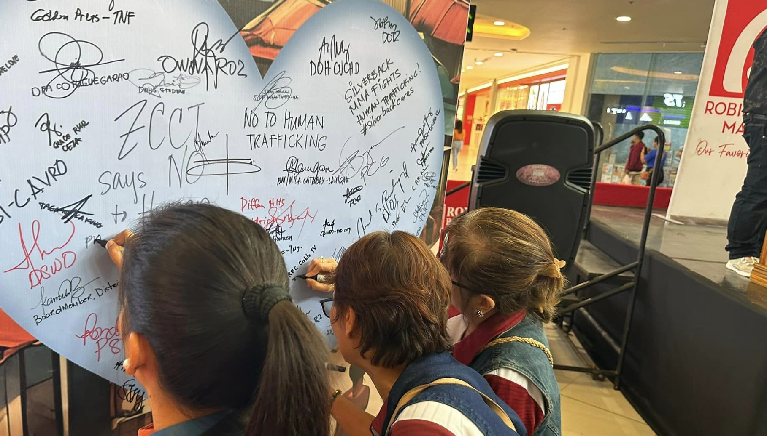
WHAT WE HAVE ACHIEVED
Implemented and monitored the strategic plan.
10-Year Forecast updated.
Alternative revenue working group for ZI.
Diversifying support for the Foundation.

Slide 23

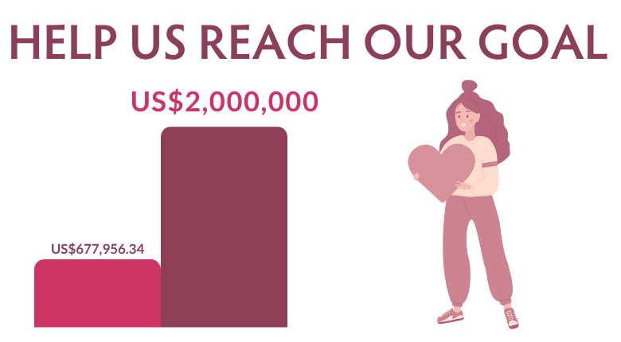
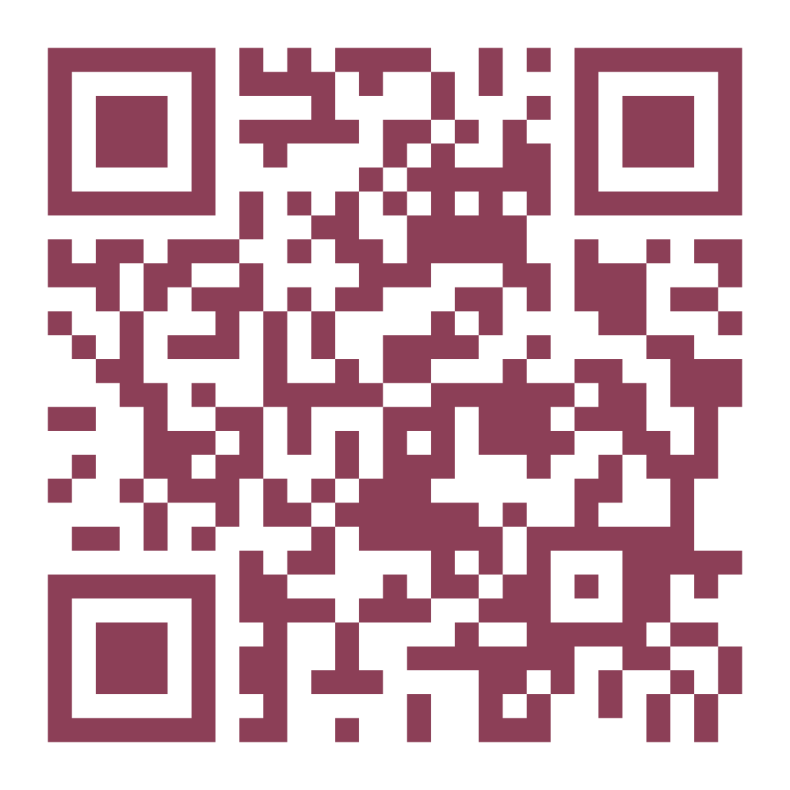
Campaign Update
www.zonta.org/Foundation40
*As of 1 August 2025

Slide 24

General Endowment Fund
We reached our US$10,000,000 goal this biennium!
Current Total: US$10,065,145!

Slide 25
Goal 4
Engagement of Audiences and Allies
In order to further Zonta’s mission and extend voice, Zonta develops collaborations with like-minded organizations.
Zonta Spirit, Sustainability and Speaking up for Human Rights

Slide 26
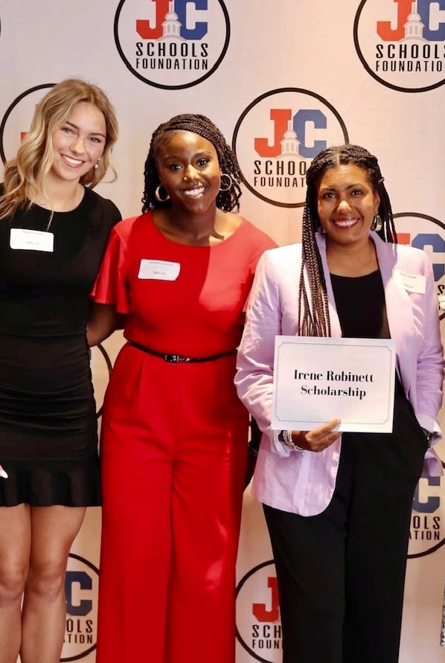
WHAT WE HAVE ACHIEVED
Greater focus on work at the Council of Europe and national-level advocacy
69th Session of the Commission on the Status of Women was a success!
Explored partnerships and sponsorships with organizations for Convention ‘26
Zonta Spirit, Sustainability and Speaking up for Human Rights

Slide 27
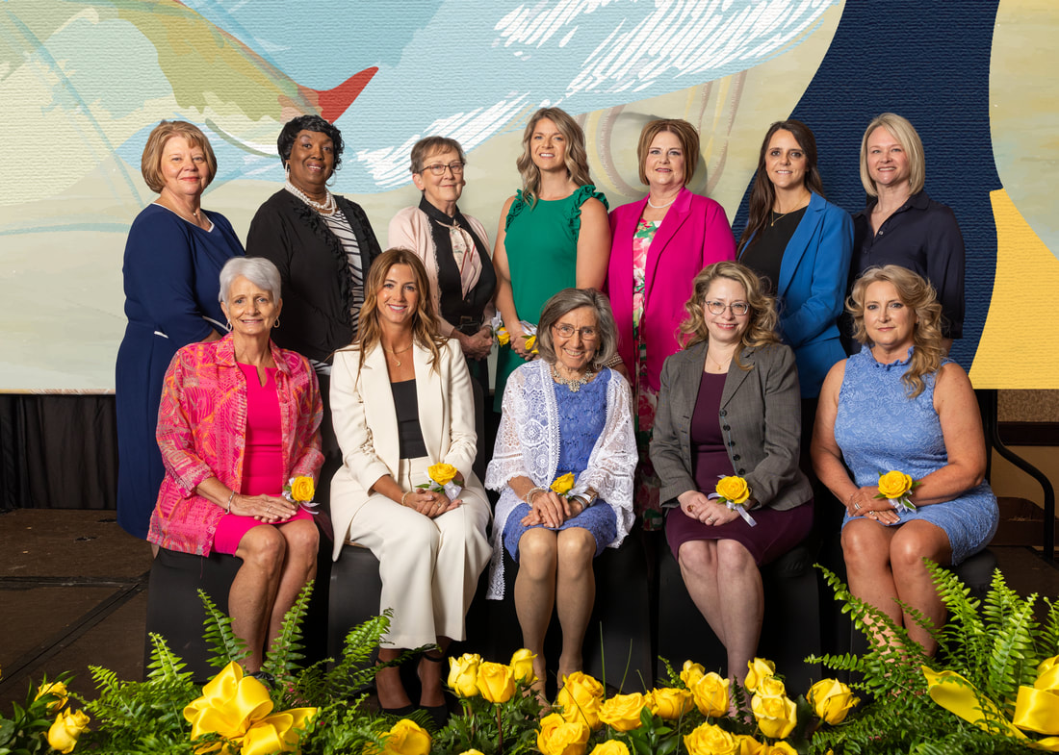
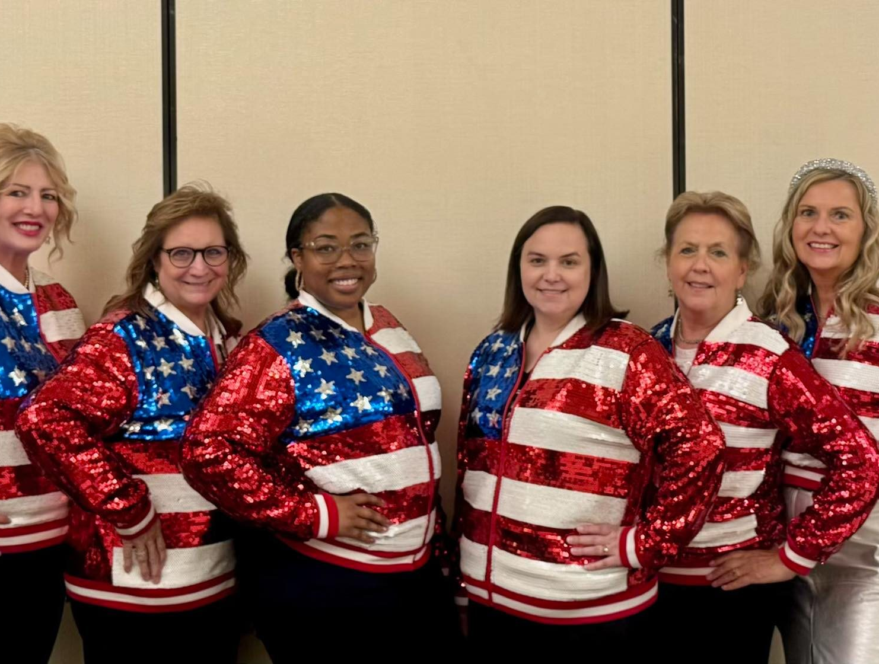
District 7 Biennial Achievements
$53,850.49* donated to ZI Foundation for Women this biennium!
Jefferson City and Cape Girardeau Zonta Club Women of Achievement Awards
Cape Girardeau presentation at NAIDM
In July the Governor of Missouri signed into law protections against child marriage
*to June 2025
Zonta Spirit, Sustainability and Speaking up for Human Rights

Slide 28

LOOKING
FORWARD

Slide 29
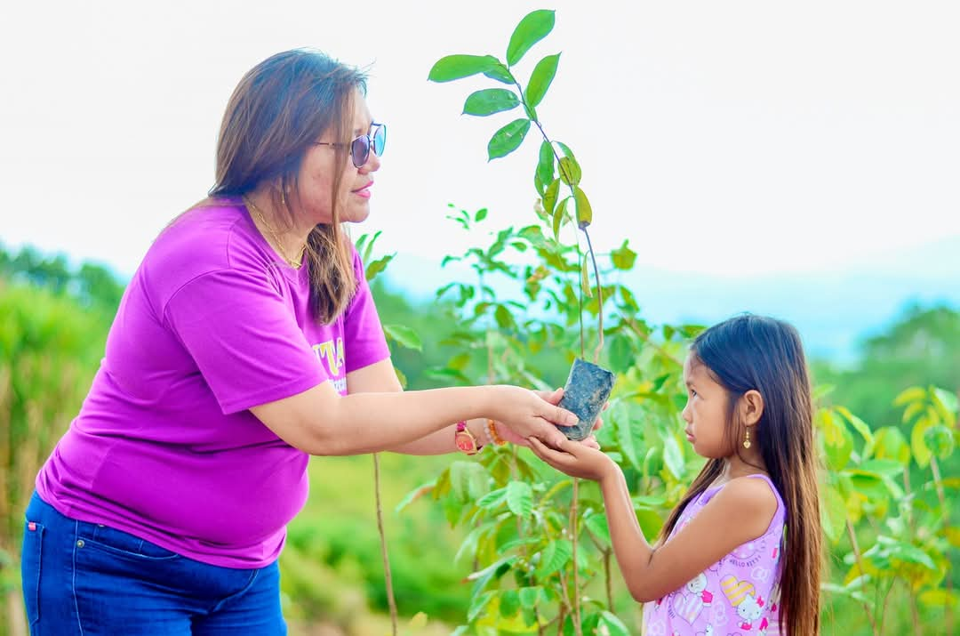
WHAT WE HAVE LEFT TO DO
Complete first cycle of two new awards.
Climate justice education and action.

Slide 30
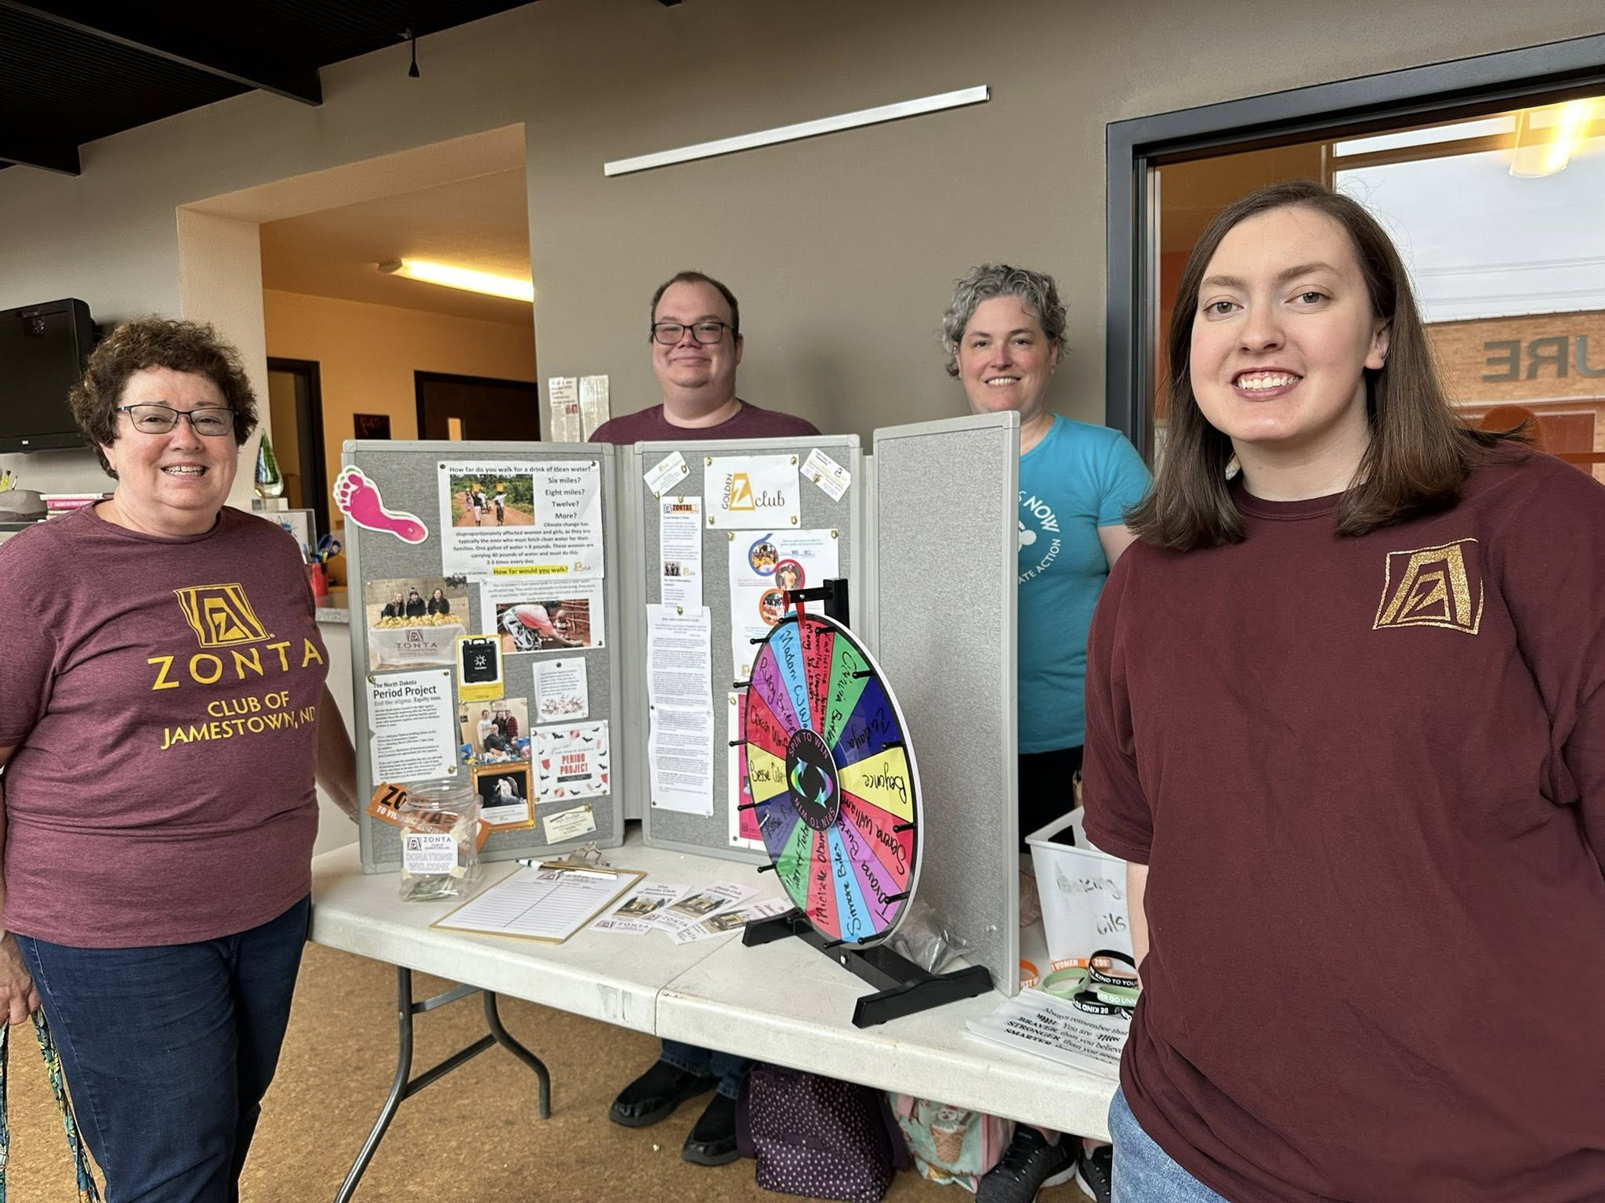
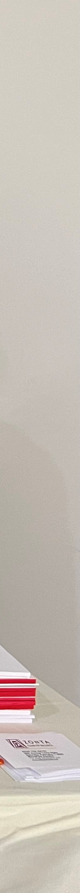
WHAT WE HAVE LEFT TO DO
Finalize membership strategy.
Assess clubs and ensure they are fit for the future.
Engage youth members – involve your student clubs.
Diversify membership by asking others to “Add Your Voice!”

Slide 31
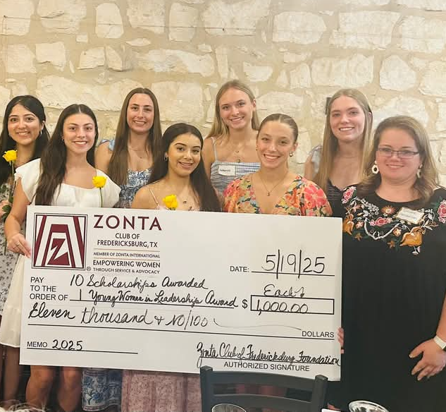
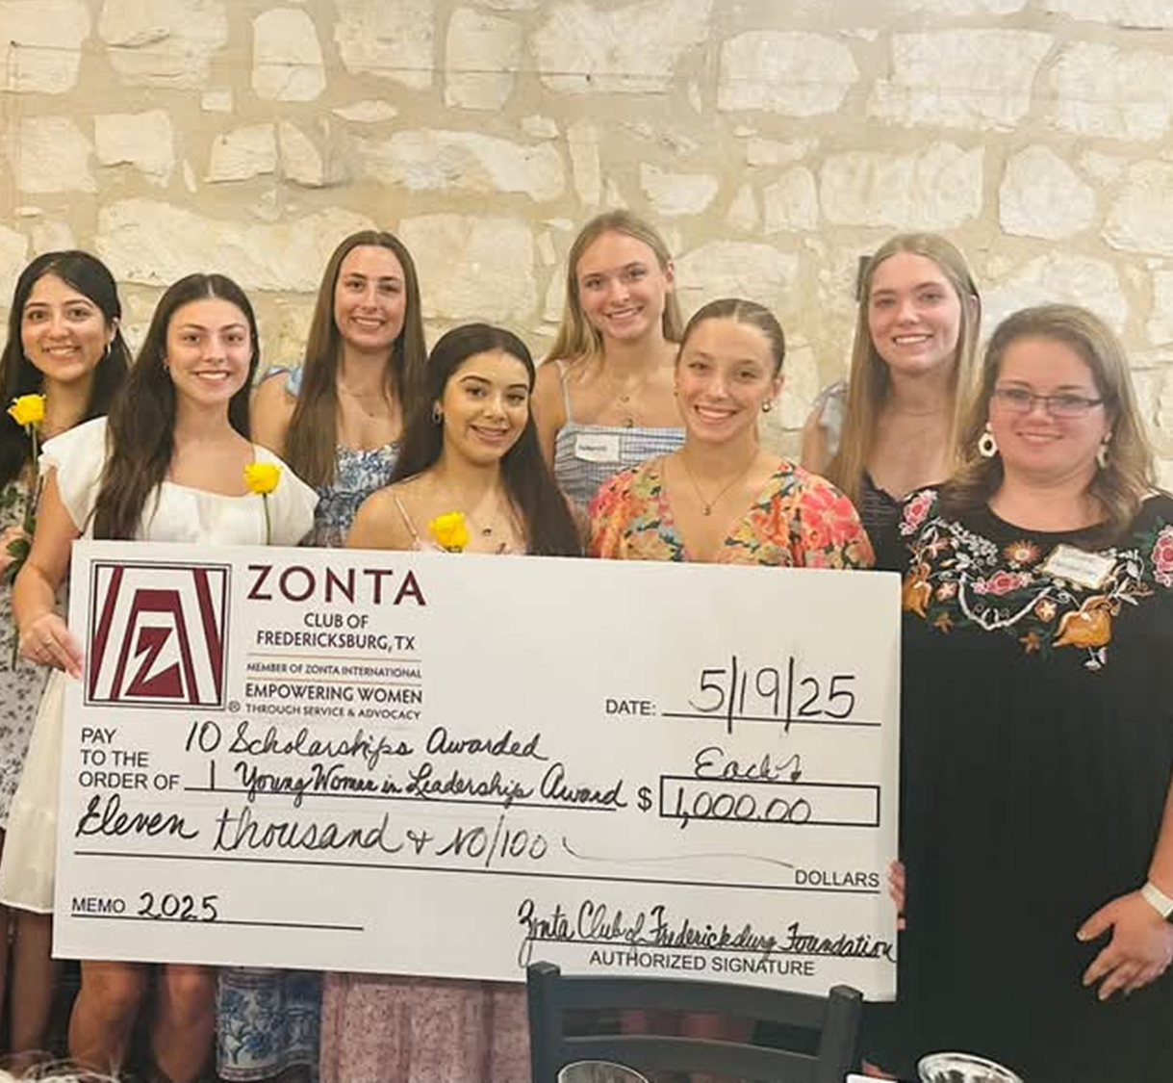
WHAT WE HAVE LEFT TO DO
Meet 40th anniversary and biennial fundraising goals.
Zonta 1919 Legacy Giving Circle.
Report to members on governance review.
Complete ESG review.

Slide 32
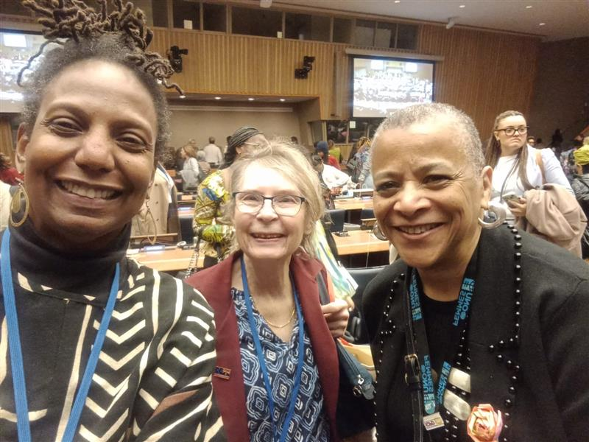
WHAT WE HAVE LEFT TO DO
Increase knowledge of Zonta’s work at the United Nations.
Announce global advocacy partnership.
Secure corporate sponsorships.
Hong Kong

Slide 33

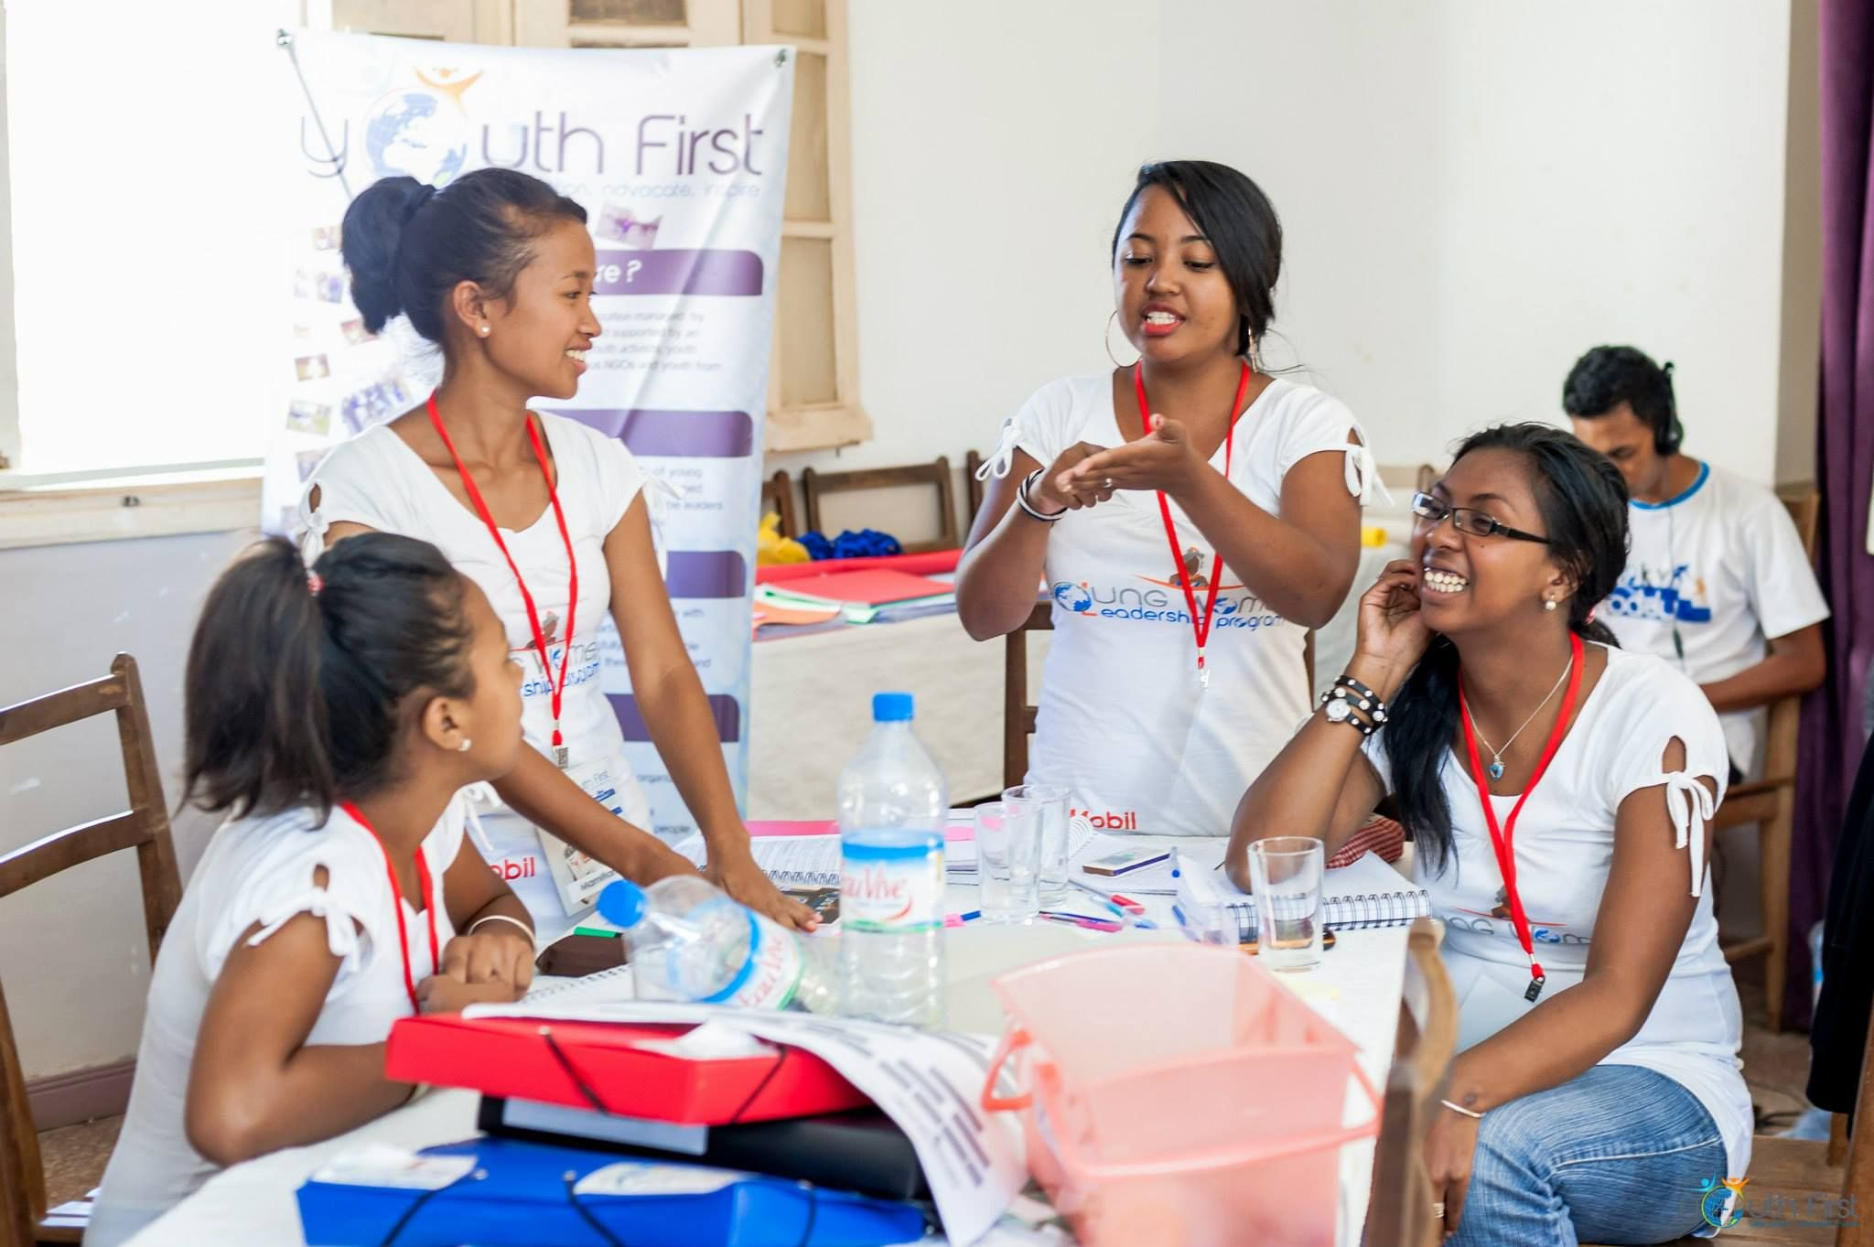
International Service Projects
©UNICEF-UNI490036-Panjwani
Ending Child Marriage: A Program to Accelerate Global Action Phase III
Zonta International Signature Project
Climate Empower: Empowerment and Innovation for Gender-Transformative Climate Action
Laaha: A Virtual Safe Space for Women and Girls

Slide 34

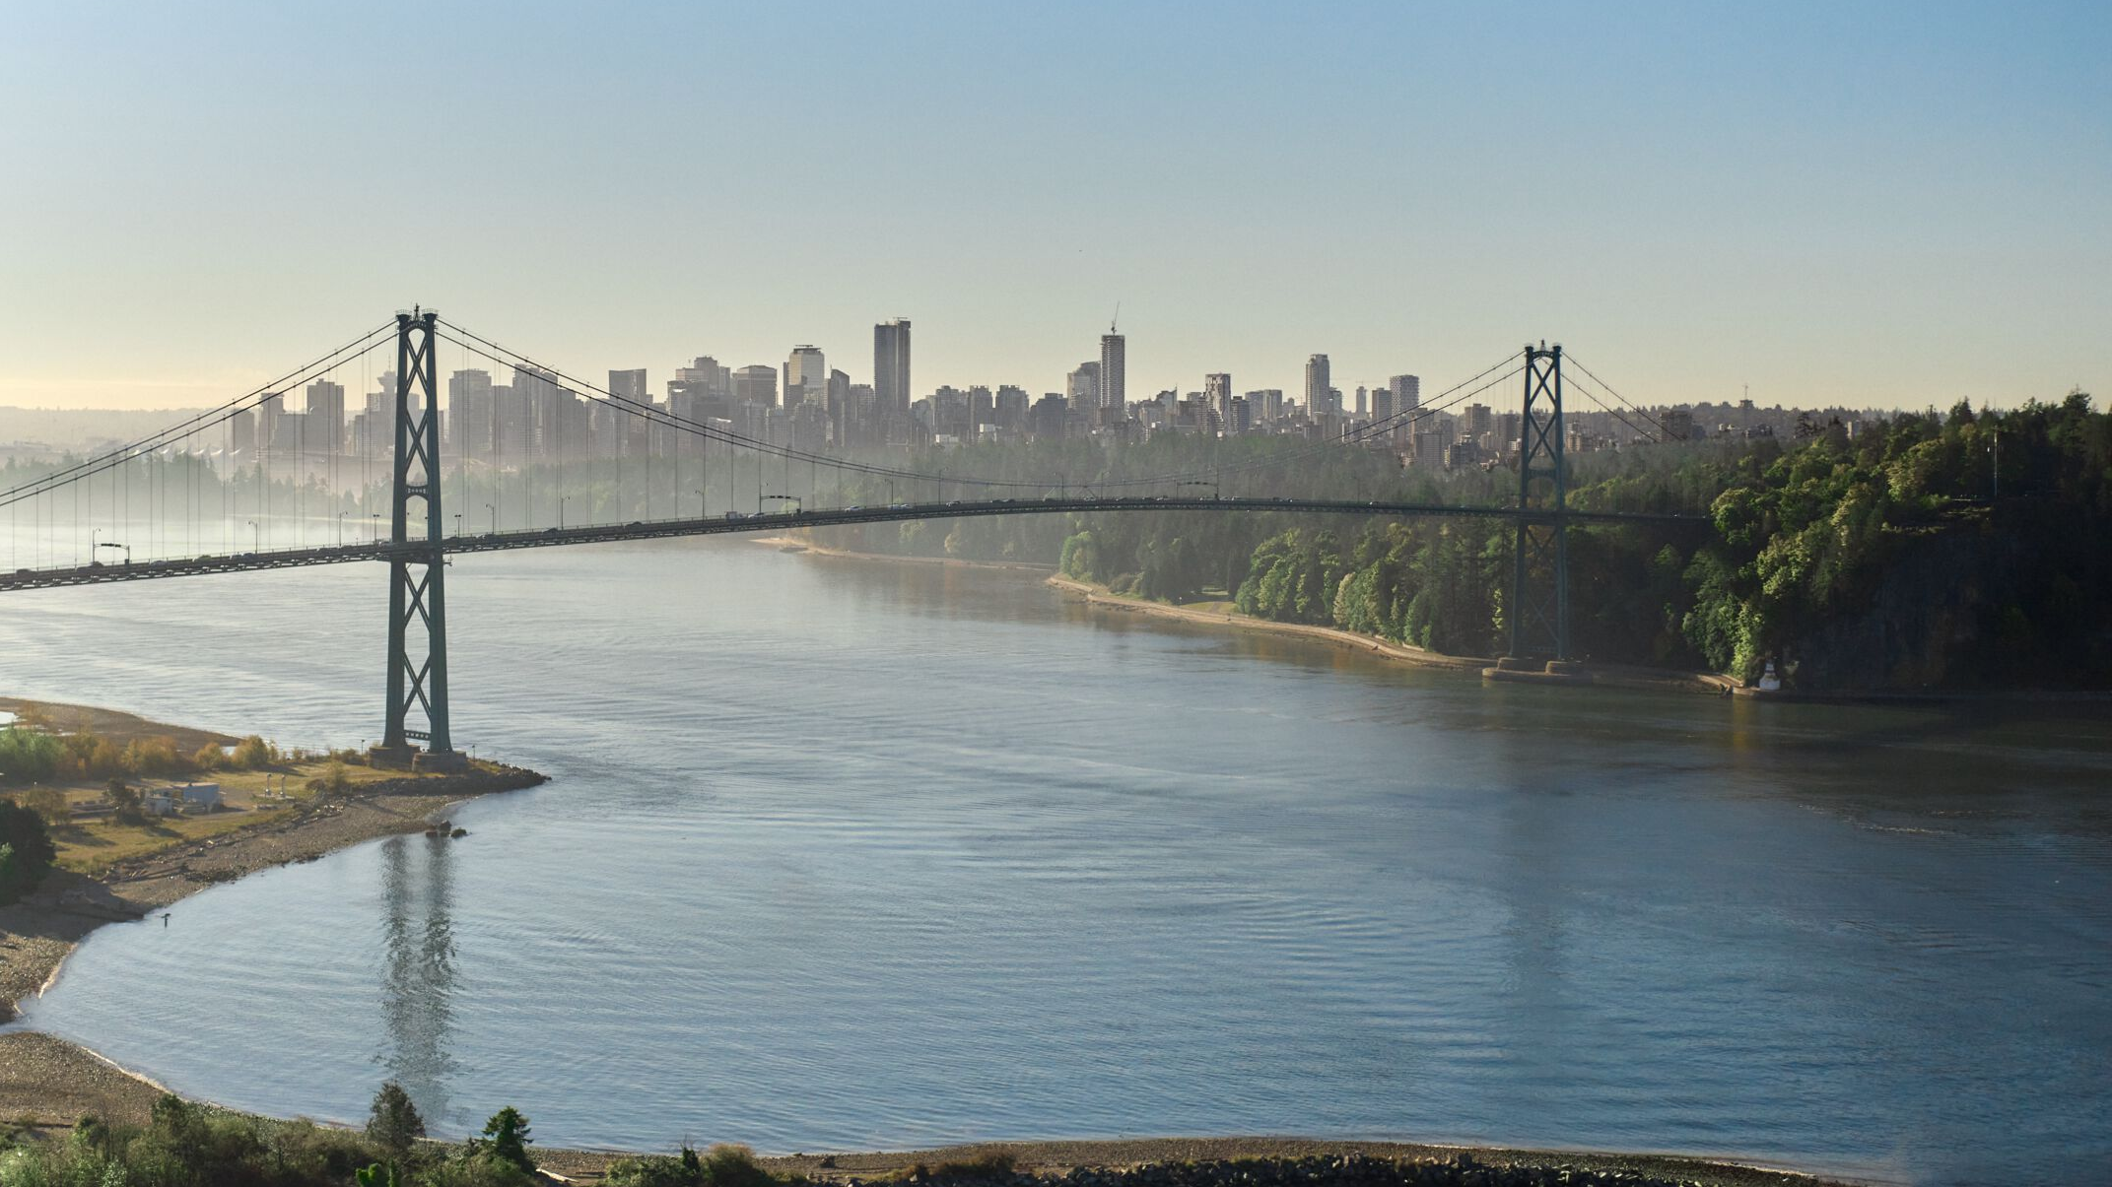
11-14 JULY 2026
#ZONTAVANCOUVER

Slide 35
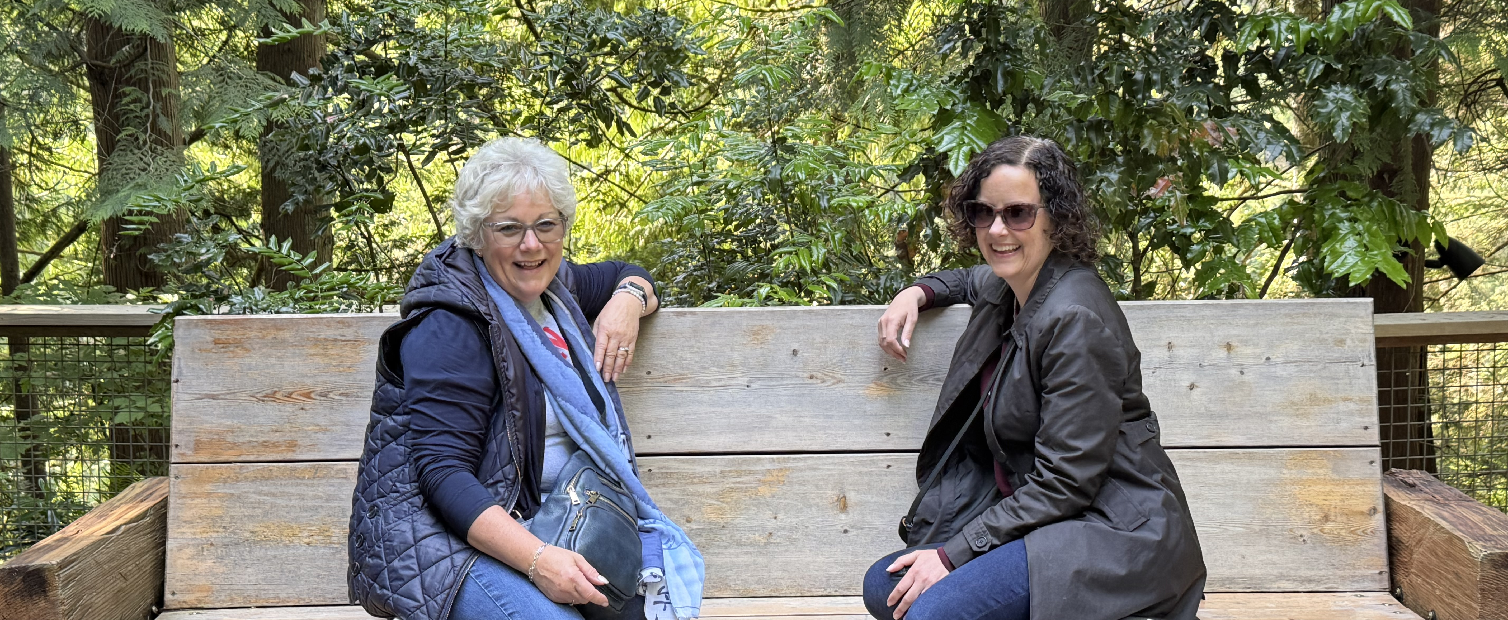
2026 Zonta International Convention
Celebrate successes.
Engage in important conversations about the future.
Have fun with purpose!
#ZONTAVANCOUVER
Zonta Spirit, Sustainability and Speaking up for Human Rights

Slide 36
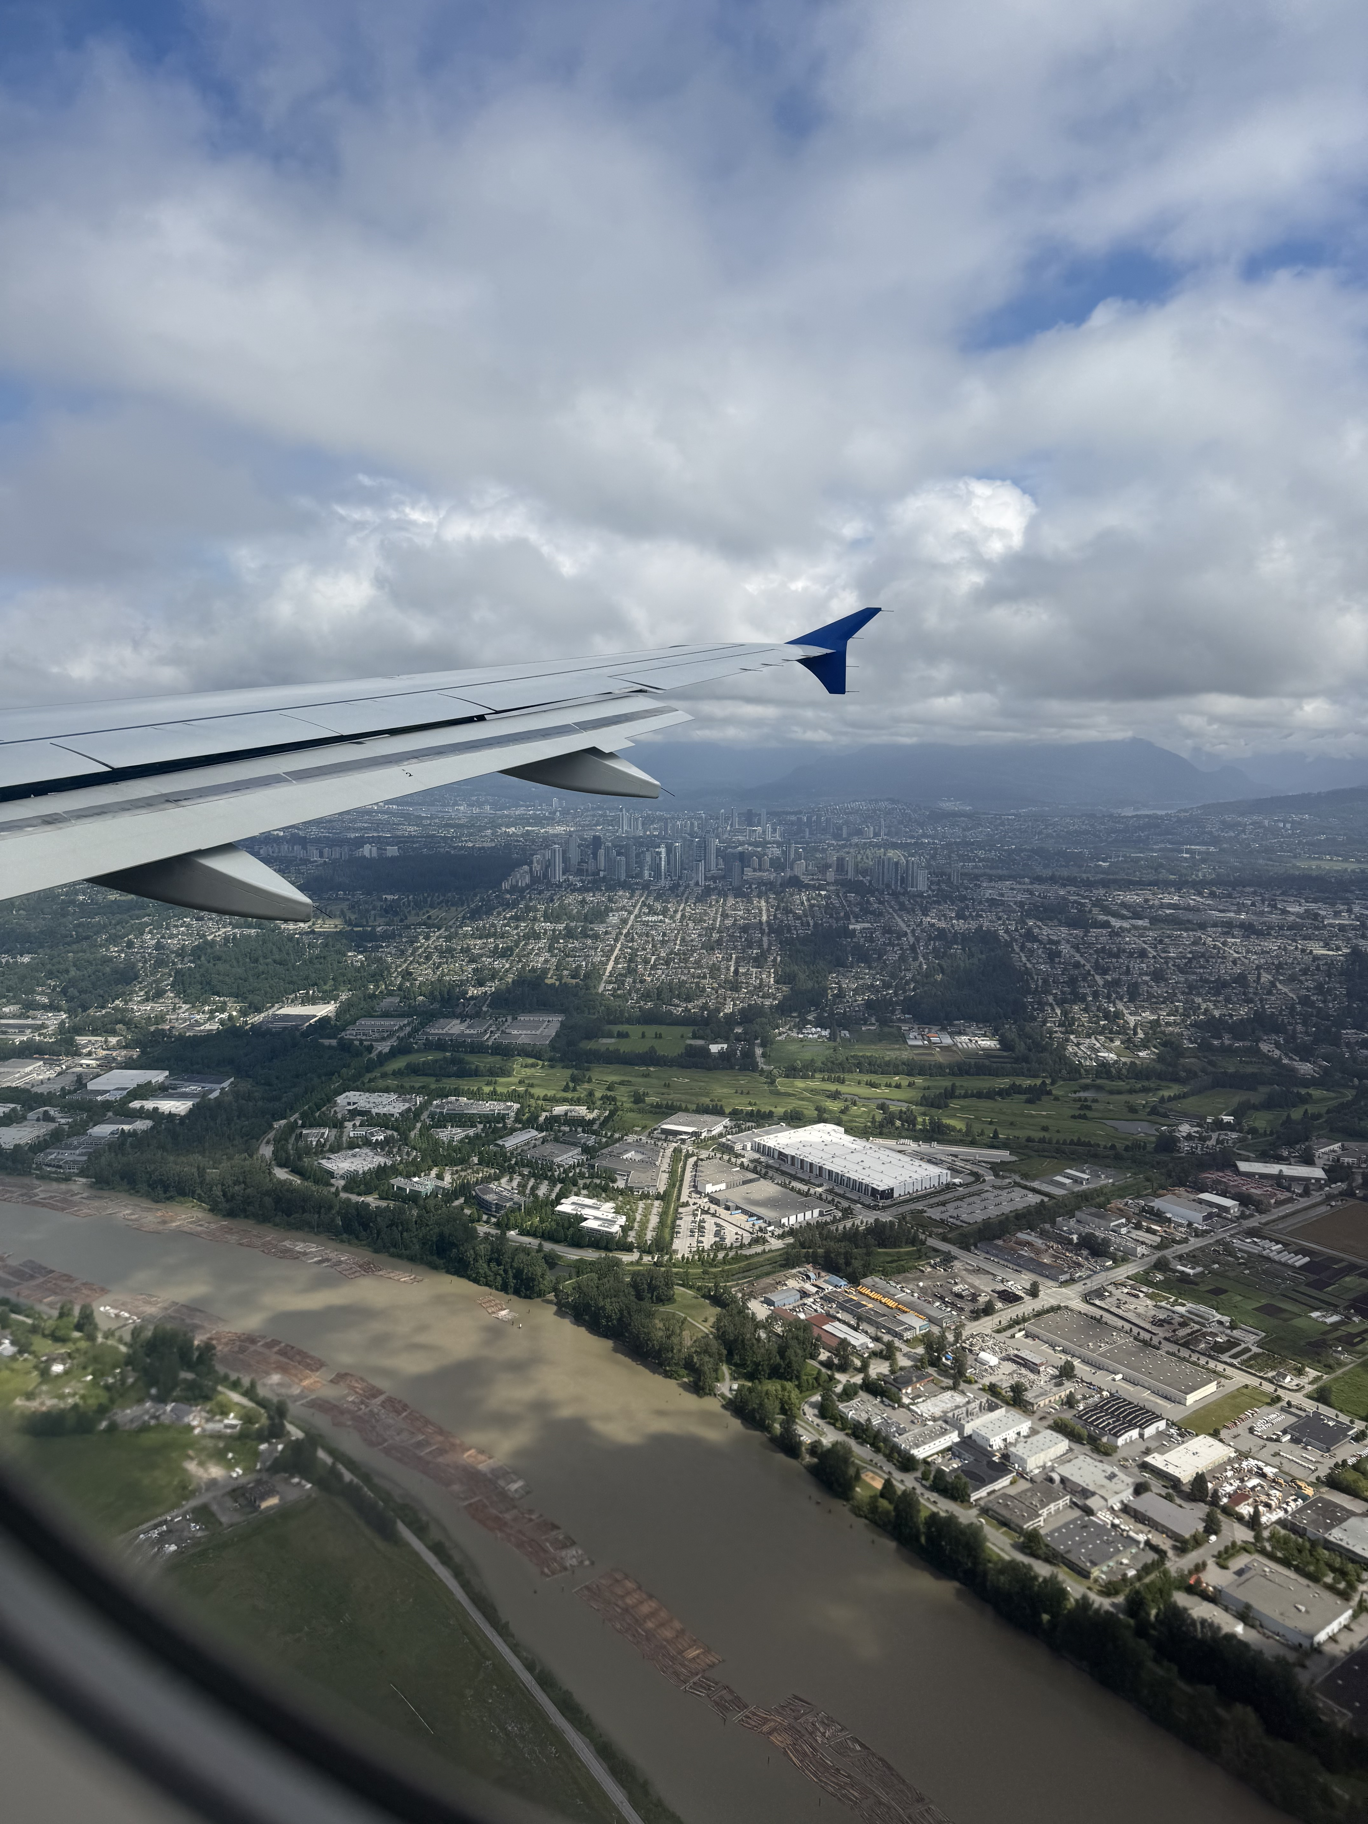

#ZONTAVANCOUVER
We are excited to welcome Air Canada as the Preferred Airline Partner for the 67th Zonta International Convention.
✈ ✈ ✈ ✈ Take advantage of Air Canada discount offer and book your flights today!
Zonta Spirit, Sustainability and Speaking up for Human Rights

Slide 37


Slide 38

Questions?

